Slide 1



Aboriginal Worldviews and
Perspectives in the Classroom
Moving Forward
Professional Development
Workshop
Notes:
Copyright © 2015 Province of British Columbia. All rights reserved.
This material is owned by the Government of British Columbia, or reproduced with permission,
and protected by copyright law. It may not be reproduced or redistributed without the prior written
permission of the Province of British Columbia and/or the copyright owner. To request permission
to reproduce all or part of this material, please complete the Copyright Permission Request Form
at www.gov.bc.ca/com/copy/req/.
Limited Exception to Non-Reproduction
Permission to copy and use this publication in part, or in its entirety, for non-profit educational
purposes within British Columbia and Yukon Territory, or by explicit permission of the Minister of
Education, is granted to (a) all staff of British Columbia boards of education and independent school
authorities and other parties providing, directly or indirectly, educational programs to students or
registered children as identified by the School Act, R.S.B.C. 1996, c.412, or the Independent School Act,
R.S.B.C. 1996, c.216, and (b) all staff of a school operated by First Nation or treaty First Nation; or (c)
a party providing, directly or indirectly, educational programs under the authority of the Minister of
the Department of Education for Yukon Territory as defined in the Education Act, R.S.Y. 2002, c.61.

Slide 2

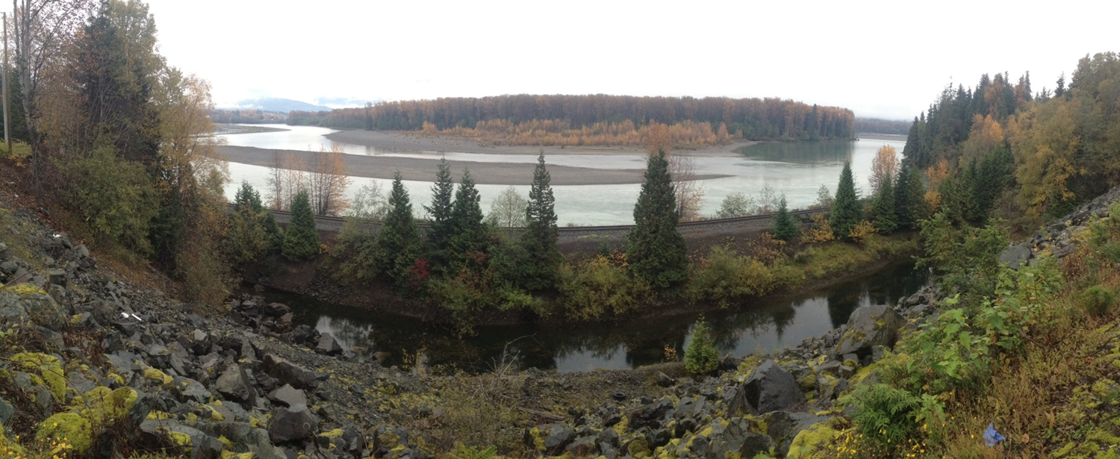
Acknowledgement of Territory
Notes:
Acknowledge local traditional territory.
This photo is from Terrace, so replace it with a local image.
Slides 1 - 47 can be used to present an overview of this project, the development of the resource and the emergent themes. After the overview is presented, participants can delve into the resource booklet and focus on the questions posed on slide 48 and 49.
The resource booklet is accessible online here:
http://www.bced.gov.bc.ca/abed/awp_moving_forward.pdf
Print copies of the resource booklet can also be ordered directly from Crown Publications at https://www.crownpub.bc.ca/Product/Details/7610003550_S at the cost of $7.45 each.
Modify the presentation as required to meet the needs of your learning community.
For more information about this presentation or the resource booklet, “Aboriginal Worldviews and Perspectives,” please contact Sarah Cormode at the BC Ministry of Education: Sarah.cormode@gov.bc.ca
This presentation was created to support educators in BC through professional development workshops and to supplement the resource booklet.

Slide 3


Overview
Introduction and Process
Working sessions:
  Characteristics
  Attributes of Responsive Schooling
  Indicators of Success
Additional Resources
Co-operative Reflection on Practice

Slide 4

Resource Guide
Embracing the mindset “If not here, where?”
Created to build upon regional dialogue and share findings with educators
This project seeks to encourage strategies and clear commitments from all educators
Provides support for teachers to introduce the new curriculum
Notes:
If not here, where?
If not us, who?
If not now, when?
As educators, we have a great opportunity and responsibility.

Slide 5
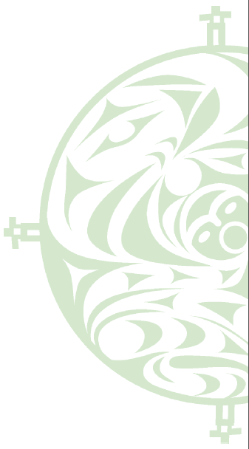
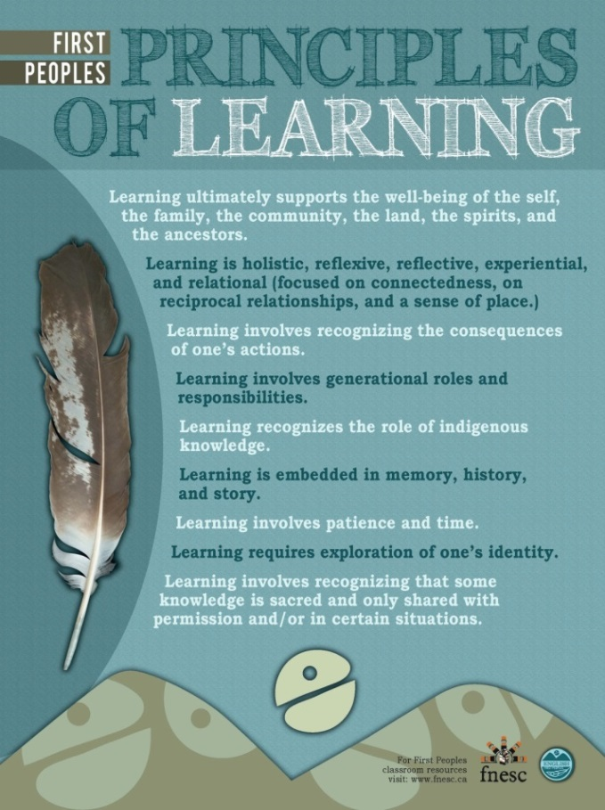
Notes:
Opening activity – review the First Peoples Principles of Learning and identify one of the principles that resonates with you. Perhaps this is related to something that you are already doing in your teaching practice or something that you would like incorporate more.
For example, I resonate with the second principle as I am passionate about outdoor experiential education and how this learning environment encourages connection to sense of place.

Slide 6
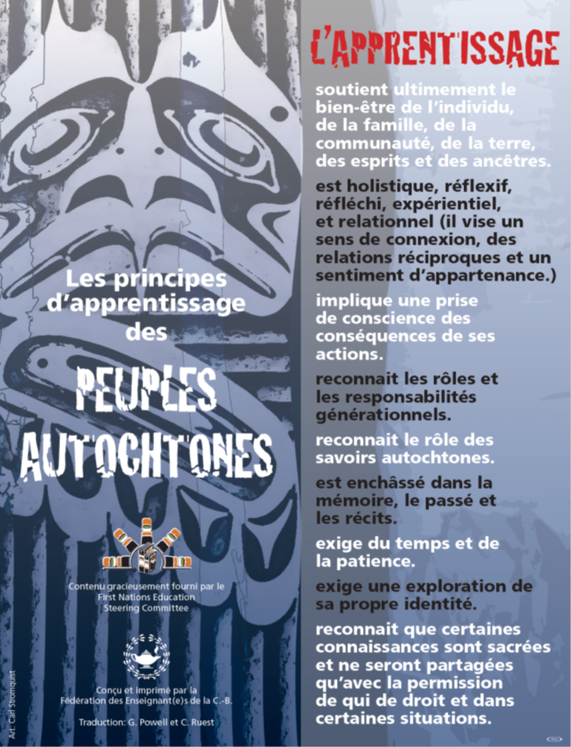
Notes:
The First Peoples Principles of Learning are also available in French.
Poster available for download here:
http://www.bcatml.org/uploads/3/9/5/8/39584835/frenchfirstpeoplelearning8.5x11pdf.pdf

Slide 7
This [the problem of education in the wake of Canada’s history of residential schooling] is not an Aboriginal problem. This is a Canadian problem. Because at the same time that Aboriginal people were being demeaned in the schools and their culture and language were being taken away from them, and they were told that they were inferior, they were pagans, that they were heathens and savages and that they were unworthy of being respected…
Notes:
Quoted in The Vancouver Sun,
Monday, May 25, 2015, p A8
Justice Murray Sinclair calls us to action.
Share video of Justice Murray Sinclair (3 minutes)
https://vimeo.com/25389165

Slide 8
— that very same message was being given to the non-Aboriginal children in the public schools as well. As a result, many generations of non-Aboriginal Canadians have had their perceptions of Aboriginal people “tainted.”
Justice Murray Sinclair, Chairman of the Truth and Reconciliation Commission
Notes:
Quoted in The Vancouver Sun,
Monday, May 25, 2015, p A8

Slide 9
Voices from around the Province
Notes:
Share video of Aboriginal Educators from around the province speaking about the need to do this important work. The short 4 minute video is available on the BC Ministry of Education website under Aboriginal Education Resources here:
http://www.bced.gov.bc.ca/abed/documents.htm

Slide 10
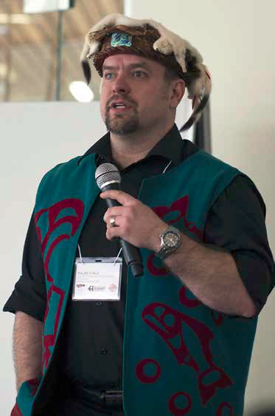
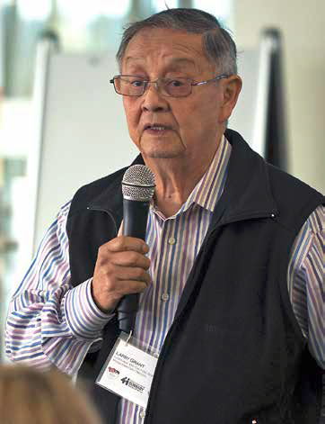
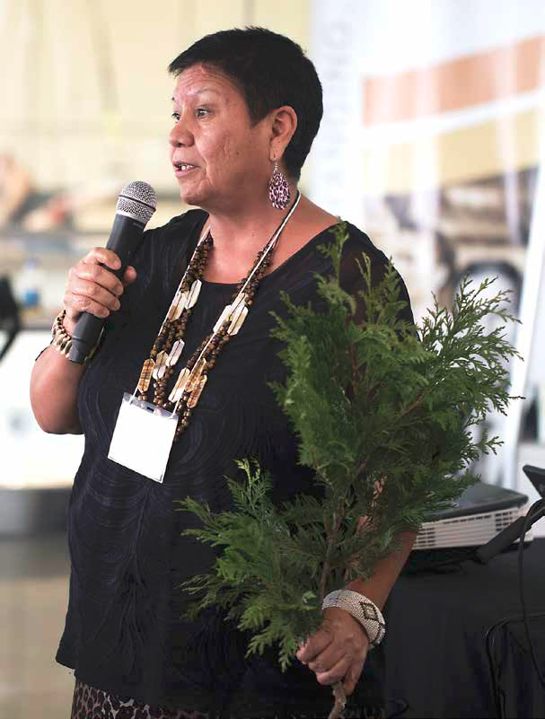
Opening Remarks
Community Chiefs, Elders, and members welcomed participants with traditional greetings
Notes:
Kaleb Child, Director of Instruction for Vancouver Island North School District, acted as facilitator for five regional gatherings.
Each of the school districts invited participants to attend. Participants included Chiefs, Elders, principals, teachers, Aboriginal Education council members and post-secondary partners. Protocol was followed at each event by recognizing traditional territory and providing a traditional welcome.
Photographs here are of Elder Larry Grant and Elder Roberta Price at the Burnaby gathering.

Slide 11
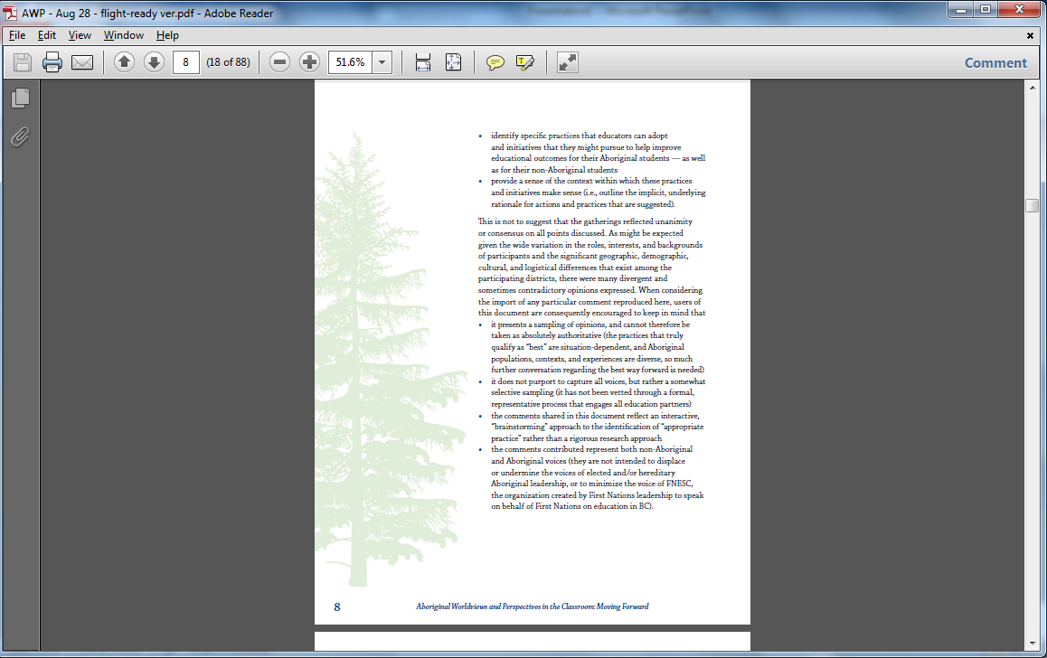

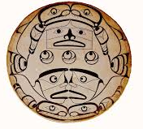



Process
Inspired by Scott Benwell and Kaleb Child from SD 85
  SD 85 (Vancouver Island North)
  SD 41 (Burnaby)
  SD 5 (Cranbrook)
  SD 27 (Cariboo Chilcotin)
  SD 23 (Kelowna)
First Nations, Métis and School District leaders, teachers, support staff, students, post-secondary institutes and agency partners during public gatherings
Notes:
Focus on system change, supporting pedagogical change.

Slide 12
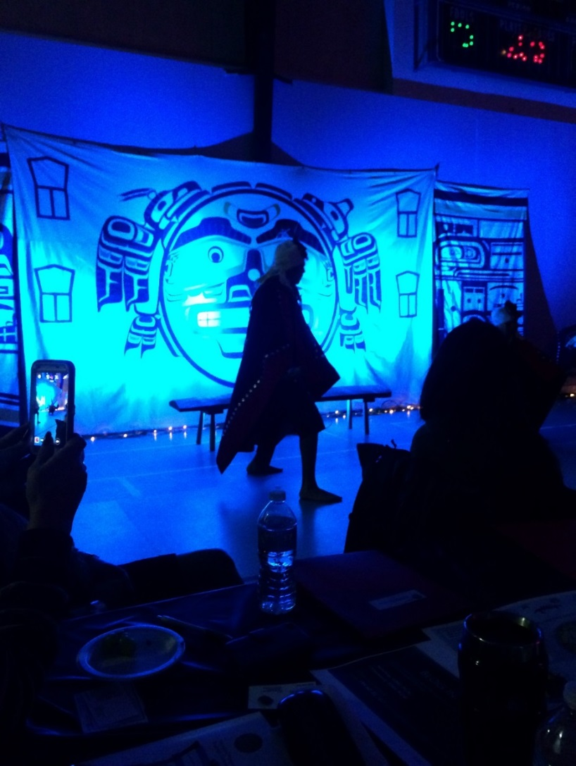
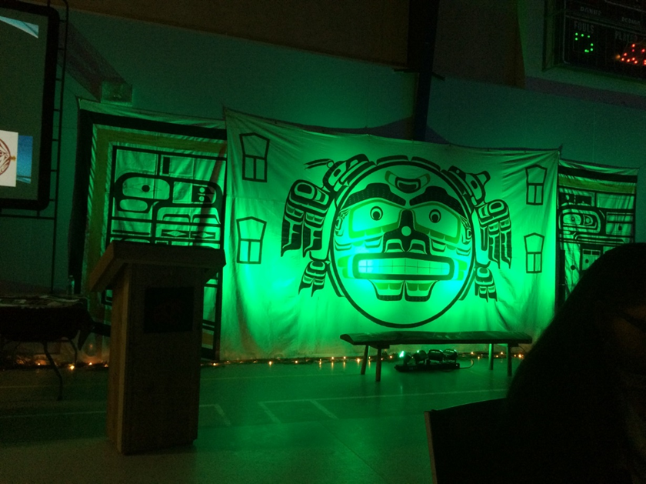
Tsaxis
Vancouver Island North
Notes:
Slides 12 to 19 are images from the 5 regional gatherings.

Slide 13
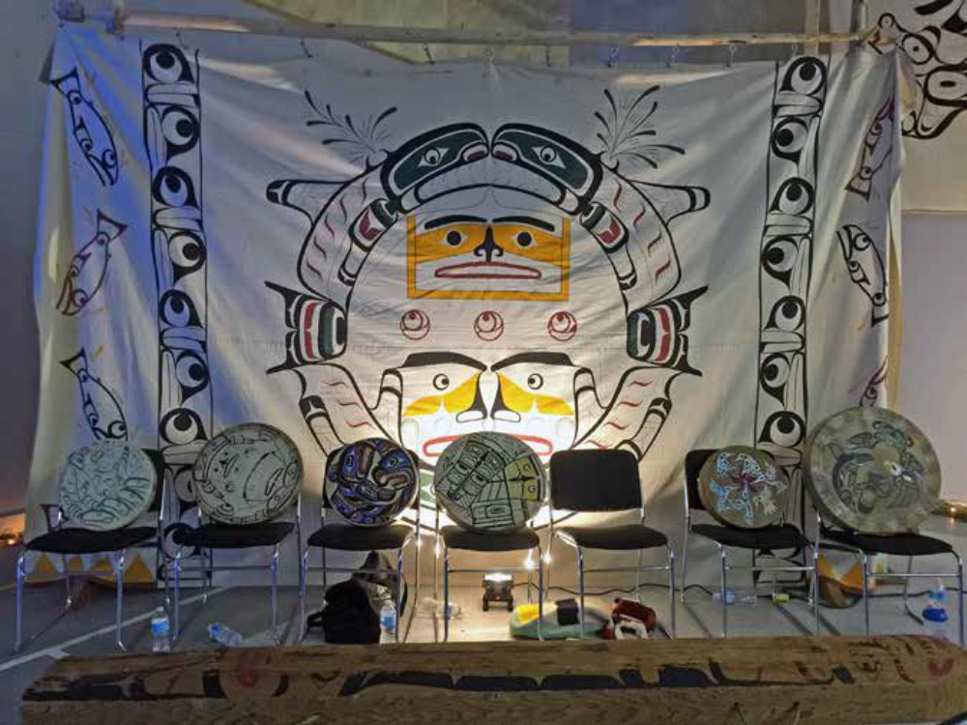

Slide 14
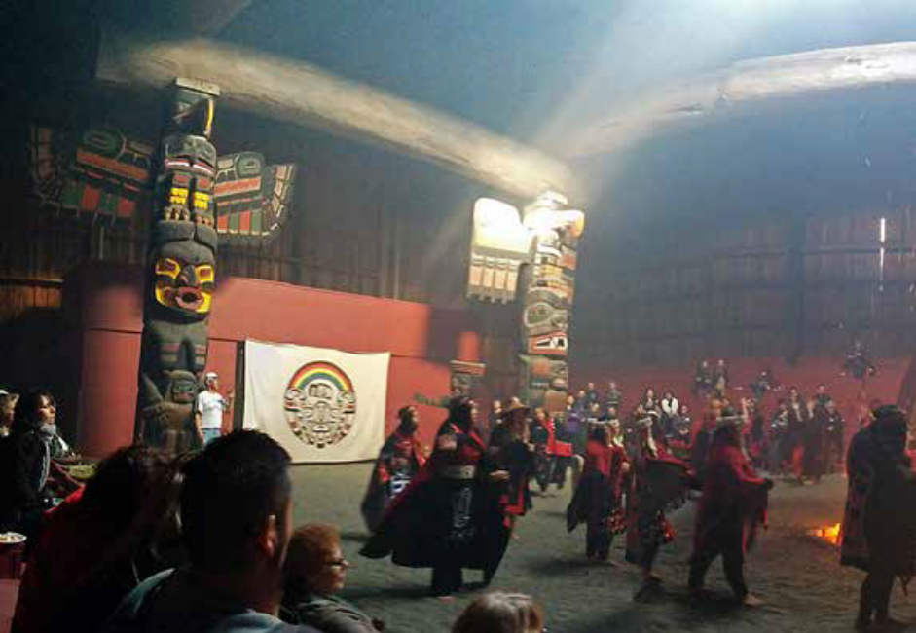
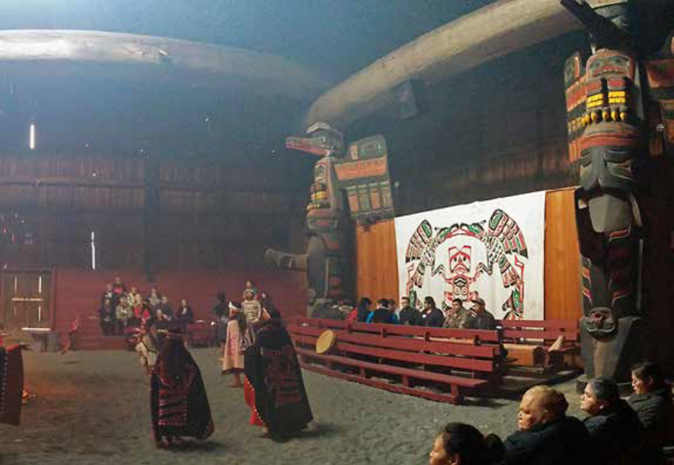
Notes:
Students sharing their culture at the Tsaxis (Fort Rupert) gathering.

Slide 15
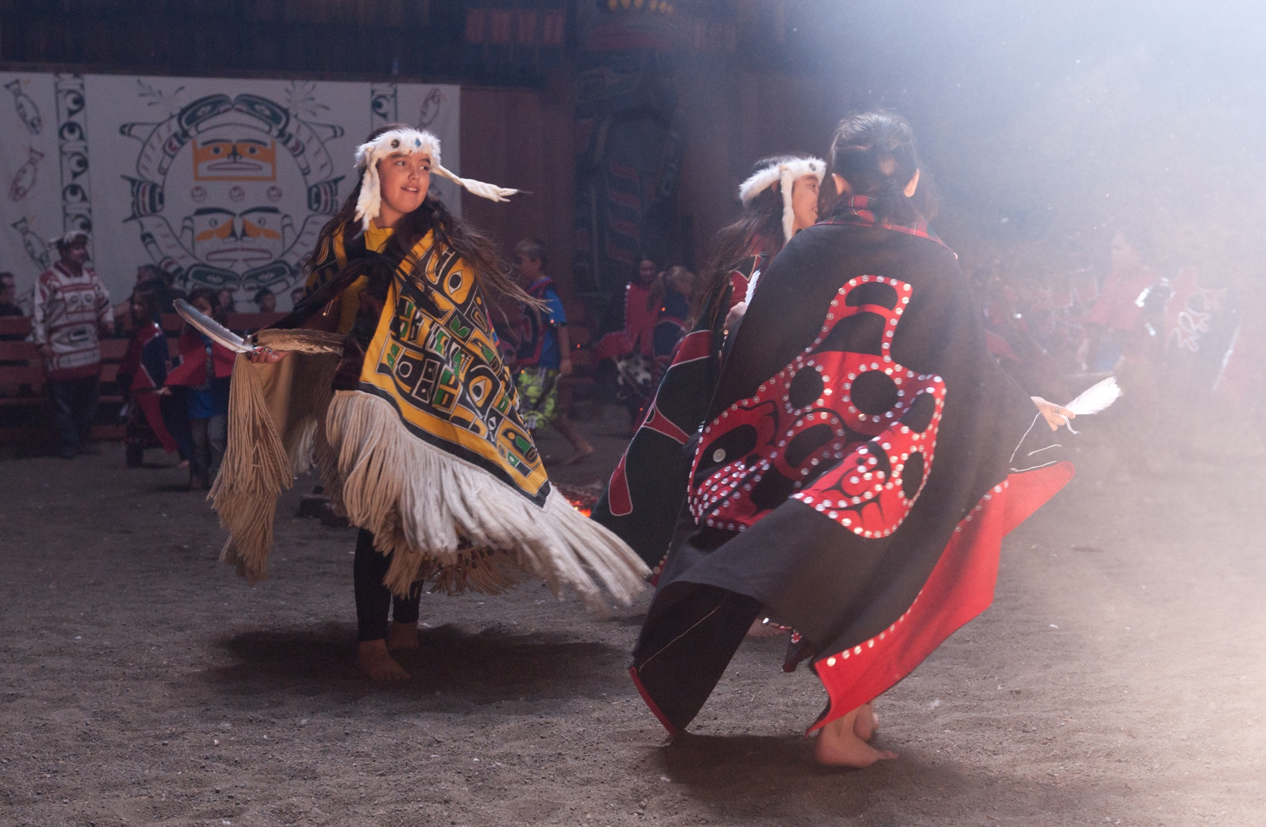
Notes:
Tsaxis

Slide 16
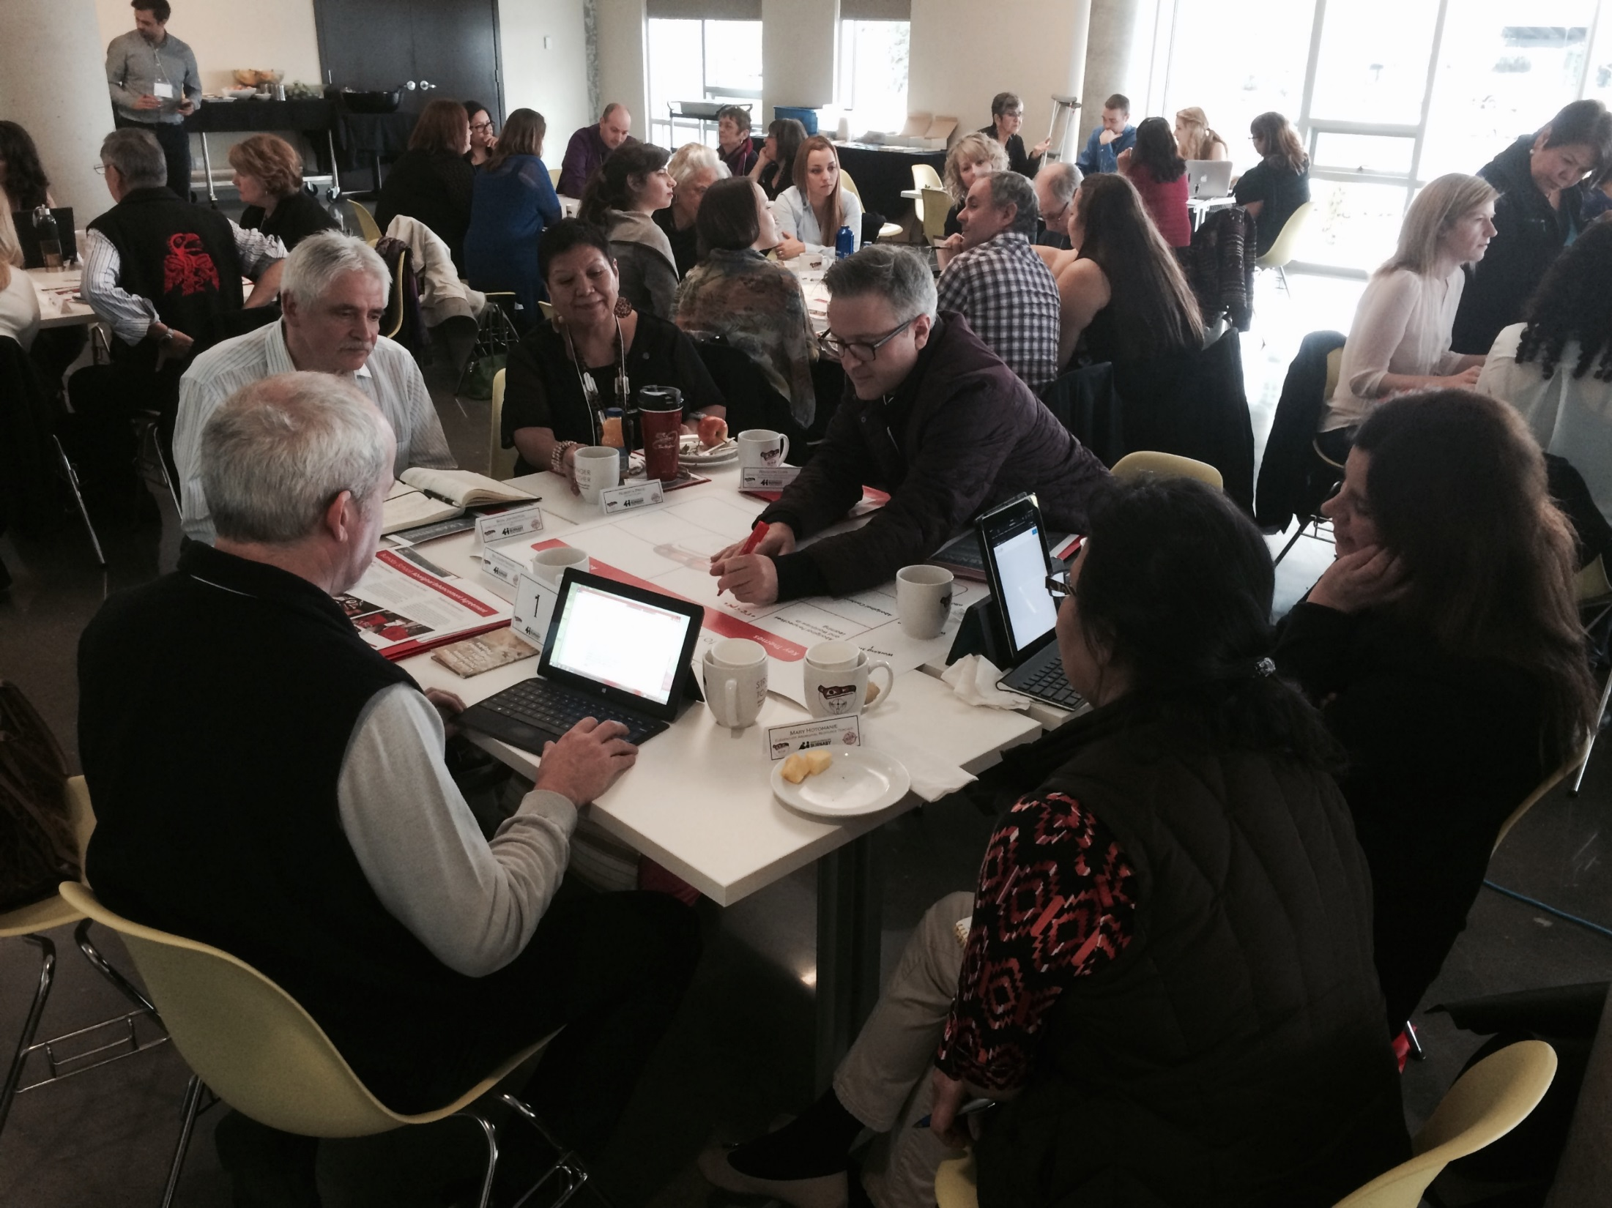
Notes:
Burnaby Session
Diversity of attendees and table families makes for a strong process. Each “table family” represented diverse perspectives. For example, at the Burnaby gathering (photographed here) we had students, parents, Aboriginal support workers, teachers, principals, post-secondary and BCTF representatives.

Slide 17
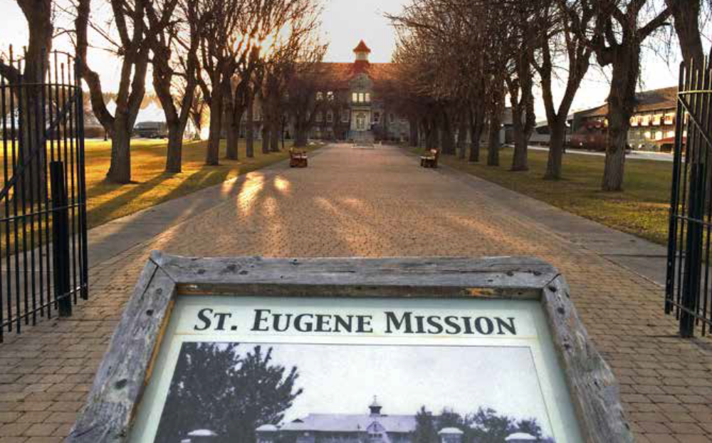
Notes:
Cranbrook session
Our questions were designed to help us get to a definition, how this might look in classroom practice, how it might impact learners and how we might know we are being successful.
Encourage staff to use these questions in planning actions of their own and in their schools.

Slide 18
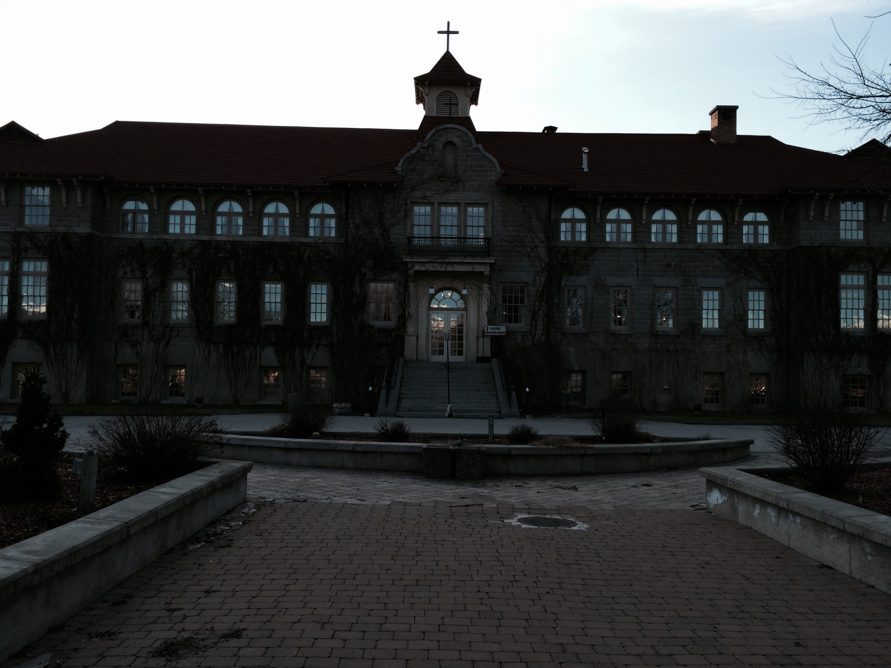
Notes:
Cranbrook - Ktunaxa Territory - St Eugene Mission
This residential school has been revitalized by the Ktunaxa Nation and is now a hotel resort and conference centre.

Slide 19
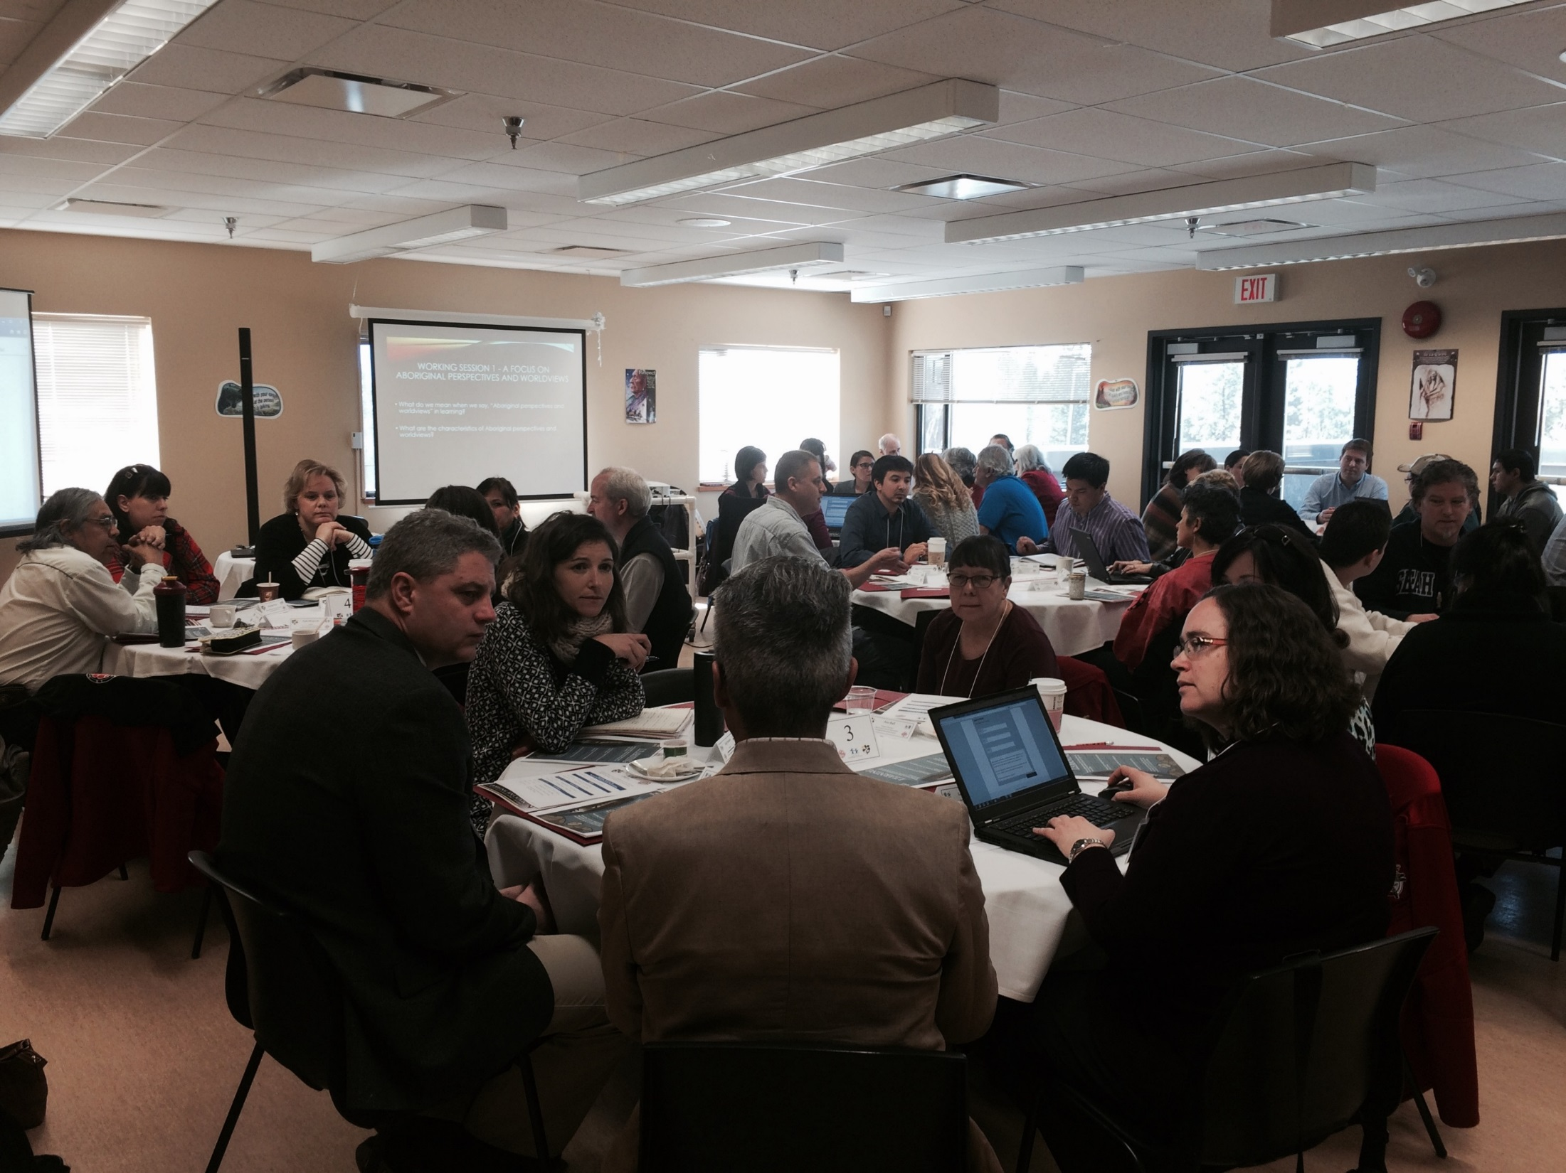
Notes:
Okanagan Territory – Westbank First Nation

Slide 20
Participation
Commitment to respectful participation – there is a time to talk and time to listen
How does this align with your current work?
Think next steps and new possibilities
Think big, set the bar high, focus on forward thinking
Lead with your hearts and open minds
Notes:
At our sessions, we prepared the participants by asking them to follow these suggestions. You may want to present these options at your workshop also. Set the bar high and do not limit the possibilities of what we can achieve together.

Slide 21
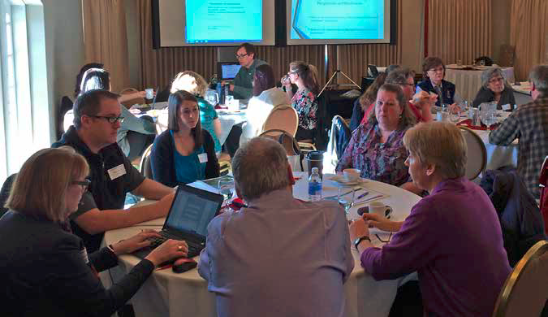
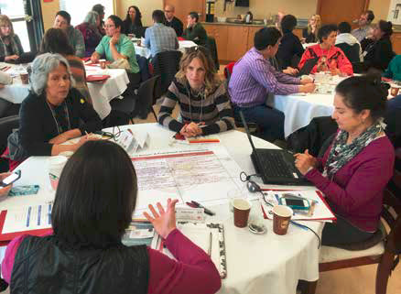
Working Sessions
Discussion occurred in three sessions guided by a particular set of focus questions

Slide 22

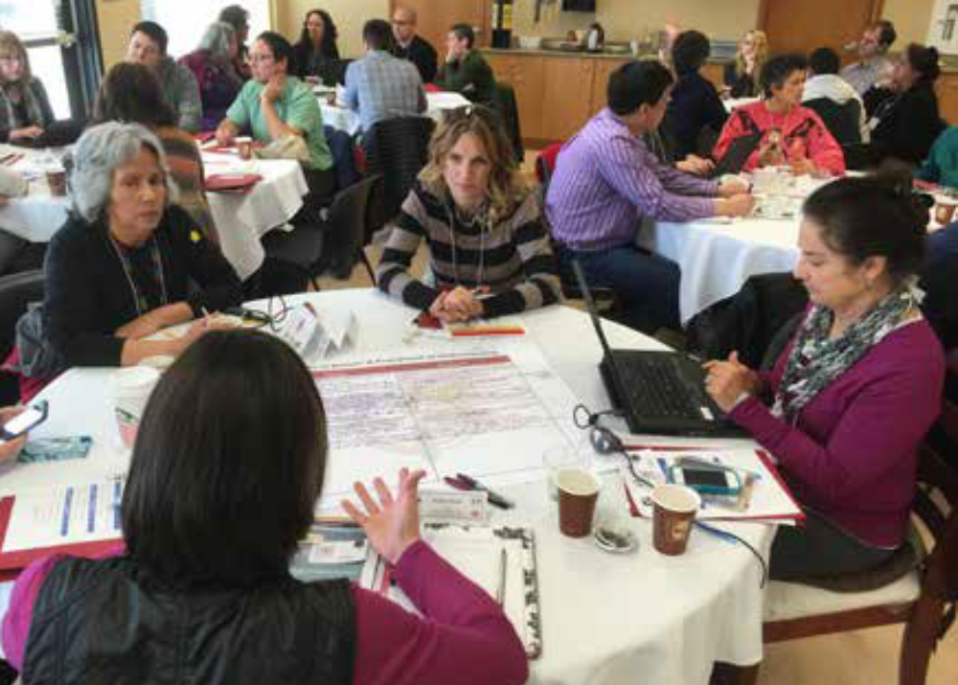
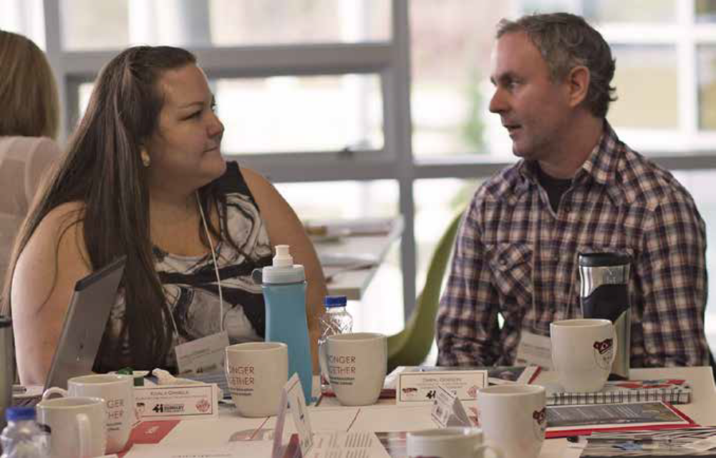

Slide 23
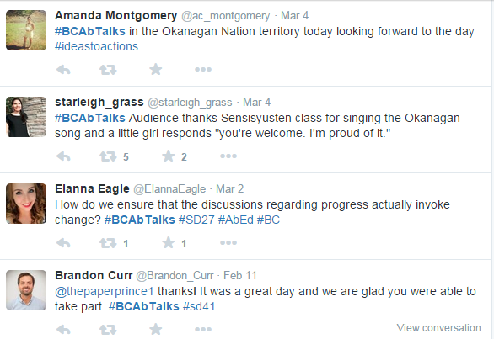
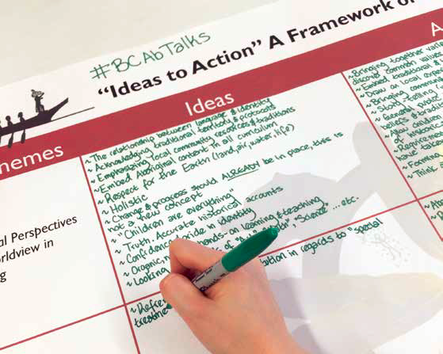
Gathering Information
Conversations were transcribed and then compiled into a resource booklet
Share your thoughts on Twitter using the tag #BCAbTalks
Notes:
The conversations were transcribed and then all of the information was compiled by
Bernard Gobin from GT Publishing.

Slide 24

“A teacher who believes the students are capable of excellence, and can achieve it if properly engaged, will work wonders.”
Notes:
We used the quotes taken from the meetings to guide the development of the final product, a resource guide for teachers, principals, school districts and communities to support the implementation of these concepts into the classroom.

Slide 25
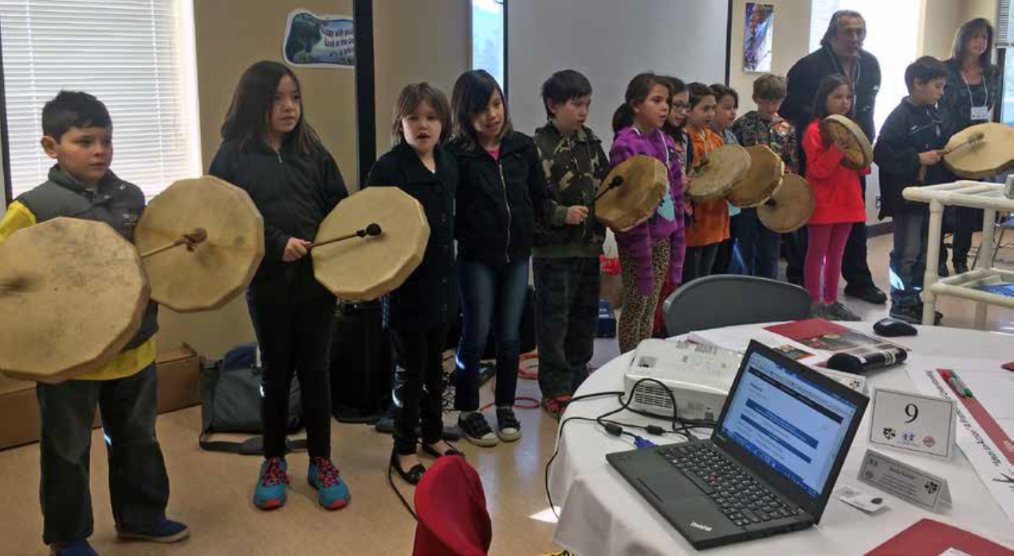
Aboriginal education is for everyone.
Collective role, not the role of one person.
  .
Notes:
We can rely on each other and work collaboratively

Slide 26
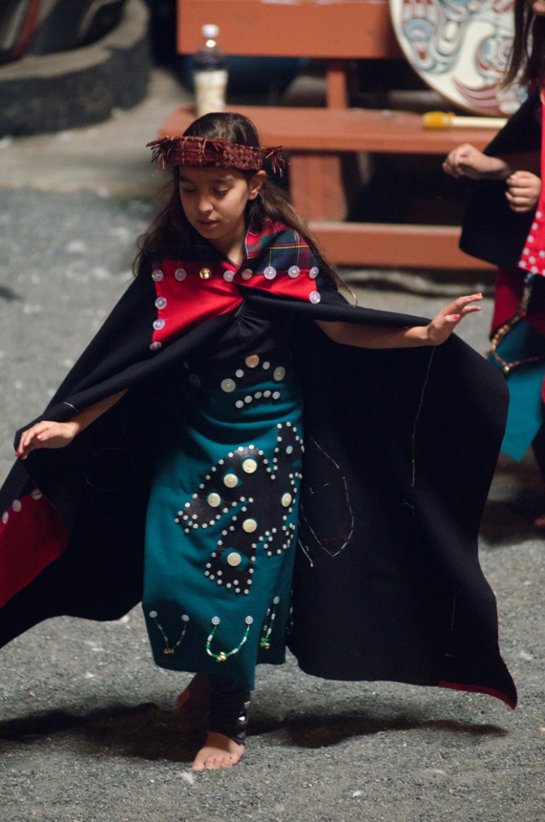
Working Session 1 - A Focus on Aboriginal Perspectives and Worldviews
What do we mean when we say, “Aboriginal perspectives and worldviews” in learning?
What are the characteristics of Aboriginal perspectives and worldviews?
Notes:
Page 6 of final report
Our questions were designed to define how this might look in classroom practice, how it might impact learners and how we might know when we are successful.

Slide 27

Working Session 2 - Content and the Classroom
How do we ensure that Aboriginal Perspectives and worldviews are embedded into practice and into every classroom? What are specific examples?
How do we engage and inspire Aboriginal learners?
How do we ensure we make space for Aboriginal voice? What conditions or spaces give rise to Aboriginal voice?
Are there regional examples of excellence to point to?
Notes:
We focused on these questions during our 2nd working session.

Slide 28
Working Session 3 - Evidence of Success
How will we know we are meeting the needs of all Aboriginal learners? What is the evidence? How does it look and feel?
What can we do to ensure we are successful?
Do you have advice for other educators, administrators, agency partners, and community members about how to work together on these initiatives?
Notes:
We focused on these questions during the 3rd working session.

Slide 29
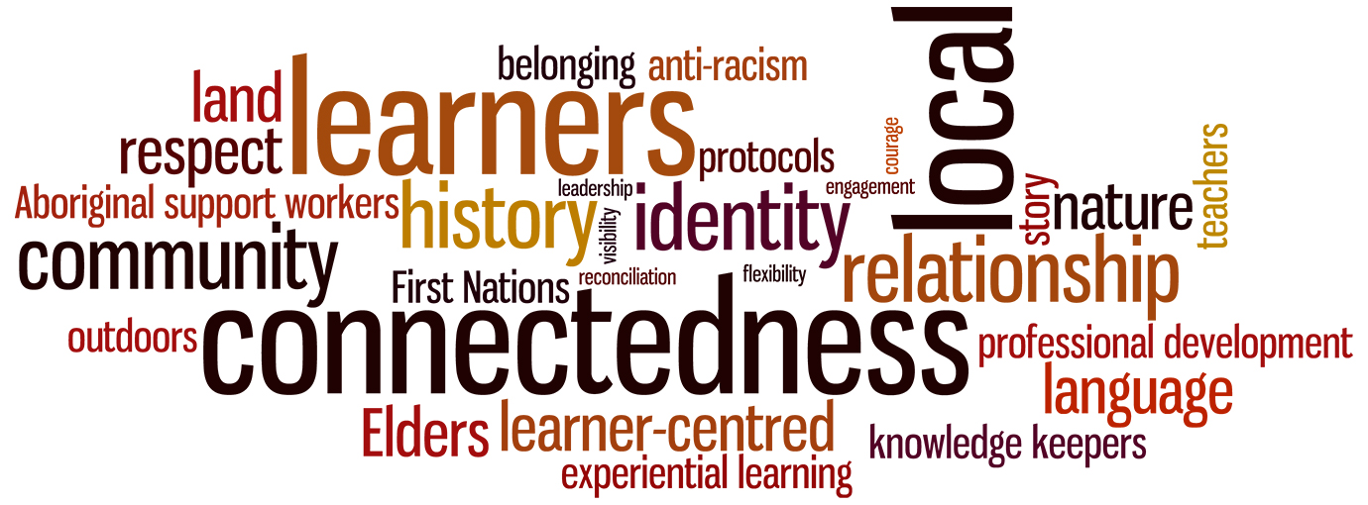
Characteristics of Worldview
Notes:
Themes that emerged from the conversations

Slide 30
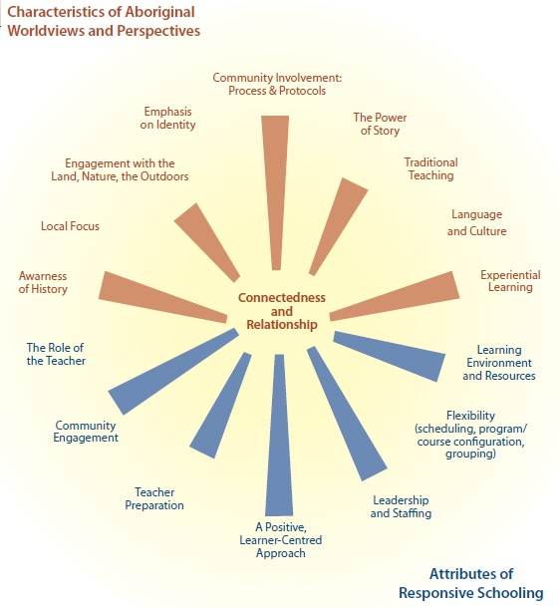
Themes
Notes:
Themes emerged the demonstrated ways in which teachers can implement changes in their classroom.
In order to do this well, the education system and the community need to support them.
The brown section of this diagram illustrates classroom strategies, and the blue section represents characteristics of a responsive school system. Let’s look at some of the classroom pieces first.

Slide 31
Themes
Notes:
Themes include Awareness of History, Local Focus, Engagement with the Land, Nature, the Outdoors, the Power of Story, Experiential Learning, Emphasis on Identity…common themes that are part of the toolbox of all good teachers.
Think about a time when you experienced one of these strategies or when the theme was part of your teaching strategy.

Slide 32
Themes
Notes:
Attributes of Responsive Schooling surfaced such themes as Role of the Teacher, Teacher Preparation, Leadership and Staffing and a Positive Learner Centred Environment

Slide 33
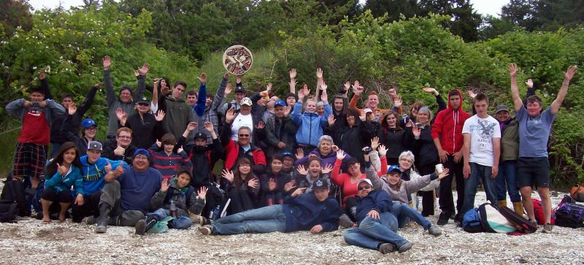
Engagement with Land, Nature and the Outdoors
Kwak’wala Language Learning Highlight
NISS students visit Mimkwamlis – Mamalilakala Village
Notes:
This is an example of a program from Vancouver Island North SD 85. Engagement with the land, nature and the outdoors with a focus on intergenerational learning, ethnobotany, place-based education and Indigenous language learning.
Use these slides, or replace them with local examples of programs/strategies from your school or school district.

Slide 34
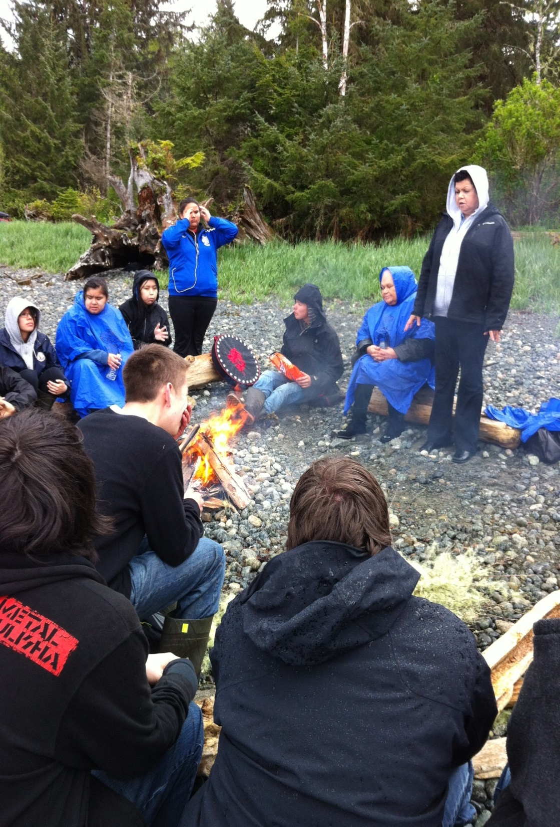
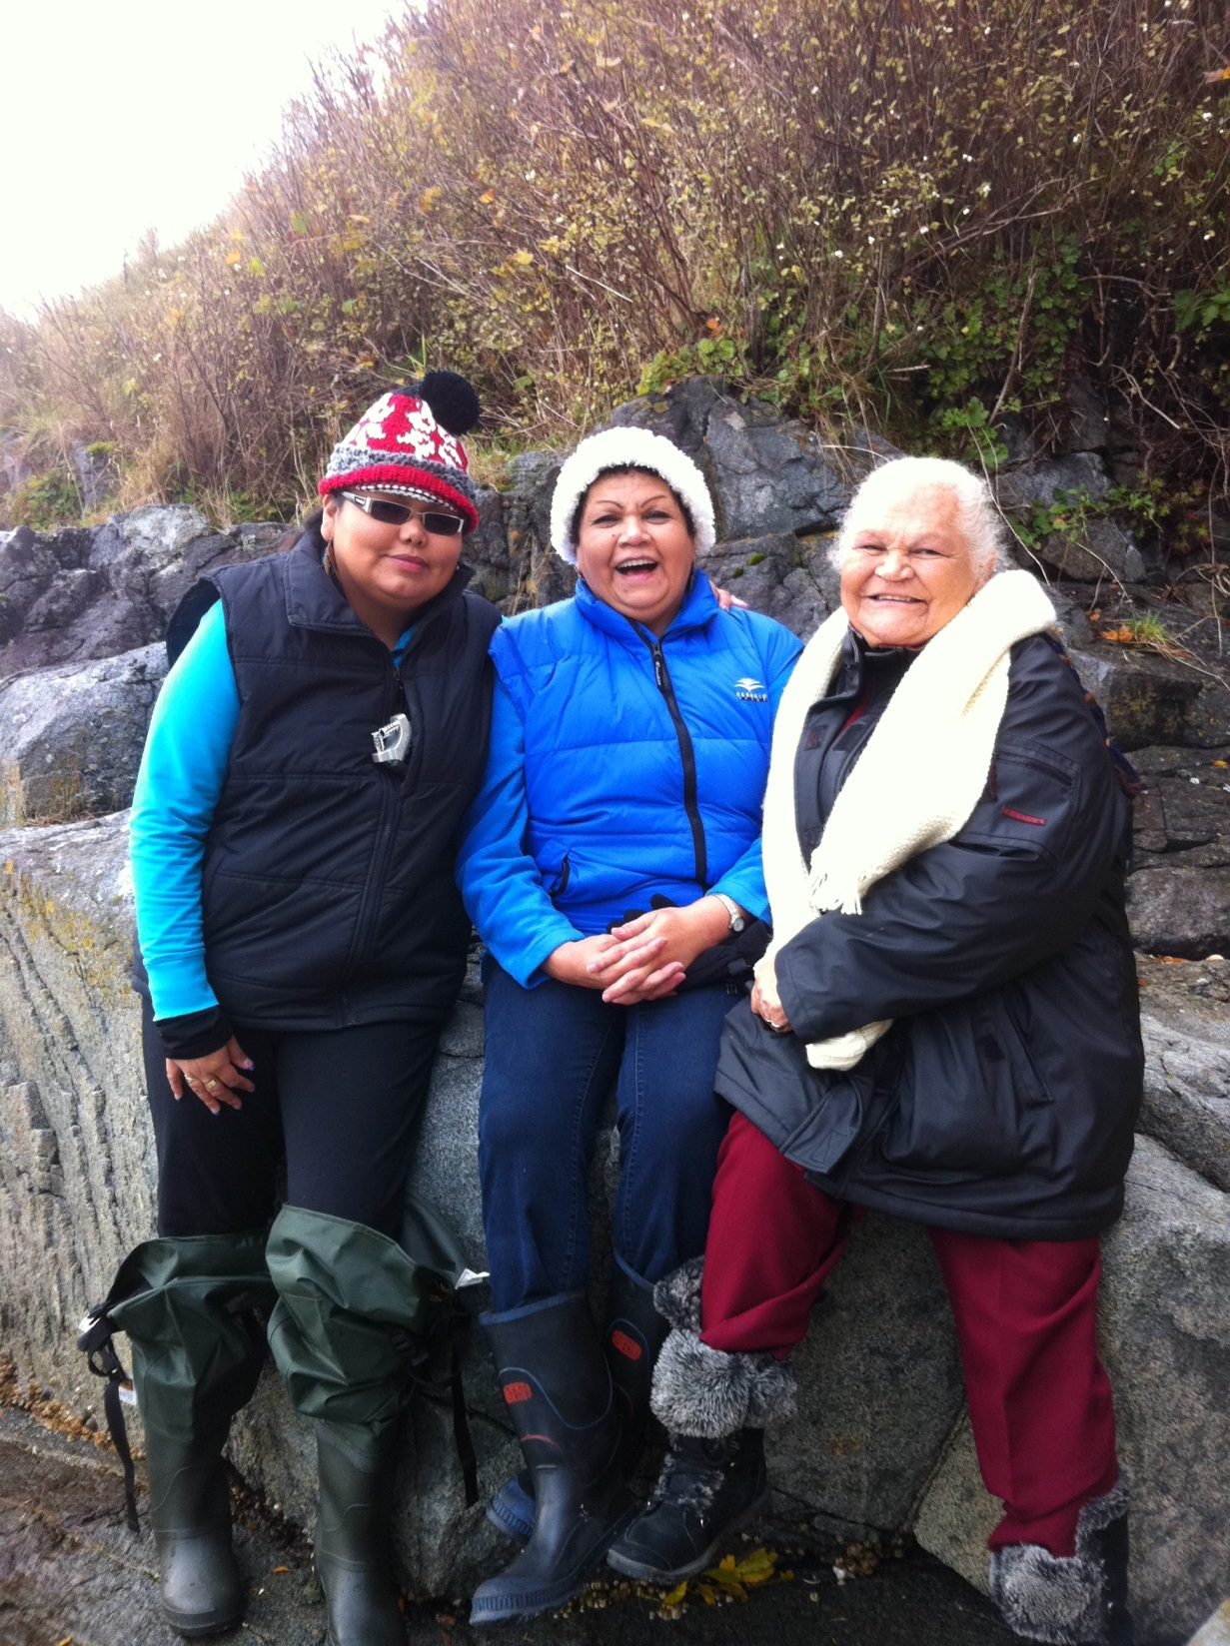
Notes:
Learning is enhanced when local Elders share their teachings with the students.

Slide 35
Local Focus
“Look for opportunities to incorporate place-based learning into your practice (a focus on local Aboriginal history, experience stories, imagery, ecology).”

Slide 36
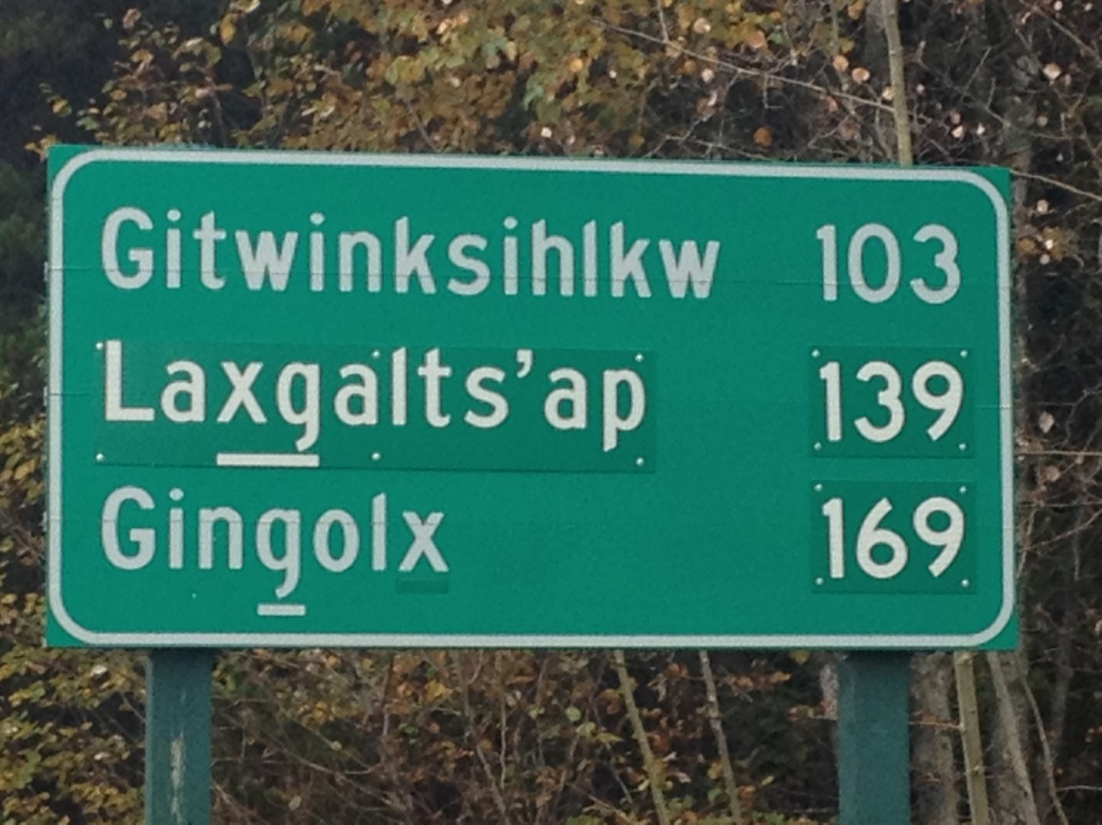
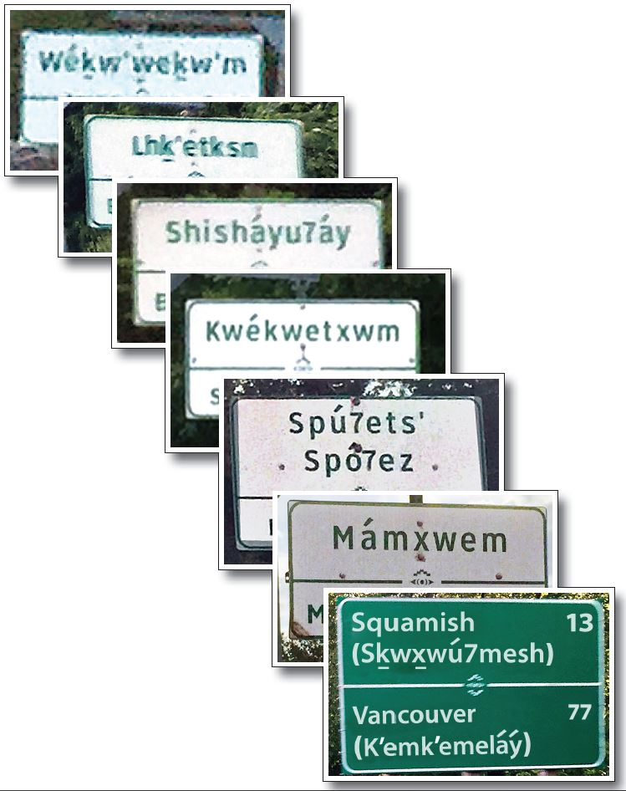
Language & Culture
Notes:
Local language examples from Sea to Sky (SD 48)and Terrace (Coast Mountains SD 82).

Slide 37
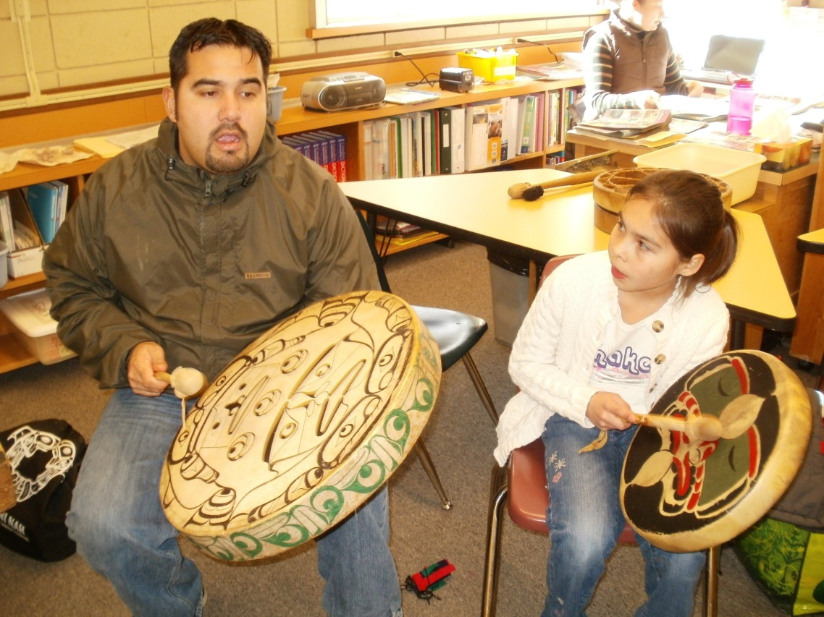
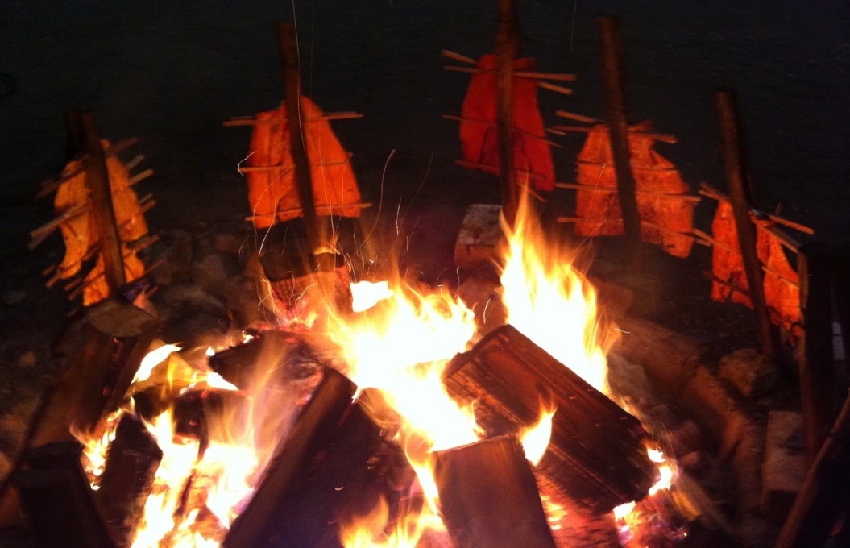
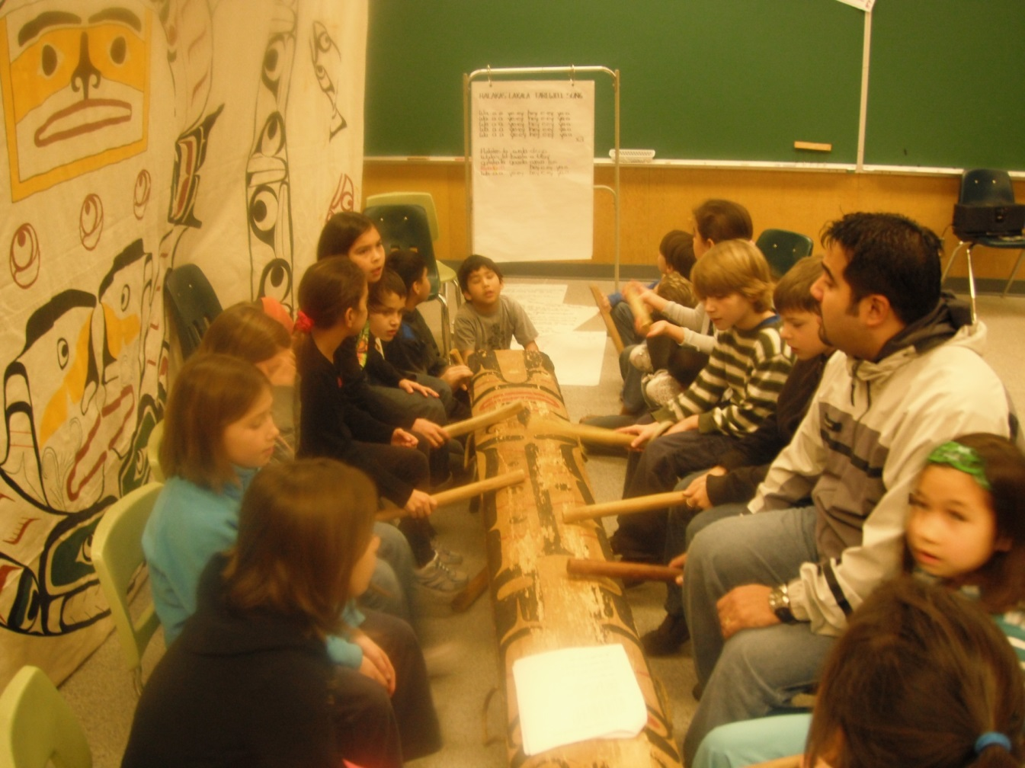
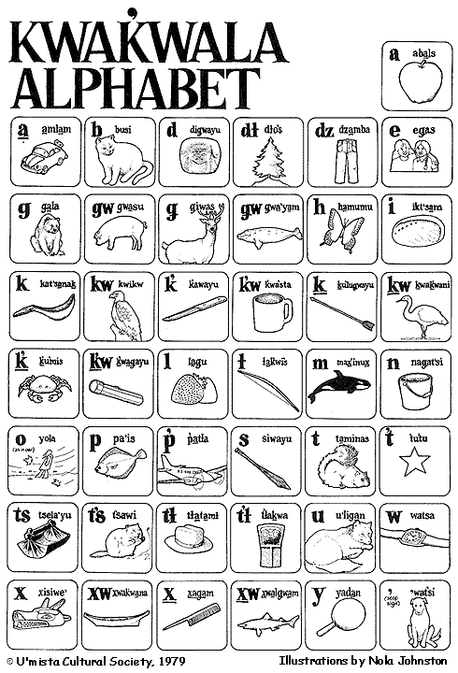
Notes:
Indigenous language learning, Vancouver Island North SD 85.

Slide 38

Emphasis on Identity
“Encourage student self-awareness grounded in knowledge of family origins, cultural background, place of origin, and other identity ‘markers.’ Student self-expression is an opportunity to address and revisit this theme at various stages during their K-12 schooling.”

Slide 39
The Role of the Teacher
“The teacher has an important role in contributing to truth, reconciliation, and healing.”

Slide 40
The Role of the Teacher
“Racism is a major challenge. Overcome this by being courageous and relentless in addressing it, identifying it when we see it, and teaching our children well. Model a better way to behave, take individual responsibility to improve self and the area around you. Address racism through cultural teachings of respect, patience, and self-regulation.”
Notes:
Racism is an on-going challenge for our students and our teachers. We need to see it, respond proactively to it and overcome it through education. This topic surfaced at every gathering and we can make the difference by modeling and teaching more inclusively and designing our curriculum and learning experiences with this in mind.

Slide 41
Teacher Preparation
Teachers require relevant and reliable information about Aboriginal education in order to confidently engage with Aboriginal worldviews and perspectives.
Notes:
Discuss working with post secondary and the changes that are in motion in teacher training programs. Required courses, presence of language, community learning opportunities.

Slide 42
Teacher Preparation
“As [teachers] begin incorporating Aboriginal perspectives and characteristics into their knowledge base and their practice, it will allow them to feel more comfortable and confident in their abilities to engage with Aboriginal perspectives, get past the fear of making mistakes, consult with others to become increasingly knowledgeable, and ask questions.”
Notes:
Not just teacher training programs. How can we, as a system, better support you as teachers to do this well? Resources, time, relationships, knowledge.

Slide 43
Leadership and Staffing
The leadership role includes:
  Raising the level of attention paid to Aboriginal Education
  Recognizing the role and potential associated with Aboriginal support workers and engaging them more deliberately in the delivery of education

Slide 44
Leadership and Staffing
“Leadership is needed to move educators away from the fear of making a mistake – saying something offensive or getting involved in discussing things you do not understand. If we want our students to be risk-takers, we need to be risk takers too.”
Notes:
Principals, you have an important role to play in this effort.

Slide 45
Indicators of Success
We’ll know we’re successful when:
  We see increased numbers of non-Indigenous people taking direct personal responsibility for their own decolonization and reconciliation
  When any Indigenous person who has an education doesn’t feel obligated to fight for the rights of Indigenous people
  When teachers see the relevance of Aboriginal knowledge, and when kids believe in themselves and are confident learners
Notes:
Participants created a vision of what education could look like if we implement some of these changes.
We will have an increased awareness of where each of us is at in our own learning journey and actions that we are taking due to this new awareness.

Slide 46
Indicators of Success
The voice of youth (including Aboriginal youth) is present and heard as part of district educational decision making
We see decision makers in community and in school districts recognizing that they have a role in reconciliation and making decisions with this as a fundamental consideration
We no longer have “Aboriginal curriculum” and other curriculum – we just have curriculum

Slide 47
Indicators of Success
Indigenous languages are heard on school announcements and at celebrations, and seen on newsletters and the school website
The values underlined in district Enhancement Agreements guide educators’ work with all students
Teachers regularly ask for and receive professional development and support in Aboriginal education
Students’ own ideas of success are taken into account
Notes:
This is the last slide of the presentation.

Slide 48
Working sessions
Explore specific section of the report.
Discuss in teams how this theme applies or could apply to your work?
How can we work collaboratively towards addressing this theme?
Report out.
Notes:
Explore the three sections of the report separately and report out before moving to the next section:
Characteristics of Aboriginal Worldviews and Perspectives
Attributes of Responsive Schooling
Indicators of Success

Slide 49
Co-operative Reflection on Practice
On-going professional development
Bring together colleagues to ponder collective action through staff meetings and/or special-purpose “mini-gatherings”
Primary and secondary questions
(pages 76-77)
Notes:
Further reflection on practice – pages 76 – 77 of the resource booklet provide additional follow up questions.

Slide 50
Every learner graduates with dignity, purpose, and options of what they are going to do next.
Aboriginal students all take visible pride in their culture.

Slide 51

Resources
Access this resource booklet
  https://www.bced.gov.bc.ca/abed/awp_moving_forward.pdf
Ministry-produced learning resources and curriculum materials
    www.bced.gov.bc.ca/abed/documents.htm
FNESC documents and videos
  www.fnesc.ca/resources

Slide 52
Resources
First Peoples Principles of Learning blog (Jo Chrona)
  https://firstpeoplesprinciplesoflearning.wordpress.com/
Aboriginal Enhancement Schools Network
  http://noii.ca/aesn/ and http://noii.ca/spiral-of-inquiry/
Innovation Inventory
  www.k12innovation.ca

Slide 53

Notes:
A world of resources now exists to help K-12 teachers and students enrich their knowledge about Aboriginal themes and topics.
The development and implementation of courses such as BC First Nations Studies 12 (1995 & 2006), English First Peoples 12 (2008) and English First Peoples 10-11 (2012) that incorporate the input of Aboriginal educators and that address historical and contemporary themes and topics, with an emphasis on the BC context.

Slide 54

Thank You
Notes:
Let’s work together to create a society where:
we know on whose traditional territory we live, work and play because we learned it in school;
we contribute to First Nations language revitalization as a shared treasure of our province by learning words and phrases in our local language; and,
we all become part of reconciliation through education.

Slide 55
