Slide 1

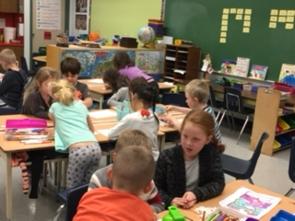

Self Assessment of
Core Competencies
Curriculum and Assessment Network
MPSD Adapted presentation
January 2017

Slide 2
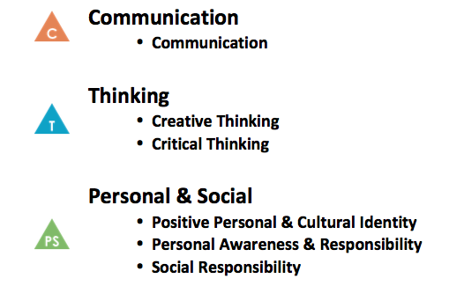

Self-Assessment of Core Competencies
For Today’s Session:
1. What is the purpose and rationale?
2. How do I incorporate Core Competencies in teaching?
3. How do I prepare students to self assess?
4. How will I document it?
5. What will the final self assessment look like?

Slide 3
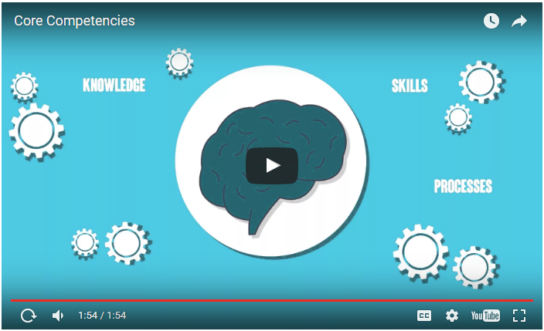

Slide 4
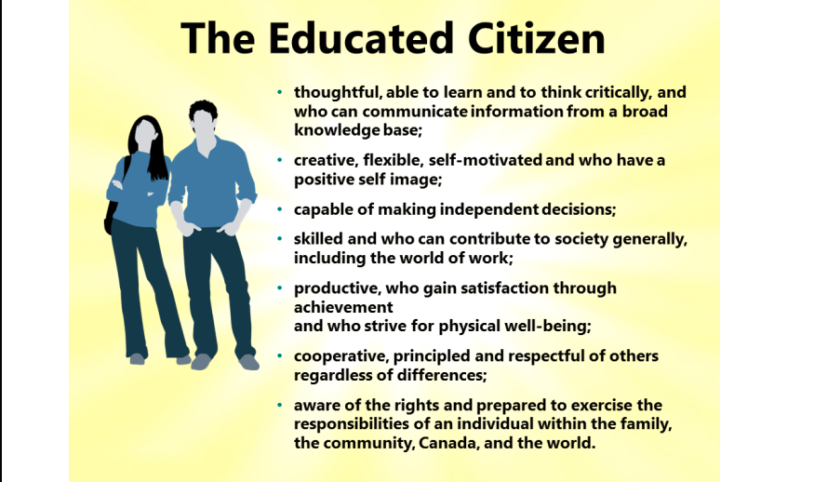

Slide 5
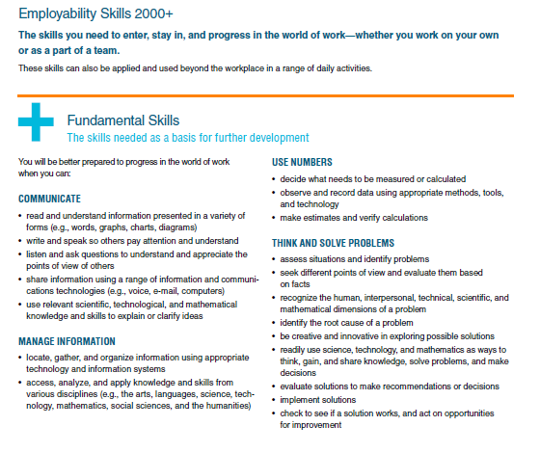
Notes:
Source: Conference Board of Canada

Slide 6
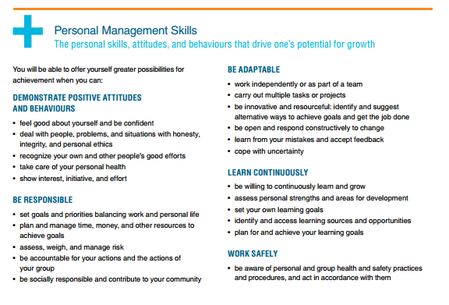

Slide 7
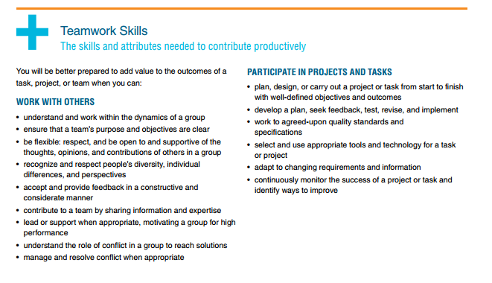

Slide 8
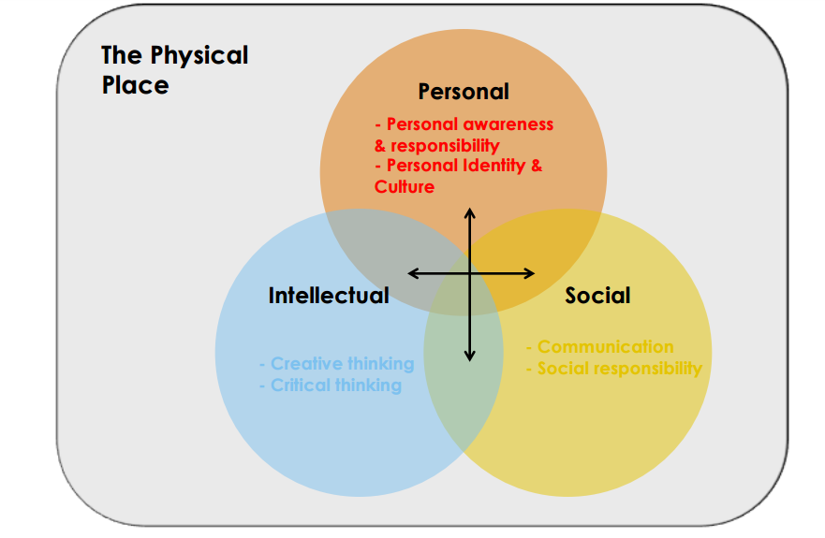
Planning Using BC’s Renewed Curriculum
(Shelley Moore, Inclusion Presentation)

Slide 9
What do you think might be the rationale and purpose of the self assessment of core competencies as a part of the reporting process?

Slide 10
Reflects the importance of the self assessment process
Builds student ownership
Opportunity for student voice
Support the development of student reflective skills and their ability to set their own learning goals through a meaningful process

Slide 11
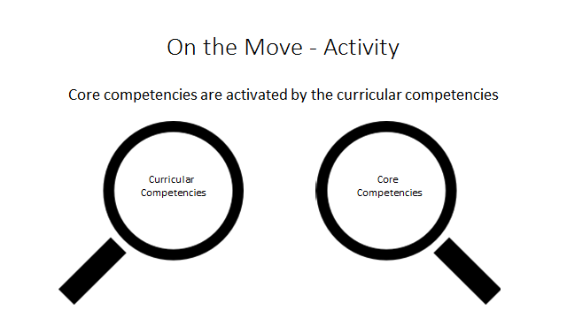
Activating Thinking

Slide 12
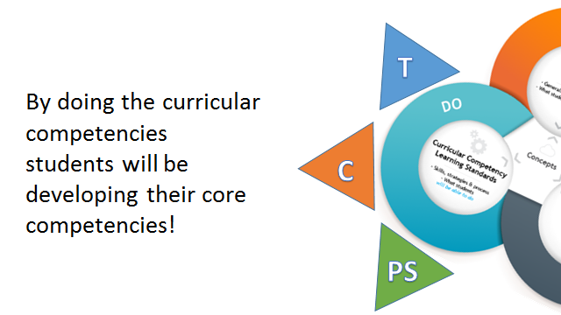
Activating Thinking:

Slide 13

Linked to
Curricular Competencies
Core Competencies
Create
Use reasoning and logic
Synthesize ideas….
Compare and Contrast….
Exchange ideas and viewpoints….
  Formulate hypotheses
  Think critically, creatively, reflectively
  Apply multiple strategies
  Communicate and express
  Contribute to care for self, others and community
Notes:
2. Incorporating Core Competencies into teaching
(Pat Horstead note: These stems are from the curricular competencies – these examples were taken from Grade 9 – math, science, ELA, SS. Note how these connect to the core – if curricular are where we see evidence of learning (the doing), how will asessment be impacted? Hard to assess with a “test” – some will have to be observed, student interviewed and asked questions and sometimes a product/performance assessed.

Slide 14
Making Core Competencies Explicit
Use the language of the core competencies in the classroom and help students become familiar with them
  What does thinking look like?
  What is good communication?
  How do we contribute positively to the classroom environment?
  What do you do when you want to generate lots of ideas?
  What strategies do we use when we are frustrated or angry?
  How do we collaborate effectively with others?
Notice them and name them and celebrate when students demonstrate them.
Notes:
Use the language – “thinking like a scientist”, communicating in math, working collaboratively”, caring for your community”
Build reflective language with kids – increase the opportunities for self assessment and peer assessment
Get familiar with the aspects of the core competencies and the profiles

Slide 15
When Planning Learning Experiences
Identify the core competencies that are connected to the curricular competencies and intentionally plan with them
Think about how the core competencies take expression in the different disciplines
    -what does communication look like in math vs language arts, thinking in science vs social studies…
Draw connections for students
    -goals of the learning experience and how it promotes and develops core competencies
Notes:
2. How to incorporate into teaching
(Pat Horstead note: Identify as you are planning and using the curricular competencies the connection to the core competencies. Think about how the core competencies take expression in the different disciplines – what does communication look like in math, communication in language arts, thinking in science vs social studies. How do the curricular competencies capture this? Are there some core competencies that you might see outside of the curriculum; such as in the classroom interactions, playground, contributions to the school and class community, playground, ways students are contributing to the school and class community?)

Slide 16
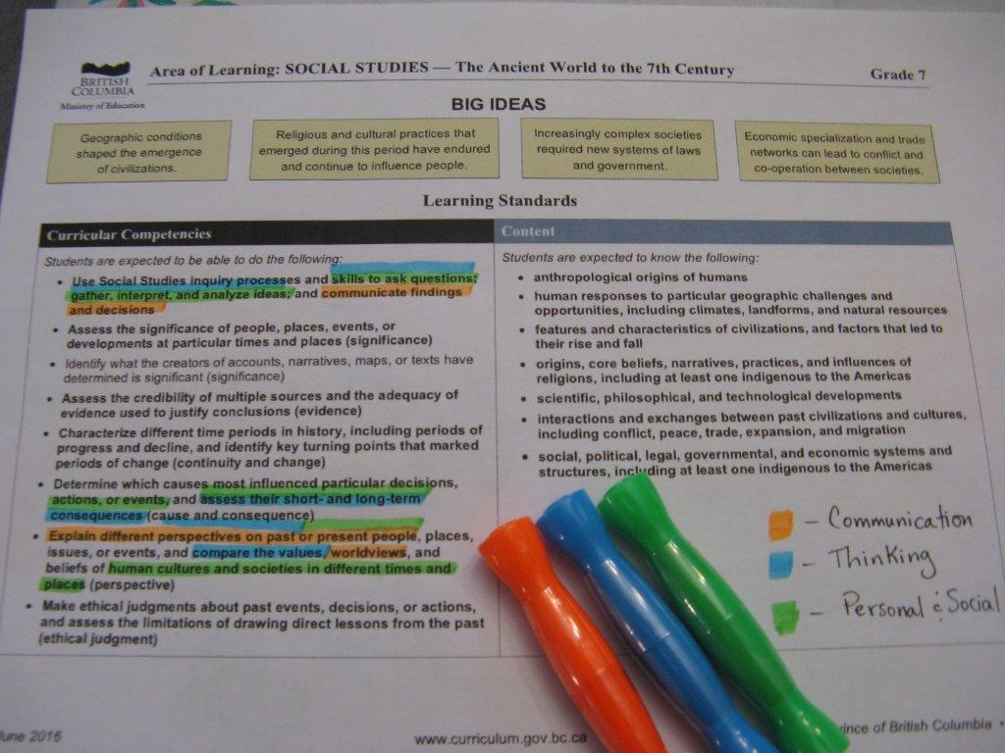

Slide 17
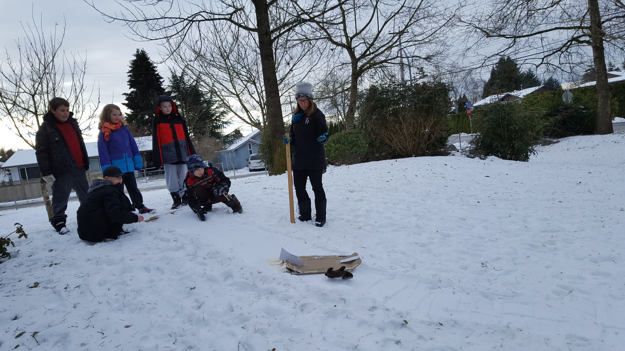
Notes:
2. How to incorporate into teaching: Grade ¾ class at West Heights measuring the distance their team-created toboggan travels…Courage bear is taking a tumble

Slide 18
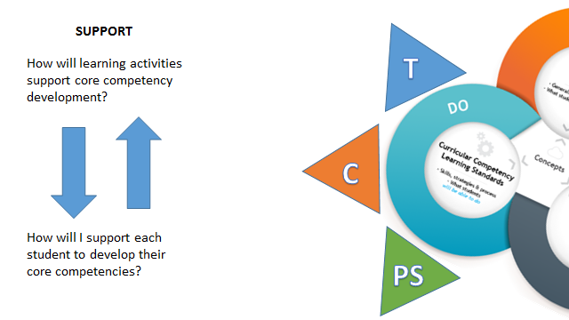

Slide 19
What are some of the ways I can support students to be prepared for a meaningful self assessment process?

Slide 20
Self-Assess Throughout the School Year
Encourage students to talk about their attributes, skills and proficiencies in relation to the core competencies.
Ask open-ended questions to prompt student reflection and gain the language in order to be meta cognitive
provide greater opportunities for students to self-assess core competencies throughout the school year
involve students throughout the year in self assessment opportunities … help them better understand who they are, and the ways they are unique.
Notes:
(Pat Horstead note: Competencies not incompetencies)

Slide 21
Core Competencies
…in working with students:
Notice them, name them and nurture them; and give students opportunities to demonstrate them!
Together, focus on learning about them – be intentional, model, provide guided practice and support
Build student ownership and voice
  – support the development of metacognition
Use the language with students
  – help students develop language of reflection; encourage and incorporate self assessment in your classroom
Notes:
3. How do I prepare students to self assess?
Pat Horstead notes:
-Core Competencies are foundational in this curriculum – give us our overall purpose of schooling, align with the Educated Citizen and are agreed upon skills that the world of work, business etc. suggests are needed for success
(thinking like a scientist, historian, communicating like an author a mathematician)
what makes a good thinker, the difference between critical and creative thinking, aspects of good communication, what it means to have a positive personal identity
Can they describe their personal development of the core competencies?
Core competencies are embedded in the curricular competencies, however, we do also need to pay attention to them and ensure that they come alive in our classrooms
Start by noticing them, naming them and nurturing them
There is a uniqueness about their expression in different disciplines – use the language, talk about how historians think, authors communicate
Make them explicit with kids, talk about the aspects, go into the profiles
Incorporate the core competencies in your self-assessment work with kids

Slide 22
Documenting the Self Assessment
Options Include:
A reflective summary provided by the student
A summary of a conference with the student and parents based on development of the core competencies
Notes:
4. How will I document it?
(Pat Horstead note: Ways to document the self assessment reporting requirement – does not have to be just one template)

Slide 23
Documenting the Self Assessment
Options Continued…..
a video of a teacher and student interview
a video that a student creates where they speak to who they are as a learner in relation to the core competencies
A written summary as part of a portfolio review where evidence of core competencies is presented
Notes:
4. How do I document it?
(Pat Horstead note: Ways to document the self assessment reporting requirement – does not have to be just one template)

Slide 24
Considering what we just talked about:
How can we create a meaningful process for students to self assess core competencies at the end of the year?
Notes:
5. What will the final self-assessment look like?
Consider a thoughtful process at the end of the year – include as part of a portfolio review, summary of a teacher/parent conference, a video of a student describing themselves as a learner
The “form” will fall out of the process – what makes sense? What will capture the process for kids? Districts can develop their own templates, forms and formats

Slide 25
Sample prompts based on facets of Core Competencies
Can you describe some the ways you have collaborated with others in…..?
What strategies do you use when you want to generate lots of ideas?
Talk about something you have designed in…..
What do you see as your personal strengths?

Slide 26
Can you talk about a time that you exercised some good choices that contributed to your well being…
How have you improved this year in building relationships with others?
What goals have you met that you are proud of?

Slide 27
Sample Illustrations
Primary/Intermediate
Communication: Retelling Little Red Riding Hood, Building a Shelter,
Creative Thinking: Medicine Making, LEGO Creations (math)
Critical Thinking: Stacking and Building, Sharing Cookies
Positive Personal & Cultural Identity: How Names Were Given, 10 Things, Identity Recipe
Personal Awareness & Responsibility: Running Gives a Person Energy, Showing Love, Asking for Math Help
Social Responsibility: Cleaning Up the Beach, Trees and Me
Intermediate/Middle/Senior
Communication: Persistence, Memoir: Sky Diving Experience, Interview (Grade 10)
Creative Thinking: “Steal a Story”, Dance ‘Poem’ to Describe Happiness
Critical Thinking: Earth Sciences Mind Map, Finding the Area under a Curve
Positive Personal & Cultural Identity: Grad Transitions, Welcome Centre ELL
Personal Awareness & Responsibility: Creating a Button Blanket, Using Poetry for Personal Awareness, Alternate School Student Denied Job
Social Responsibility: Downtown Eastside Service, Poverty, Burlap Sac Dress

Slide 28
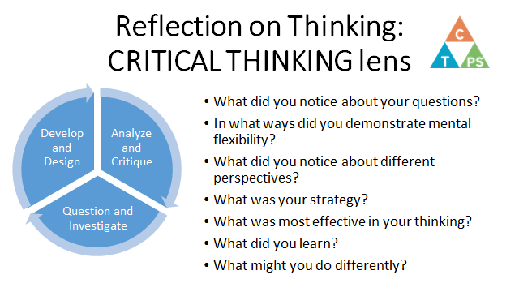
Sample lesson/Classroom Activity (Science):

Slide 29

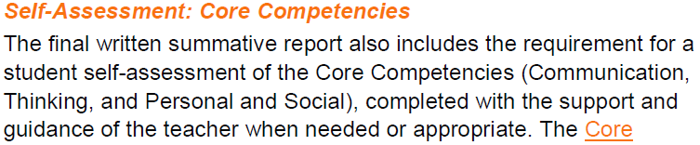
Next Steps
Share practices and learn from each other – work to collectively get it right!
June 2017 Report Cards

Slide 30
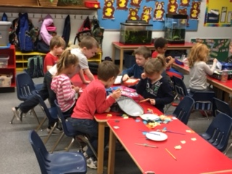
And, it still is a bit “messy”!
As in any change process, there are still things we need to figure out together. Feedback and input is welcomed via the Ministry website.

Slide 31
Provincial Examples
Making Thinking Visible
Explicitly embedding the Core Competencies into teaching and learning

Slide 32
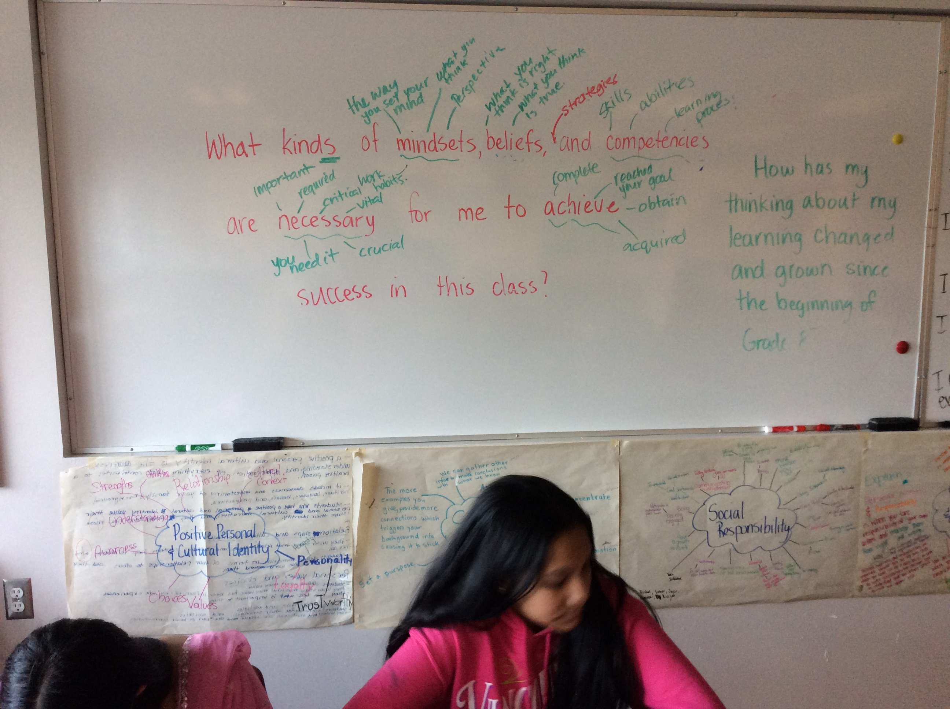

Slide 33
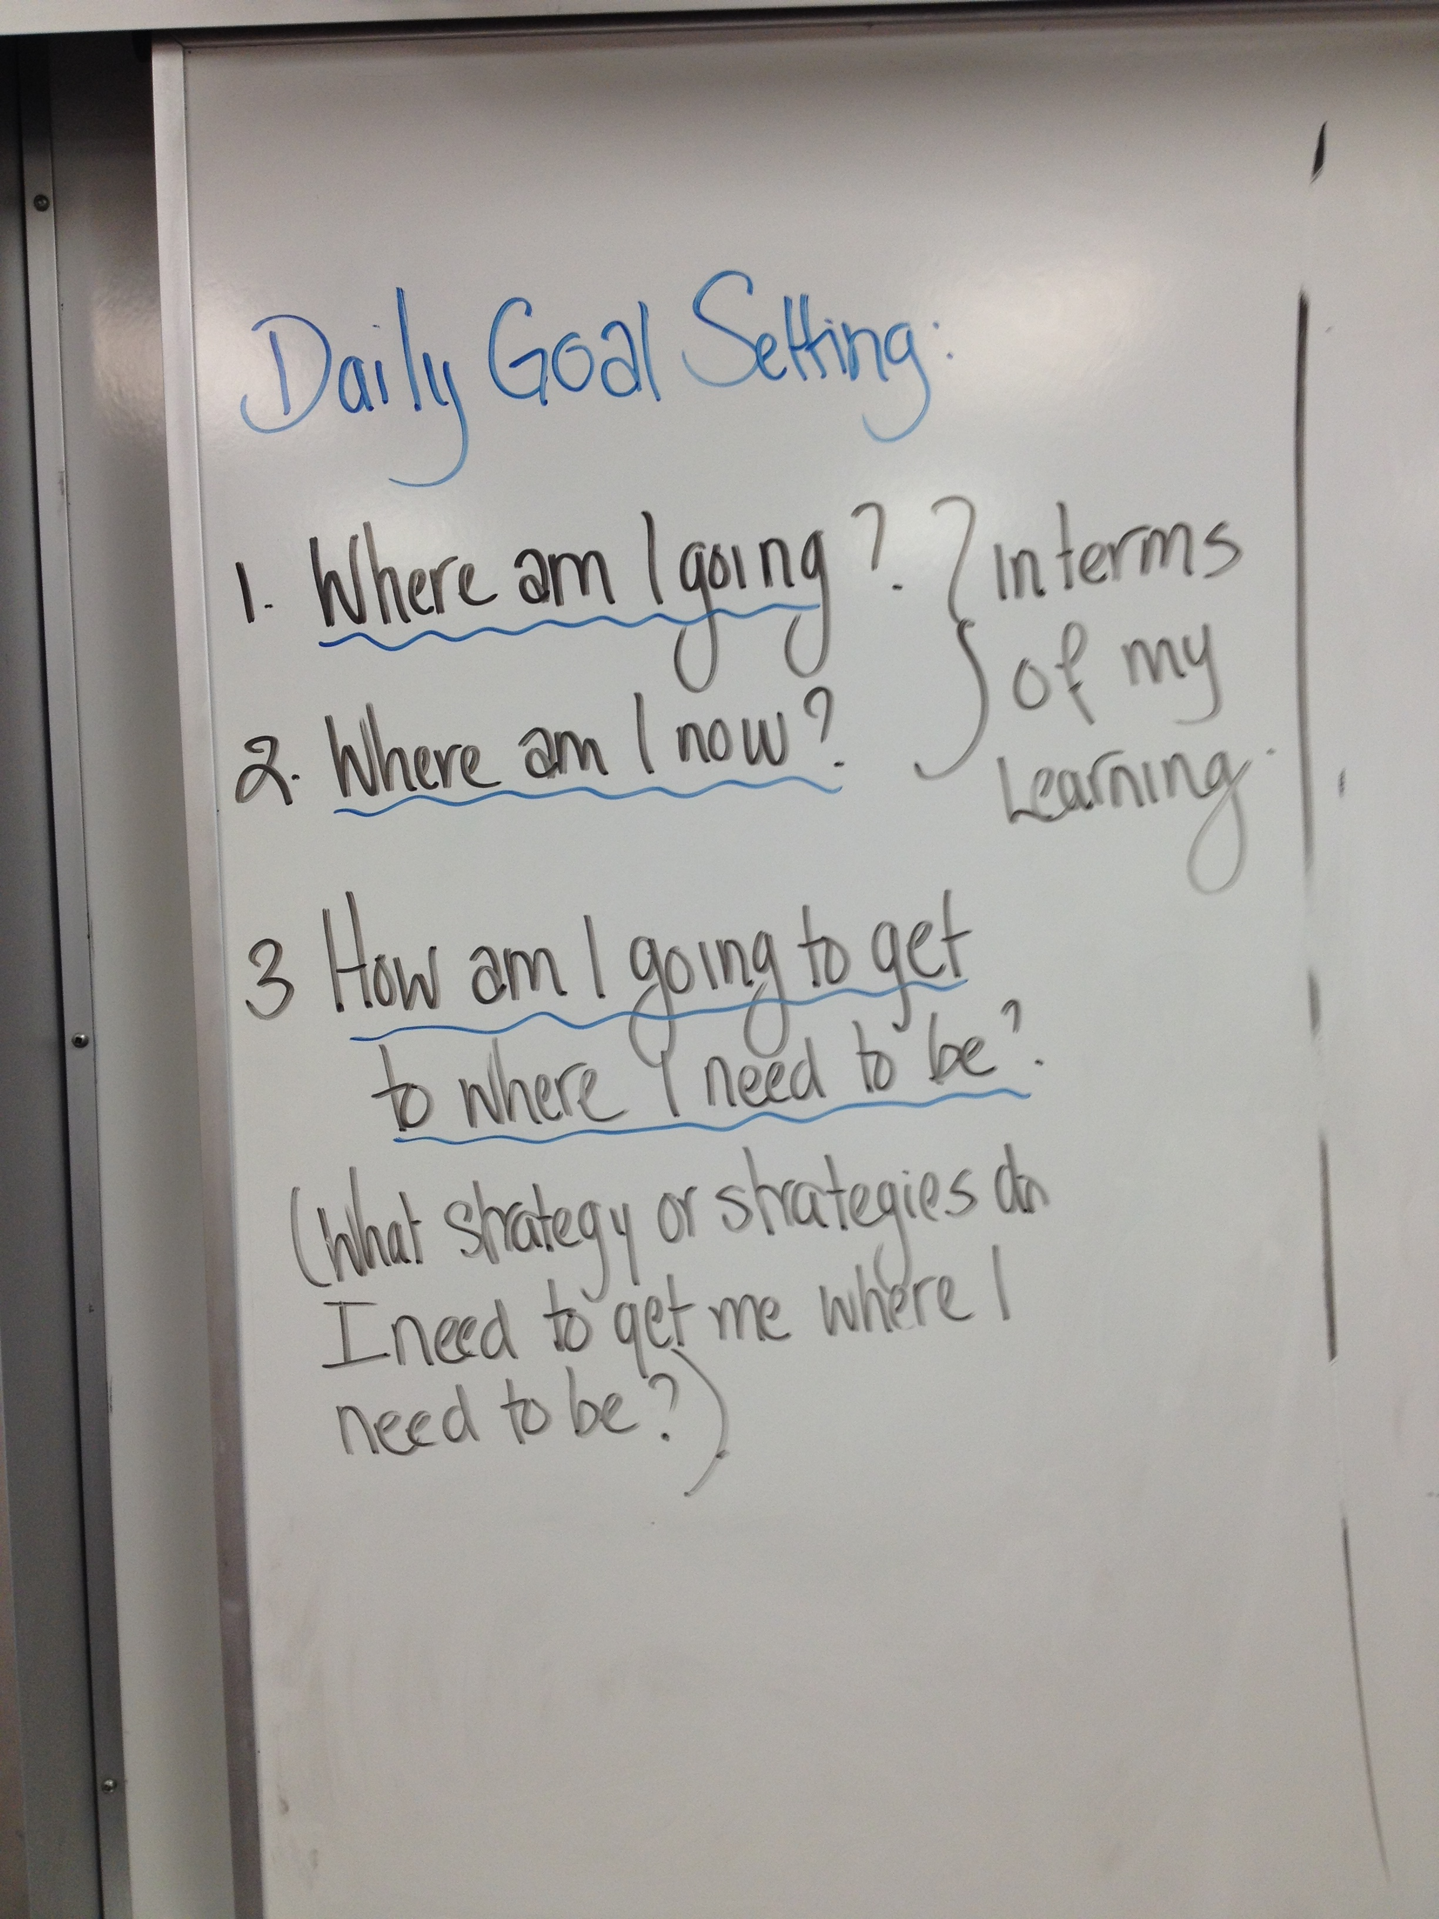

Slide 34
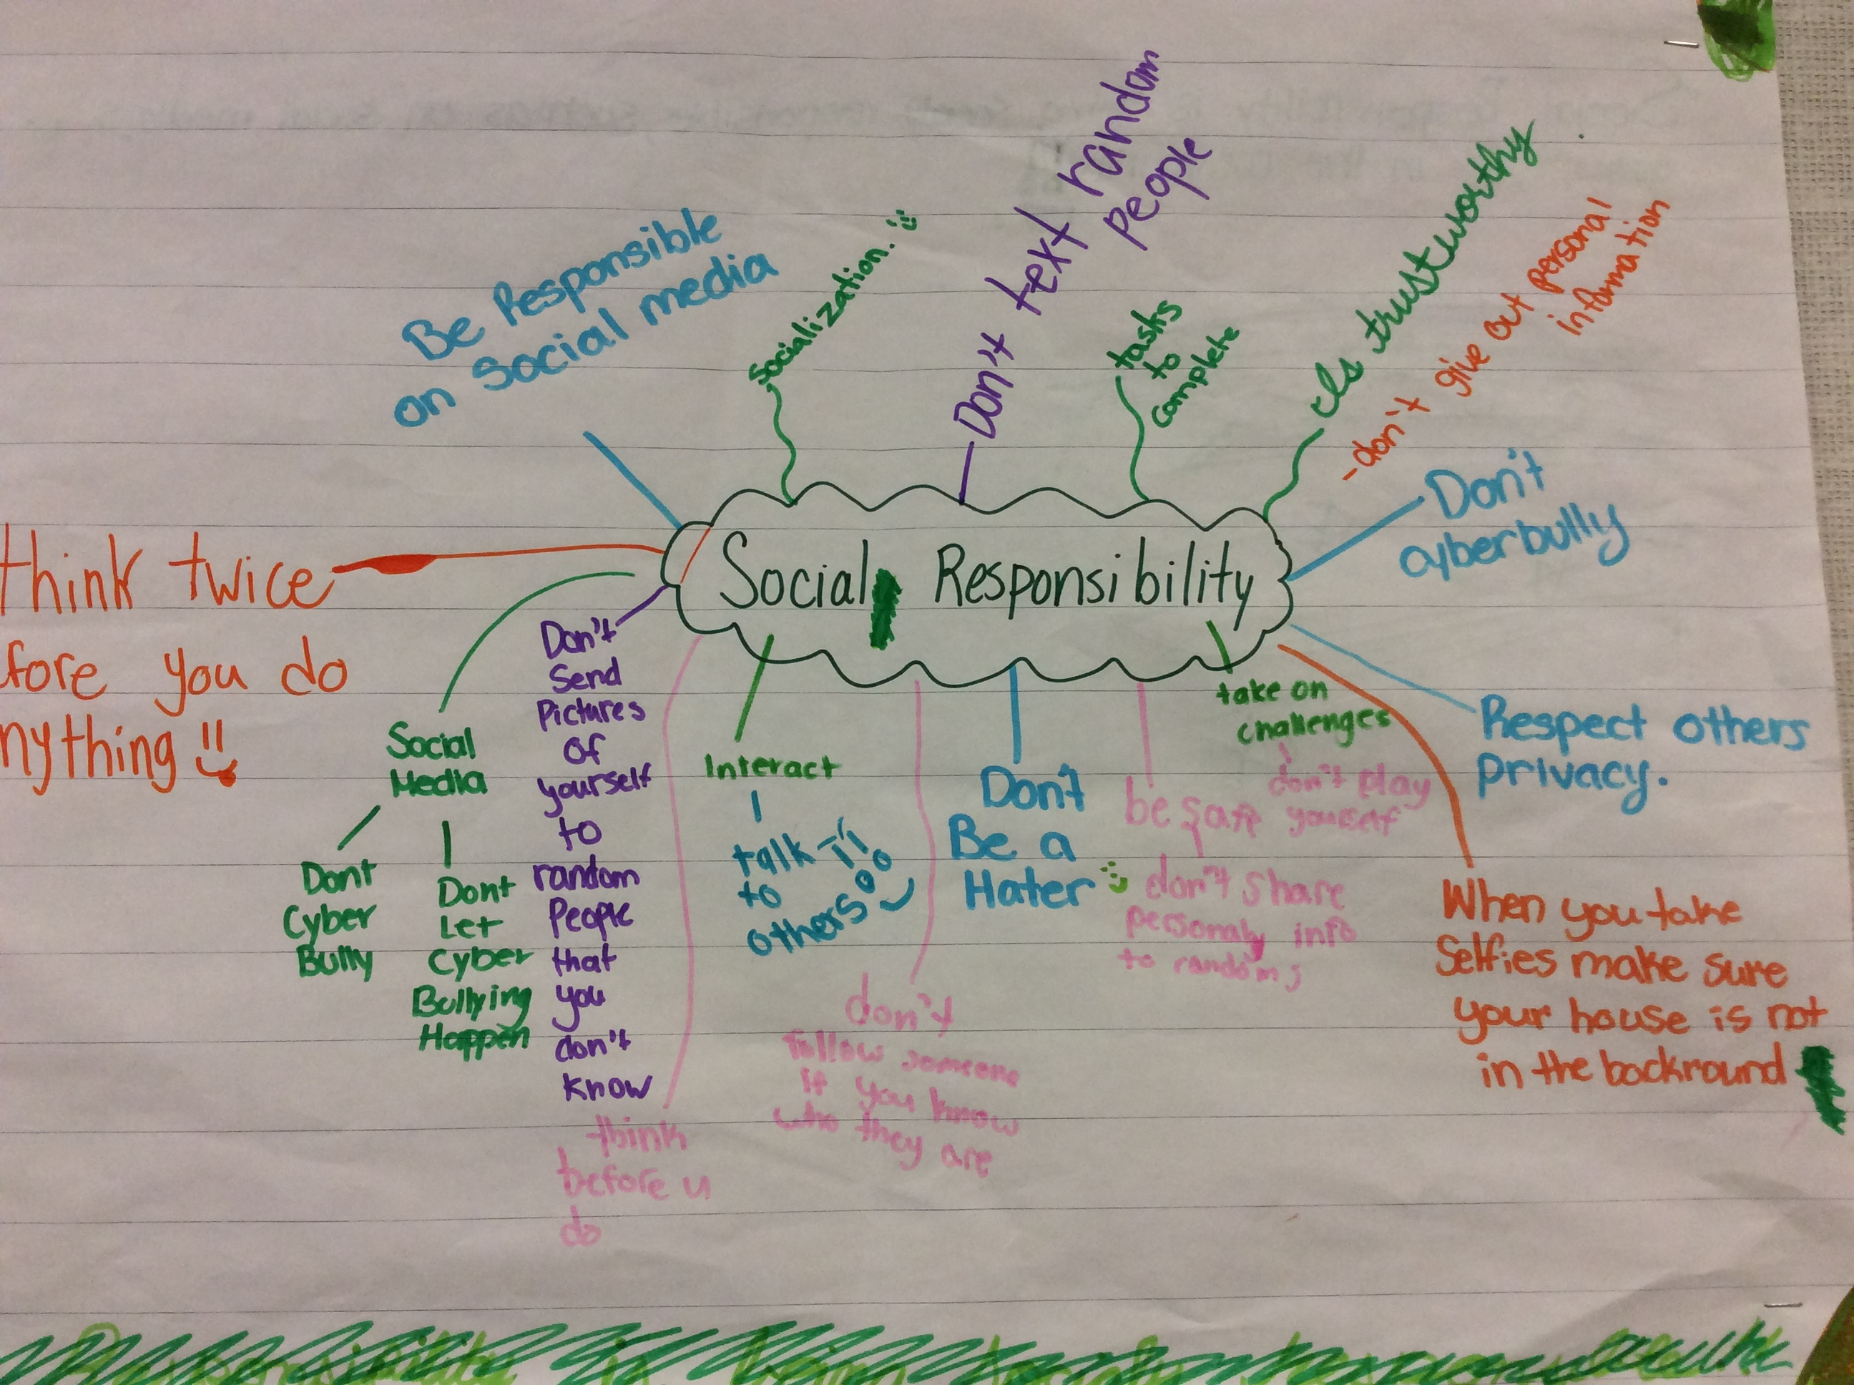

Slide 35
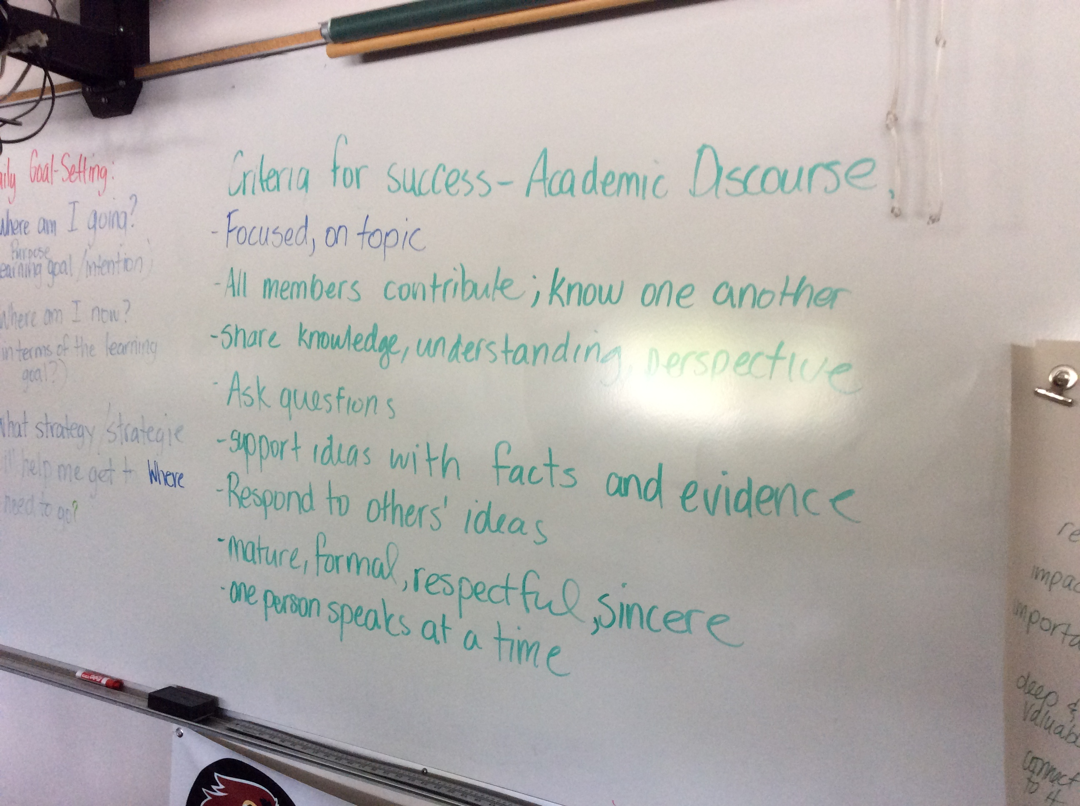

Slide 36
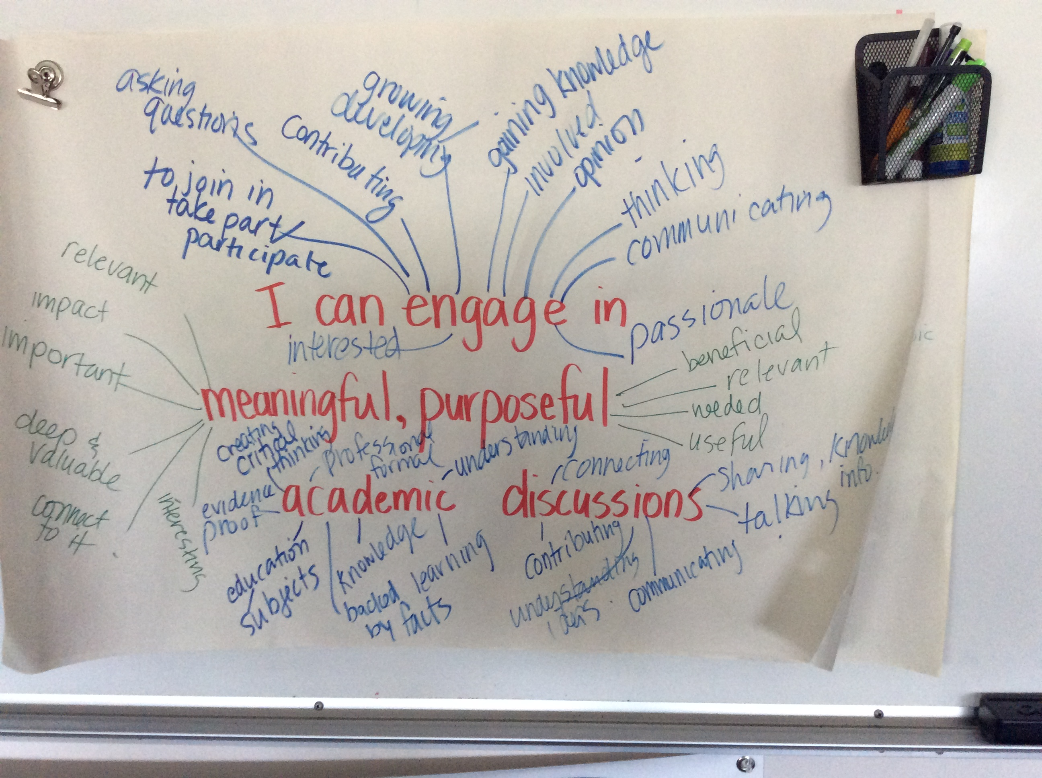

Slide 37


Self Assessing Core Competencies
What do we need to consider and think about?
- Incorporating Core Competencies in my teaching
- Building student ownership and voice
- Ensuring a meaningful process

