Slide 1


Presenters:
Debbie Kooy, School Counselor
Lori Patterson, R. Psych, District Psychologist
Dan Thiessen, School Counselor
MPSD: Mental Health Literacy & High School Curriculum Guide - TRAINING – June 25 & 26, 2019
Developed By:
Dr. Stan Kutcher MD, FRCPC, FCAHS
Dr. Yifeng Wei Med; PhD
Andrew Baxter MSW RSW

Slide 2
Every month has 28 to 31 days, so why does the last month of school seem to have 2689 days! Just me?!

Slide 3
What prompted you to volunteer for this training?
What are you hoping to take away/learn from this training?

Slide 4

Dr. Stan Kutcher
Dr. Stan Kutcher is the Sun Life Financial Chair in Adolescent Mental Health and the Director for the World Health Organization Collaborating Centre in Mental Health Policy and Training at Dalhousie University and the IWK Health Centre in Canada. He is a renowned expert in adolescent mental health and leader in mental health research, advocacy, training, and policy and has been involved in mental health work in over 20 countries.

Slide 5
Practice Support Program (PSP)
Designed by Dr. Kutcher and his team in 2011 to create a wraparound system of care for children, youth, and their families that goes beyond the health care system.
Family Physicians who complete the CYMH module training will work in collaboration with child and adolescent psychiatrists, pediatricians, child and youth mental health clinicians, and school counselors in their local communities.
Identification, diagnosis and evidence-based treatments of mild to moderate cases of Anxiety, Depression and ADHD in children and youth

Slide 6
Mental Health Literacy Curriculum (MHL)
https://youtu.be/VqZE3cgXo58
https://www.straight.com/news/992141/ubc-faculty-education-places-high-premium-mental-health-literacy-future-teachers
Notes:
Training has already occurred in all but 2 school districts in the province.

Slide 7

Mental Health Literacy Training – February 11-13, 2019 (UBC)

Slide 8

Mental Health Literacy Training
February 11-13, 2019
(UBC)

Slide 9

Literacy is the Foundation
Treatments & Care
Health Promotion
Prevention
Mental Health Literacy
Notes:
Mental Health Awareness vs. Literacy
Increasing awareness of mental health and mental illness is rising across Canada. However, awareness without mental health literacy does not lead to improved mental health and better access to mental health care for those who need it. Knowing about something is not the same as knowing something.

Slide 10
Literacy is the Foundation
Ministry of Children & Family Development, CYMH, Physicians, Adolescent Day Treatment Program, START, Psychologist, Counselor, Fraser House
Treatments & Care
Health Promotion
Prevention
Teachers, School Counselor, Fraser House, Programs (Mental Health Awareness Week, Beyond the Blues, etc)
Mental Health Literacy
This training!
Notes:
HEALTH PROMOTION – is also created through the new mental health curriculum. We can help build resilience and teach problem solving skills to deal with everyday stress. We can implement preventative measures to ensure a mental health problem doesn’t escalate into a disorder – (unhealthy environments and relationships CAN escalate disorders).
Mental disorders and illnesses require informed school staff to make quality referrals in order to effectively support students in receiving effective interventions.
*START –Short Term, Assessment, Response, Treatment - Team - is an assessment and intervention program for 6-18 year olds experiencing a mental health crisis in Fraser Health. Mental Health Crisis may include: self-harming, suicidal thoughts or attempts, intense anxiety and depression, distorted thinking, or high risk of significantly harming others. Located in Abbotsford (101, 32555 Simon Avenue)
*Adolescent Day Treatment Program – sub-regional community-based program providing a wide range of individualized mental health services and educational programming for adolescents with acute psychiatric illnesses. Youth aged 13-18 from Abbotsford, Mission, Chilliwack, and Fraser Cascade attend the program four days a week from 9:30am until 3pm for up to five months. Usually on the Friday, they attend their home school. They are provided assessment, interventions (individual, family and group), recreational assessment and activities, and educational assessment and programming. Located in the Abbotsford Regional Hospital.

Slide 11
Mental Health literacy is…
A component of health literacy – very strong independent factor improving health outcomes of populations and people
A foundation for health promotion, prevention and ongoing care
Able to be taught (to teachers and students alike)
Ideally taught in schools (that is what schools do)
A life-long skill that can be used for self, family, friends, others
Notes:
So what is Mental Health Literacy?
It’s a component of HEALTH LITERACY….Health literacy is the degree to which individuals have the capacity to obtain, process, and understand basic health information and services needed to make appropriate health decisions.
It’s a foundation to health promotion and prevention.
It’s a teachable and evidence has shown its best taught in school.
It’s a life-long skill, that you can use for all the people in your life.

Slide 12

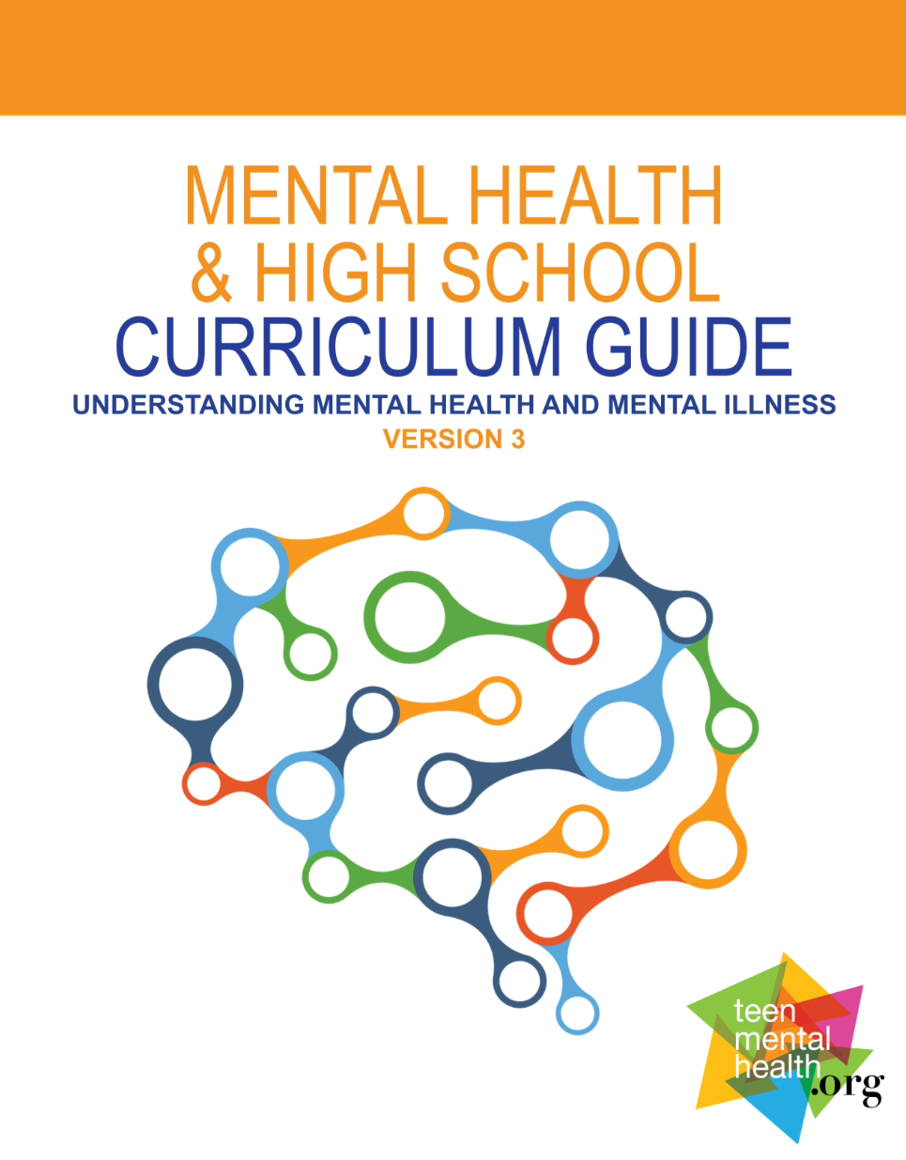

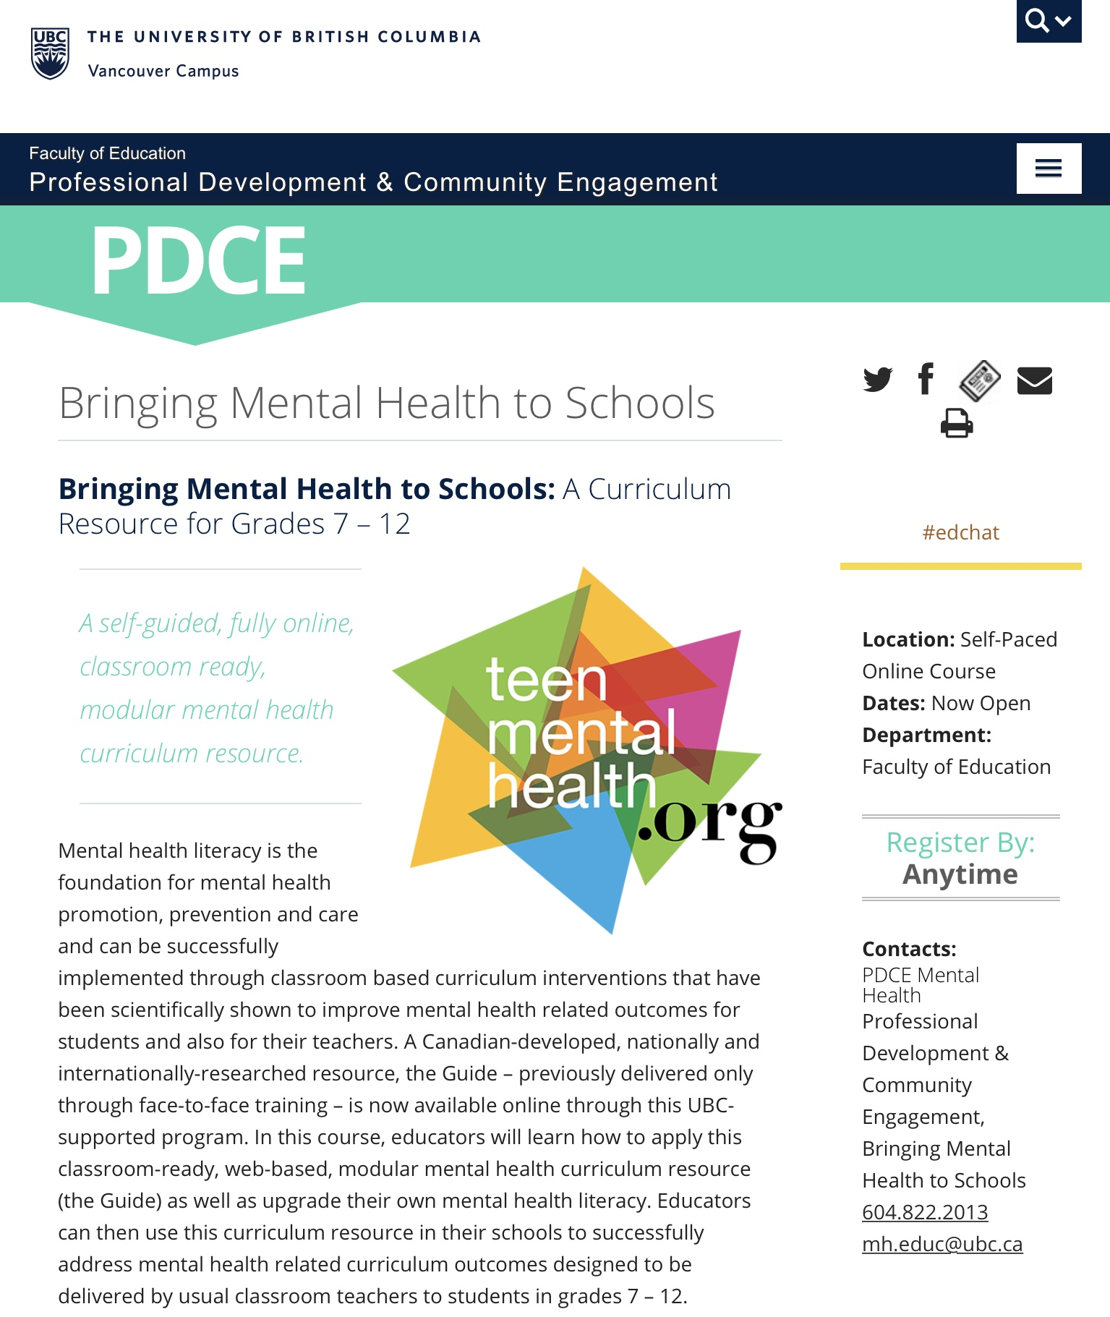

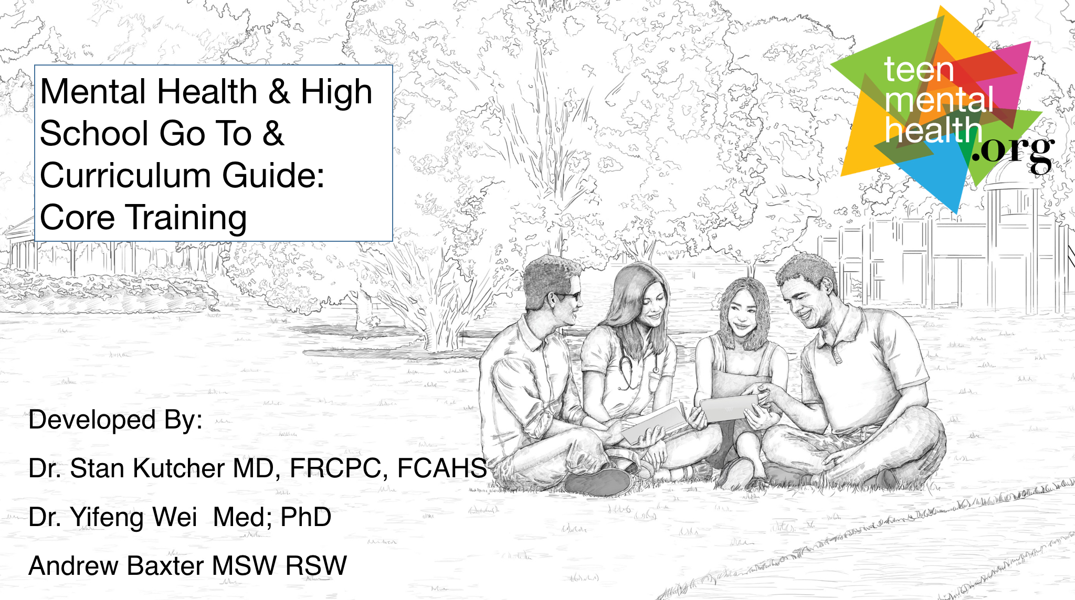

4 Integrated Approaches to Building MHL
Go To Educator
Curriculum Guide Training
Curriculum Guide
Parent MHL Session
Educational Professionals
Classroom Teachers
Students Grade 8 & Up
Parents/Guardians
Notes:
During the first day of training, we will be covering the “Go To Educator” materials, which is essentially the Mental Health Literacy curriculum for educators. The second day we will be covering the curriculum guide. In the fall, we will be implementing the Curriculum to grade nine students.
There is another step in this integrated approach and it is Mental Health Literacy for Parents, but this step will be implemented in future years.

Slide 13
Role of a Teacher
Teach and promote students mental health literacy
Recognize a potential problem
Refer appropriately – linking WITHIN the school
Work effectively in the classroom and with other professionals – support not counseling or therapy
Do not use diagnostic terminology
Do not prescribe/suggest specific treatments (know where to find out about treatments)
Notes:
This training will further develop your skills to teach MHL and you will be able to use these skills to promote students' mental health literacy.
Compared to clinicians and doctors, educators have valuable contextual information. They get to see students across multiple settings and demands (i.e., math vs. PE class) and unlike parents have a large “sample size” of students to compare any individual to and have a strong understanding of age-appropriate behaviors. This along with this training will help you recognize a potential problem.
We will talk about possible referrals sources and who you should be consulting when you recognize a problem.
Mental Health Literacy is not about counseling or therapy, but understanding mental health and mental disorders, so that you can work effectively with students and staff in the school setting.
We encourage you not to use diagnostic terminology, but rather describe the behaviors you see. For example, instead of telling a parent that you think their child is depressed, described the behaviors you see, such as your child seems to have lost interest in activities that used to bring them joy, they are lethargic, frequently tearful, and are withdrawing from all of their friends. This is concerning me. Are you seeing the same things at home?
We will share with you common places children may go to for treatment, but we do not suggest particular treatments to parents and/or students. This is the role of the medical professional , psychologist or counselor that is involved with the child.

Slide 14
What is mental health literacy?

Slide 15
Mental Health Literacy:
The 4 components
Understand how to obtain and maintain good mental health
Understand and identify mental disorders and their treatments
Decrease stigma
Enhance help-seeking efficacy: know where to go; know when to go; know what to expect when you get there; know how to increase likelihood of “best available care” (skills and tools)

Slide 16
Semantic Confusion
mental health
mental health issue
mental illness
mental wellness
mental health illness
mental disorder
mental wholeness
mental and social well-being
mental health condition
mental wholeness
mental wellness illness
mental health problem
mental well-being
mental happiness and well-being
Notes:
All of the words on this slide have been pulled out of academic literature and government documents to describe mental disorders. This slide demonstrates how much confusion there is around the topic of mental health and mental disorders.
BY CALLING MENTAL HEALTH ANYTHING ELSE, WE PERPETUATE STIGMA.

Slide 17
What do these words mean?
Mental Disorder/ Illness
Mental Problem
Mental Distress
No Distress, Problem or Disorder
Notes:
INTRODUCE ACTIVITY. ALLOW 12 MINUTES TO COMPLETE. Break into groups of 4-5. Each group will be given the large piece of paper with the triangle and an envelope with the various words. There are 28 words in the envelope and each word describes various emotional states. The triangle has four levels or states- 1. no distress or problem, 2. mental distress, 3. mental problem and 4. mental disorder/illness. Place each word on the level/state you think it belongs. Will allow about 12 minutes to do this activity and then we will come back and discuss.
Then discuss WHAT DO THESE WORDS MEAN?
MENTAL DISTRESS – is everywhere and unavoidable. It is the expected and usual emotional, cognitive, behavioural, and somatic response of an individual to external or internal stress. It is necessary and promotes life-skills. It also builds resilience. Mental distress is a signal from our brain that we need to adapt to our environment, that there is a problem that we have to solve. When we solve the problem the distress goes away, and we are left with a new skills that we can use to help us solve further problems. Mental distress is necessary for growth and development. Mental distress doesn't require medical TREATMENT.
MENTAL HEALTH PROBLEMS – Also arise in response to an environmental stressor, but one of significantly greater magnitude, such as loss of a loved one, loss of a job, immigration, etc. When faced with such a large stressor our capacity to deal with it may be overwhelmed for a time. This doesn’t mean there is an illness. On the contrary, what we are experiencing is an expected response to a significant stressor. Mental problems are an indicator that we are having difficulties adapting to the environment and may need external help (e.g., counseling, additional family and/or community support). Can think of it as a substantial and persistent mental distress leading to functional impairment but not meeting diagnostic criteria for a mental disorder.
MENTAL ILLNESS – occurs when there is a disruption in usual brain functions. . It can often occur regardless of environmental factors. But is often the result of complex interaction between the environment and genetics/epigenetic factors
IT IS ESSENTIAL TO NOTE THAT PEOPLE CAN HAVE GOOD MENTAL HEALTH AND A MENTAL ILLNESS AT THE SAME TIME. A PERSON WITH DEPRESSION (A MENTAL ILLNESS) CAN HAVE GOOD MENTAL HEALTH WHEN THE DEPRESSION IS APPROPRIATELY TREATED AND MANAGED.
PEOPLE CAN ALSO BE IN MORE THAN ONE CATEGORY OF THIS TRIANGLE AT ONE TIME. FOR EXAMPLE, A PERSON WITH ADHD (A MENTAL DISORDER), CAN BE GRIEVING THE DEATH OF HIS DOG (A MENTAL PROBLEM), AND HAVE A DIFFICULT HOMEWORK ASSIGNMENT DUE THE NEXT DAY (MENTAL DISTRESS).
Hand out the LANGUAGE MATTERS sheet and ask them to check how they did with placing the words on the triangle.

Slide 18

Clarity is essential:
“Depression”
Mental Disorder/ Illness
Depressed
Mental Problem
Demoralized, Disengaged, Disenfranchised
Mental Distress
Unhappy, Disappointed, Disgruntled
Notes:
Depression is used as an example to express the importance of clarity when using terms related to diagnosed illnesses. Using the right language for each of these states is essential. Watch out for pathologizing clinical words.

Slide 19
Events and Adjectives on the Pyramid
Mental Disorder/ Illness
None required
Depression
Parent dies
romantic breakup
lost my job
Mental Problem
Grief, Devastation, Demoralization
Mental Distress
Agitated, Disappointed, Nervous
Lost Keys
Going on a first date, didn’t make the team
Notes:
Watch out for pathologizing clinical words

Slide 20
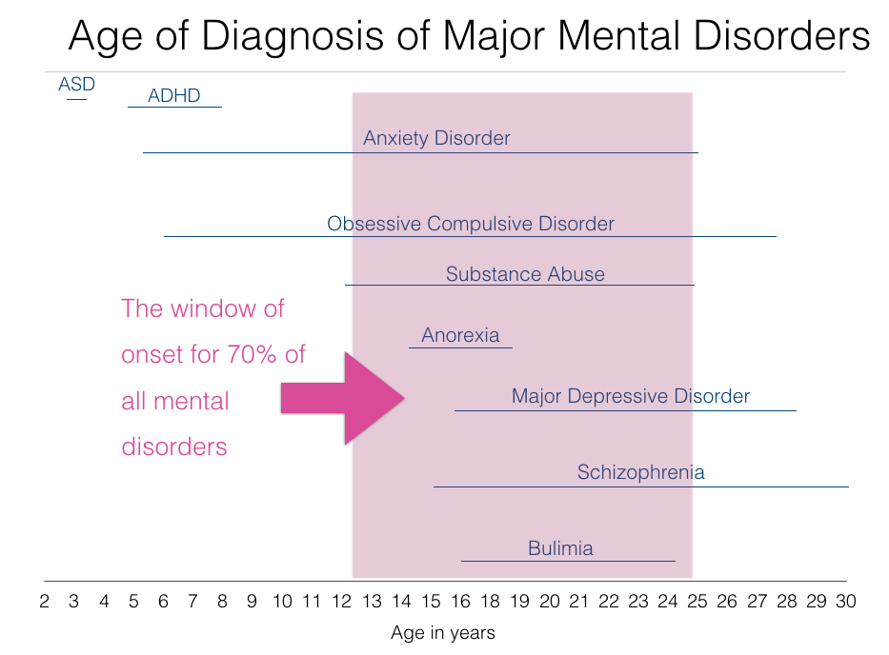
Notes:
Adolescence is a period during which many mental disorders, such as schizophrenia, bipolar disorder, depression and anxiety disorders appear.
Mental Disorders are illnesses of the youth
Someone at a previous presentations asked about the length of the line for each disorder. So lets look at the ADHD line or onset line. Onset for ADHD is somewhere between 5 to 7 years of age. This means if a teenager starts to present with symptoms of ADHD at the age of 15 but did not have symptoms before that time. And when clinical history is obtained the youth did not exhibit the typical symptoms present at age 5, then it is not likely the child has ADHD and it is likely another disorder is present and masks as ADHD. For example, a child experiencing abuse or trauma may look like a child with ADHD. Or a child with significant anxiety may look like a child with ADHD.
All of these disorders are life-long. They are not just present for this window of onset. This is just when it first presents and then when it develops, it continues in the child’s life span.

Slide 21
The Language of Stress
Equilibrium
Stressor
Stress Response
Anxiety
Anxiety Disorder
Fear
Trauma
In an ideal situation:
Stressor - stress response - ADAPTIVE SOLUTION - decrease in stress response - skill learned – resilience is built
Notes:
But we know that life is often not ideal.

Slide 22
Typology of Stress
Positive: relatively brief, leads to adaptation and learning, does include negative emotional, physical, behavioral and cognitive states.
Tolerable: serious impact, temporary, buffered by supportive relationships.
Toxic: Prolonged and extreme – abuse, chronic neglect, violence; without adequate adult and caregiver support.
Do not confuse positive or tolerable stress with toxic stress
Harvard Center for the Developing Child: https://developingchild.harvard.edu/science/key-concepts/toxic-stress/
Notes:
Here’s the kicker. For people who are experiencing toxic stress, events that should result in tolerable stress quickly become intolerable. In these cases, people often cannot distinguish a real tiger from a paper tiger. Situations that should be a 2 are often perceived as an 8.
Teaching distress tolerance is what is needed but how we teach it will differ than for people who haven’t or aren’t experiencing toxic stress.
Tolerable stress is tricky because what if it feels like it is becoming intolerable but it is not toxic.

Slide 23
Stress in our Modern Society
The enemy of a healthy life
The driver for selling products
We now get stressed about stress
Notes:
When we are talking about tolerable stress, it doesn’t have to be bad. In fact, it isn’t. We can frame things in a “growth mindset” and look at stress as a stimulus to change, like motivation.
The stress response drives learning. We don’t always get things correct the first few times we attempt - stress is a necessary biological component to help us focus and overcome difficulties.
Stress can be an ally.
Many people are familiar with the stress response “fight or flight” – less discussed is another stress response: excite and delight. Our response to stress helps us solve problems, leading to adaptive solutions.

Slide 24
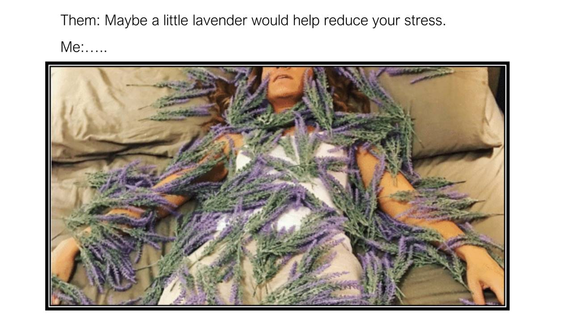

Slide 25
Media’s Message about Stress
Ziploc bags and cafeteria chaos:
www.ispot.tv/ad/7ia5/ziploc-easy-open-tabs-cafeteria-chaos
Stress Free Kids:
http://greatergood.berkeley.edu/raising_happiness/post/managing_stress.
Stress Free Birthday Parties:
http://www.wikihow.com/Organize-a-Stress-Free-Kid's-Party.
Notes:
Distress tolerance is equally as important as stress prevention/reduction.

Slide 26
Inverted U-shaped relationships between arousal and performance
Good
Maximum Performance
Performance
Poor
Low
(Under aroused)
Moderate
(Optimally aroused)
High
(Over aroused)
Emotional Arousal
Hebb, D.O. (1955). Psychological Review, 62, 243-254
Notes:
In baseball, people refer to hitting the ball on the "sweet spot" of the bat. And, if you find that sweet spot, you don't even need to hit the ball super hard to hit a homerun. The same applies to stress and arousal. Somewhat tense and nervous is required to get maximum performance but too much is counterproductive.
Some students need a kick in the pants and some need to be calmed
Some students interpret normal level of arousal as anxiety

Slide 27
High
Exposure after avoidance
First Exposure
Anxiety
Exposure after practice
Low
Time
Notes:
Avoidance and withdrawal is really good at dealing with unpleasant arousal, however it actually just increases the anxiety.
You can habituate yourself over time by going through the event, repetition can help ease anxiety and increase habituation.
Avoidance is generally seen as negative. But, the same action using a different term, retreating, can be positive if:
It is used as a temporary method to regain emotional control/equilibrium
It is accompanied with cognitive and other strategies to re-engage with the stressful situation (eg. Relaxed breathing, progressive muscle relaxation, positive self talk etc.)
It is not the only strategy one uses to deal with uncomfortable situations. Sometimes, challenging oneself in the moment to face your stress head on can be affirming and confidence boosting

Slide 28
Compare that to this…
https://www.youtube.com/watch?v=RcGyVTAoXEU
Notes:
Positive or Tolerable stress is actually good for us. While this is true, some people are by nature more optimistic and some less; some people tend to be worriers and others more easy going; some people are risk takers and others are more cautious. The unique and complex combination of personality, life experiences, childhood environment all contribute to create an individual. This is why what seems intolerable to some people can be tolerable to others, why some people seem more resilient than others when faced with similar challenges.
So, while tolerable stress is actually a positive, we want to be careful in two ways: 1) confusing tolerable stress with toxic stress and 2) unintentionally minimizing someone else’s suffering by not validating their experience of their stress. The most effective way to mitigate these two outcomes is to establish safe and trusting relationships. Within the context of a safe and trusting relationship, people can relax and feel confident to face a fear and view their stress differently. Those of you who know me know I am fond of saying “We earn the right to challenge people to the degree that we have supported them”. This is definitely true in trying to help people view tolerable stress as positive in their life.
“Chasing Meaning is better for your health than trying to avoid discomfort in your life.”
“Connecting with others while experiencing stress creates resilience”

Slide 29
Useful Approaches to Tolerable Stress
Understand the Stress Response, its purpose and its various levels
Interpret the stress response as positive, not negative. A challenge to be faced. A problem to be solved.
Identify the problem that needs to be solved. Consider how to solve the problem. Seek assistance and help of others.
Modulate the apex of the stress response. Use simple and effective breath-holding and “centering” progressive muscle relaxation techniques

Slide 30
Mental Health and Stigma:
Quiz Time
https://www.time-to-change.org.uk/mental-health-quiz

Slide 31
Mental Health Stigma: What is it?
Simply put, stigma is a negative stereotype based on myths like:
People with mental illness are crazy
Mental Illness is caused by a personal weakness
Mental Illness is rare
People with a mental illness are violent
People with a mental illness should be hospitalized or locked up
People with a mental illness are lazy and just need to try harder
Notes:
Mental illness is typically not cured, it is managed much like diabetes
Email Andrew for data/research to support this

Slide 32
Public Stigma
Stereotype (belief) – All people with mental illness are dangerous
Prejudice (feeling) – I agree, people with mental illness are dangerous and I am afraid of them.
Discrimination (action) – I do not want to be near them so I won’t hire them
Source: “How Stigma Interferes With Mental Health Care” – Patrick Corrigan, American Psychologist, 2004, Vol. 59, No. 7, 614–625
Result: 40% of people with mental illness avoid treatment and label to escape public stigma (https://www.camh.ca/en/driving-change/addressing-stigma)
Notes:
A stereotype is a societal generalization that is based on a truth but is expanded by unproven assumptions
A prejudice is a personal belief based on a stereotype.
Discrimination is action towards an individual or group of individuals based on prejudice.
“One of the reasons for this disconnect is stigma; namely, to avoid the label of mental illness and the harm it brings, people decide not to seek or fully participate in care. Stigma yields 2 kinds of harm that may impede treatment participation: It diminishes self-esteem and robs people of social opportunities.” Patrick Corrigan, Professor of Psychology (http://www.academia.cat/files/425-8237-DOCUMENT/Howstigmainterfereswithmentalhealthcare.pdf)

Slide 33
Stigma: The Shocking Facts
Due to Mental Health Discrimination:
54% of youth feel they cannot hang out with their friends
40% of youth feel that could not attend school
26% of youth have said that negative reactions from others had made them want to give up on life
90% of youth feel that they are prevented from doing things that they enjoy
Source: https://parentinfo.org/article/tackling-stigma-about-mental-health-for-young-people
Notes:
55% of parents have never spoken to their children about mental health
Many people report that the discrimination they feel is often harder to deal with than the mental illness itself.
“One of the reasons for this disconnect is stigma; namely, to avoid the label of mental illness and the harm it brings, people decide not to seek or fully participate in care. Stigma yields 2 kinds of harm that may impede treatment participation: It diminishes self-esteem and robs people of social opportunities.” Patrick Corrigan, Professor of Psychology (http://www.academia.cat/files/425-8237-DOCUMENT/Howstigmainterfereswithmentalhealthcare.pdf)
“Stigma experiences have caused hurt, anger, discouragement, and lasting damage to self-esteem. They have led many consumers to conceal their psychiatric histories from others, to withhold information on applications for jobs and licenses, and then to be burdened with chronic fear of disclosure in addition to the pain and stress of their illnesses. Experiences have led many consumers to maintain a secrecy that not only is uncomfortable but also may contribute to the very symptoms—anxiety, depression, paranoia—from which they are struggling to recover. Moreover, fears about stigma appear to result in reluctance to apply for jobs, education, or insurance or even to seek treatment. In making productive work less available, in limiting treatment resources (e.g., insurance) and discouraging treatment-seeking, in contributing to social isolation, and in generating nagging fears about disclosure and community rejection, stigma experiences have produced conditions antithetical to the goals of recovery.”
https://academic.oup.com/schizophreniabulletin/article-abstract/25/3/467/1849492 by guest on 16 May 2019 Schizophrenia Bulletin, Vol. 25, No. 3, 1999 O.F. Wahl

Slide 34
Mental Health Stigma Busters!
Most youth with mental disorders will go on to be successful at school and live productive and positive lives when receiving proper treatments for their mental illness.​
Some youth have severe and persistent mental disorders which respond poorly to current treatments (as in all other illnesses) and may require greater supports.​
Mental illness does not respect any boundaries of race, class or geography – poverty does not cause mental illness but it can have negative impact on outcomes.
Notes:
Mental illness is typically not cured, it is managed much like diabetes
Email Andrew for data/research to support this

Slide 35
Stigma Busters Continued
Young people with mental illness are more likely to be victims not perpetrators of violence.
Youth with mental illnesses have difficulty accessing best possible health care and face substantial stigma socially and in school.
Early identification and provision of best evidence treatments and social and educational support can substantially improve outcomes.
Notes:
If someone with a mental illness harms anyone, it almost always is directed towards themselves not others. Self harm or suicide not homicide is the norm.

Slide 36
Mental Health Stigma Buster Videos
https://www.youtube.com/watch?v=49mfPFTZsHs
https://www.youtube.com/watch?v=BHSonXBZOwI
https://www.youtube.com/watch?v=pnqfc_QipqI
https://www.youtube.com/watch?v=lj-VgcsV_gI

Slide 37
Stigma Buster Resources
https://www.camh.ca/en/driving-change/addressing-stigma
https://www.mendthemind.ca/stigma/top-11-myths-about-mental-illness/
http://www.health.wa.gov.au/docreg/Education/Population/Health_Problems/Mental_Illness/Mentalhealth_stigma_fact.pdf

Slide 38
“The single most important barrier to overcome in the
community is the stigma and associated discrimination
towards persons suffering from mental and
behavioural disorders.”
- The World Health Organization

Slide 39
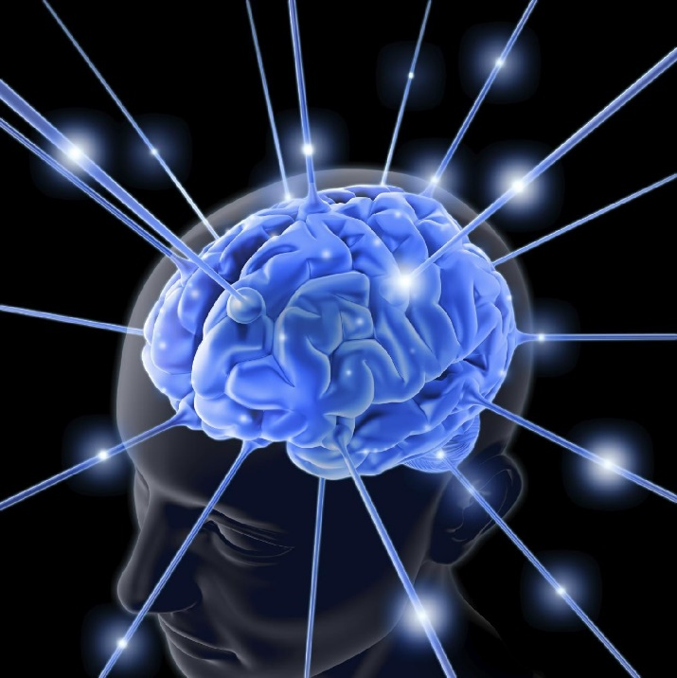
Brain Growth & Development
Significant brain growth and development occurs during adolescence, and continues into the twenties. Some studies show that this growth and development extends to the age of 30!
Notes:
The brain doesn’t stop developing until the late 20s or early 30s. This may take even longer in men than in women.
In some ways, the brain is never fully developed because it is constantly reshaping to meet the demands of everyday life, as well as being shaped in part by its current environment. There is a complex and continuing bi-directional interaction between brain development and environment that persists across life span.
During adolescent years, brain circuits become better functioning and more efficient.
There is rapid brain development during adolescence.
Drugs, alcohol, and head injuries can disrupt this development. Nevertheless, the brain is surprisingly resilient.
Cannot predict for any individual how environment or genetics will affect the brain.
We do know that good social relationships help improve growth and development.

Slide 40
Proliferation of Grey Matter Through Development
.
.
Lenroot & Giedd (2006)
Notes:
This image is the brain developing over time. The purple color represents areas of high connection (meaning high development) and red is low connection (low development).
The brain develops from the back to the front (generally) and the brain is not completely developed until later in life. The final section of the brain to mature is the pre-frontal cortex which is responsible for “higher-order” functions of cognition such as complex problem solving and moral reasoning and executive functioning.
Linking of different brain areas (such as the limbic system and prefrontal cortex) also improves during these years. And these linkages result in better brain functions. These linkages are not shown on this slide as they are referred to as “white matter”.
Researchers suggest that a mismatch of maturation timing between the limbic system – which is the where the subcortical structures meet the cerebral cortex and are involved in motivation, emotion, learning and memory. Include the hypothalamus, hippocampus, the amygdala, etc. - maturation of the limbic system takes place in early adolescence and the later developing prefrontal cortex is what makes adolescents more prone to risk-taking behaviors, but also promotes creativity and more flexible adaptation to their environment.
THE TEEN BRAIN IS DIFFERENT THAN THE ADULT BRAIN.

Slide 41

Identification May Be Difficult in the School Setting
The “presentation” of the illness may be different at different times
If a student is using drugs or alcohol the effects of those substances can be confusing
Sometimes the student does not share the symptoms (such as low mood or hallucinations)
Sometimes the student is not known to the teacher
Notes:
OVERARCHING MESSAGE: We have to make sure that we don’t hide from addressing mental disorder (THE OSTRICH), we can’t over respond to it (THE SKY IS FALLING), and we have to make sure we have accuracy in identification (WE DON’T WANT TO CRY WOLF WHEN THERE ISN’T A DISORDER).
Factors that hinder identification of a mental disorder in a school setting are:
The illness may present differently at different times; we may not always see the same thing
If the student is using drugs it may be difficult to get a baseline on the student’s typical functioning
Student may not want to talk about their symptoms for fear of “sounding crazy”.
In high school, students may not spend a lot of time with any one teacher so identification may be challenging

Slide 42
Mental Disorders:
Symptoms + Impairment
Disorder
Amount
Symptoms
Impairment
Time
Notes:
Symptoms start before the functional impairment of an illness.
Impairment and symptoms reach a point where an individual would qualify for a diagnosis.
Any point below the red circle (where we have some symptoms and some impairment but not enough to consider a diagnosis) we can consider as the prodomal period.
A prodrome is an early symptom (or set of symptoms) that might indicate the start of a disease before specific symptoms occur. It is derived from the word “precursor”.
It is important to remember that many people who show prodomal features do not develop a mental disorder. May indicate the child is "at-risk" for developing a mental disorder if there is not intervention.
Just like arrhythmia and chest pains may be the prodromal phase of heart disease, but not everyone that has arrhythmia may go on to develop heart disease.

Slide 43

Identification Keys
Is the student previously known to have significant mental health problems or a mental disorder? (family member)
Has there been a recent significant change in mood, cognition, behavior? Or is the youth known to have a mental disorder that continues – ADHD?
Are the person’s problems causing distress to them or to others or is there a lack of social convention?
Has there been a noticeable decrease in functioning: social, academic, other?
Are there substantial and unexplained major changes in peer group participation – especially peer group “slide”?
Are parents or others raising concerns?
Does a close friend have a mental disorder or a major mental health problem?
Has there been a recent head injury (concussion)?
Notes:
Ascertaining The Likelihood of a Mental Disorder
It is important to note that these are questions for the clinician, whether it is the doctor, psychologist or mental health therapist – this is what they need to address and answer. It is not the educator’s job, however these features should be kept in mind by teachers to help them identify youth with a high probability for having a mental health disorder.
When addressing the question of – Is the patient likely to have a psychiatric diagnosis? – the clinician must consider the following questions. A “yes” to two or more of these questions should raise the probability that the patient may have a psychiatric disorder and should then trigger the next steps in the diagnosis and intervention cascade available within the health care system.
Questions to consider when determining whether or not the patient is likely to have a Mental Disorder -
1. Does the child have a history of mental health problems or is their family history of mental illness?
2. Has there been a recent and significant change in mood, cognition or behavior?
3. Is the child distressed by their problems? OR Does the child exhibit a lack of social convention that he/she is unaware of?
4. Has there been a noticeable decline in functioning?
5. Has there been a major and unexplained change in peer group participation?
6. Are parents concerned?
7. Does a close friend have a mental disorder or a major mental health problem?
8. Has the child had a recent head injury?

Slide 44
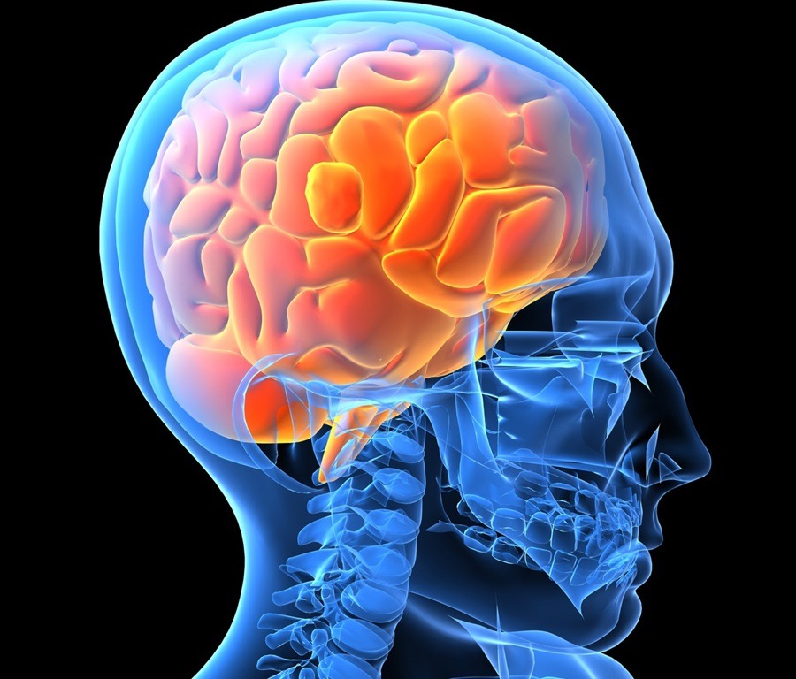
Mental Disorders are Brain Disorders: Overview of Common Mental Disorders

Slide 45

Mental Disorders of Cognition and Perception: Psychosis

Slide 46
What are Delusional Beliefs?
False
Persistent
Not shared by others of same socio-cultural group
Regarded as real and held with conviction despite being given ample evidence to the contrary
Must be evaluated from within socio-cultural context
Notes:
WHAT ARE DELUSIONS??
Delusions are fixed, unbending beliefs that are incompatible with the beliefs held by the majority of people in the individual’s culture or subculture. These beliefs are held with rigid conviction despite obvious evidence of their falsehood.
False … NOT REAL!!!
Persistent … DON’T GO AWAY!
Not shared by others of same socio-cultural group… FAMILY & FRIENDS FIND IT ODD
Regarded as real and held with conviction despite being given ample evidence to the contrary… NO PROOF IS ENOUGH!!
Must be evaluated from within socio-cultural context ... NOT IN LINE WITH CULTURAL BELIEFS
Examples of Types of Delusions:
Some of the more common types of delusions are grandiose, persecutory, religious, jealous and somatic delusions.
Grandiose: Delusions of inflated worth, power, knowledge, identity, or special relationship to a deity or famous person
Persecutory Delusions: Delusions that the person is being malevolently treated in some way
Religious: Individual’s beliefs revolve around religious themes (e.g., belief that he/she has been selected by God to carry out his bidding).
Jealous: Delusions that the individual’s sexual or romantic partner is being unfaithful
Somatic: Delusions that the person has some physical defect or general medical condition

Slide 47

Disturbance in Thought Content
Unreal?
Real?
Appropriate?
Excessive?
Collin Knopp-Schwyn
Notes:
When we have a disturbance in thought, we may have a delusional belief.
This is often a symptom in many mental illnesses, not just the most commonly thought disorder of psychosis. For example, youth with Eating Disorder have a disturbance in how they view their body and it is very common for youth with social anxiety disorders to think others are talking about them in a social gathering.

Slide 48



Disturbances of Perception
Normal
Illusion
Hallucination
Notes:
Top line: A person looks and sees leaves and there are leaves. This is normal.
Middle Line: A person looks at the leaves and sees faces – THAT IS AN ILLUSION.
Bottom Line: There is nothing there and the person sees leaves. THIS IS A HALLUCINATION. HALLUCINATIONS CAN BE IN ANY SENSORY MODALITY AND ARISE SPONTANEOUSLY FROM WITHIN THE BRAIN WITHOUT ANY EXTERNAL STIMULI.

Slide 49
Some psychotic symptoms are normal
              Occasional hallucinations such as hearing voices is common (usually a person’s name) and can occur with: excessive stress; sleep deprivation; when going to sleep or waking up from sleep
              Unusual or “bizarre” ideas can be a reflection of great creativity, or cultural/religious beliefs
Notes:
Remember that hallucinations & illusions can at times happen in the healthy brain. For example, optical illusions or seeing a person who has died while grieving.
Keep in mind: hallucinations are somewhat normal. Its common to think you hear someone call your name.
Being UNABLE to distinguish if things are REAL or NOT –is a psychotic symptom

Slide 50
Psychosis: What to look for?
Is the person acting differently and in a comparatively unusual or “strange” manner?
Does the person show signs of or admit to hallucinations?
Does the person show a thought form disorder – does his or her speech make sense?
Is the person isolating from others?
Is the person espousing bizarre and unusual ideas?
Has there been a gradual decline in many areas of functioning?
Notes:
Psychotic episodes rarely occur out of the blue. Almost always, a psychotic episode is preceded by gradual non-specific changes in the person's thoughts, perceptions, behaviours, and functioning. The first phase is referred to as the prodrome (or prodromal) phase. During this period the person starts to experience changes in themselves, but have not yet started experiencing clear-cut psychotic symptoms.
Types of changes in feelings, thoughts, perceptions and behaviours include:
difficulty screening out distracting information and sensations.
difficulty focusing or understanding what they are hearing
changes in perceptual experiences - visual experiences may become brighter or sounds louder
feeling overloaded
finding it harder to keep track of what they are thinking and what others are saying.
feeling disconnected
desire or need to be alone
sleep disturbances
depressed mood
irritability
suspiciousness
unexplained difficulty at/skipping school or work
The prodrome cannot be "diagnosed" until after psychosis has developed. Up until that point even professionals can only have a hunch that the changes may be the start of psychosis.
Psychosis is a syndrome or group of symptoms. Someone experiencing an episode of psychosis is having a ‘break’ with reality.
Major symptoms of psychosis are hallucinations and delusions.
Hallucinations are sensations that are not real, such as hearing voices or sounds that aren’t real. Hearing voices is a common hallucination, but hallucinations can be experiences with any sense—hearing, sight, smell, taste, or touch.
Delusions are strong beliefs that can’t possibly be true. Common delusions include the belief that someone is following or monitoring you, or the belief that you have extraordinary powers or abilities.
Other symptoms of psychosis include difficulties concentrating, completing tasks, or making decisions. Thoughts may feel ‘jumbled’ or confused. Some people have a hard time following conversations or speaking clearly. Psychosis can even affect the way people move or express their emotions.
Use of marijuana or other street drugs may trigger psychosis in some individuals who are at risk for developing psychosis.
The onset of symptoms of psychosis varies from person to person. The symptoms may appear abruptly but most often evolve and worsen over a period of months.
The most common age when symptoms of psychosis first begin is 18-24 years old, but can vary dependent on individual circumstances with the majority of cases first occurring between ages 13-30. Males tend to have earlier onset than females by an average of one or two years.

Slide 51
Psychosis: What to do
Discuss concerns with other teachers and student support staff.
Investigate the family situation and discuss concerns with appropriate family members.
Suggest youth seek mental health assessment immediately.
Provide mental health assessors with needed information following appropriate consent provision.
Participate in discussions with young person, health providers and family about school related issues – modification of school/academic activities.
Clarify role of school with regards to potential crisis situations
Notes:
Describe the behaviors you are seeing at school. Are other teachers also seeing the same behaviors?
Consult with the school counselor. If the student is presenting with symptoms of psychosis, then the family should take them to the hospital for immediate care.
For Mission residents – assessment/evaluation can be obtained through the Early Psychosis Intervention Program located at the Abbotsford Regional Hospital.
Family members can call the EPI and get information, book an assessment, or find out about treatment.
Another resource: 310 Mental Health Support (310-6789 – no area code needed) is the toll-free access for crisis or mental health support, information and resources. It is available 24/7/365 throughout BC.
Remember to not be confrontational with the student. Instead the message should be “I am really concerned that you are experiencing that, I think we need to get you help”.
Don’t argue with the delusional beliefs or deny the hallucinations.
Last point, ask for clarification from medical professionals about the role of the school in regards to potential crisis situations.

Slide 52
Psychosis and Treatment
Medications can help with numerous symptoms.
Additional psychological, social, education/ vocational interventions usually needed.
Family engagement is necessary.
Academic adaptations and/or modifications needed.
Treatment must be through specialty services
Hospitalizations common
Notes:
For Mission residents – treatment can be obtained through the Early Psychosis Intervention Program located at the Abbotsford Regional Hospital.
Being able to treat psychosis early is very important, since it usually first appears during a very critical stage of a young person's life. Adolescents and young adults are just starting to develop their own identity, form lasting relationships, and make plans for their careers and future. A successful recovery enables young people to continue with their development and a healthy, productive future.

Slide 53
What is Schizophrenia?
Schizophrenia is the most common of the psychotic disorders. It is a chronic, severe, and disabling brain disorder characterized by the presence of delusions, hallucinations, disorganized thinking, disorganized behaviour, disturbances in affect, disturbances in initiation and motivation (avolition), and functional impairment.
Affects 1% - 1.5% of individuals
Men and Women are equally affected
Usually begins between ages 14 and 25 years
Notes:
Schizophrenia is a mental illness that causes psychosis, but schizophrenia also has other symptoms. And it isn’t the only cause of psychosis. In some cases, other mental illnesses cause psychosis, including depression, bipolar disorder, dementia and borderline personality disorder. Psychosis may come up during times of extreme stress, a major lack of sleep, or trauma. People who are using or withdrawing from certain drugs or medications may experience psychosis. Psychosis may also be caused by a brain injury, neurological problem, or other health problem. So while psychosis can be a part of schizophrenia, it can be caused by many other things too.
Symptoms of Schizophrenia are divided into two categories: positive and negative.
"Positive' symptoms are changes in thoughts and feelings that are "added on" to a person's experiences (e.g., paranoia or hearing voices). "Negative" symptoms are things that are "taken away" or reduced (e.g., reduced motivation or reduced intensity of emotion).
Schizophrenia
Schizophrenia is a mental illness which affects one person in every hundred.
Schizophrenia interferes with a person’s mental functioning and behaviour, and in the long term may cause changes to their personality.
The first onset of schizophrenia is usually in adolescence or early adulthood. Some people may experience only one or more brief episodes of psychosis in their lives, and it may not develop into schizophrenia. For others, it may remain a recurrent or life-long condition.
The onset of the illness may be rapid, with acute symptoms developing over several weeks, or more commonly, it may be slow, developing over months or even years.
During onset, the person often withdraws from others, gets depressed and anxious, and develops unusual fears or obsessions.
What are the symptoms of schizophrenia?
Positive symptoms of schizophrenia include: DO HOT DOGS GET NERVOUS? (Delusions, Hallucinations, disorganized speech, grossly disorganized behavior, negative symptoms)
Delusions – false beliefs of persecution, guilt or grandeur, or being under outside control. These beliefs will not change regardless of the evidence against them. People with schizophrenia may describe outside plots against them or think they have special powers or gifts. Sometimes they withdraw from people or hide to avoid imagined persecution.
Hallucinations – most commonly involving hearing voices. Other less common experiences can include seeing, feeling, tasting or smelling things, which to the person are real but which are not actually there.
Thought disorder – where the speech may be difficult to follow, for example, jumping from one subject to another with no logical connection. Thoughts and speech may be jumbled and disjointed. The person may think someone is interfering with their mind.
Other symptoms of schizophrenia include:
Loss of drive – when the ability to engage in everyday activities such as washing and cooking is lost. This lack of drive, initiative or motivation is part of the illness and is not laziness.
Blunted expression of emotions – where the ability to express emotion is greatly reduced and is often accompanied by a lack of response or an inappropriate response to external events such as happy or sad occasions.
Social withdrawal – this may be caused by a number of factors including the fear that someone is going to harm them, or a fear of interacting with others because of a loss of social skills.
Lack of insight or awareness of other conditions – because some experiences such as delusions or hallucinations are so real, it is common for people with schizophrenia to be unaware they are ill. For this and other reasons, such as medication side-effects, they may refuse to accept treatment which could be essential for their well being.
Thinking difficulties – a person’s concentration, memory and ability to plan and organize may be affected, making it more difficult to reason, communicate, and complete daily tasks.
Facts about Schizophrenia:
Schizophrenia is a chronic lifelong disorder
Often requires lifelong treatment
Symptoms are disabling to the individual and distressing to family and friends
One in ten people with schizophrenia commits suicide
The burden for caring for people with Schizophrenia most often falls on families
Schizophrenia is not caused by poor parenting
Schizophrenia is not ‘split personality’
People who have Schizophrenia are not violent unless they are acutely ill
Schizophrenia runs in families, strong genetic component
The exact cause is unknown but it is a brain disorder (some research has indicated it may be due to elevated dopamine or oversensitive dopamine receptors, decreased activity in the prefrontal cortex, reduced size of the hippocampus and amygdala, and enlarged ventricles)
Schizophrenia is not caused by stress
Men and women are equally affected
Medications can help reduce and control symptoms, especially the 2nd generation antipsychotics

Slide 54
Laura’s Story
https://www.youtube.com/watch?v=d4q2tzvU6qU
Notes:
Thoughts?

Slide 55
Emotions and Moods:
What am I feeling inside?

Slide 56
Most “Mood” Symptoms Are Normal
Everyday life gives rise to numerous negative emotional states: sadness; unhappiness; disgruntlement; disappointment; demoralization; etc. These are NOT Depression.
Everyday life can also lead to emotional states of: elation; joy; irritability; anger, etc. These are not Mania.
Notes:
Positive and negative emotions are not a sign of mental illness.
There is an intrinsic brain function that controls mood, and mood oscillates.
IN all of us we have normal emotional changes, they happen naturally all by itself through the brain and environment.

Slide 57
Normal Mood Graph
+
Transient shift toward (+) pole consequent of (+) life events
Normal Range & Intensity of Mood
Transient shift toward (-) pole consequent of (-) life events
Normal Baseline Mood
-
Notes:
Everyone's mood changes over time no matter what is going on in the enviornment. Your mood changes over the day (circadian rhythm), it changes over a month (both men and women) and it changes over a year. Your body works to maintain a set point through homeostasis.

Slide 58
A Baseline Shift To The Negative Pole - Depression
+
Normal Range & Intensity of Mood
Normal Baseline Mood
-
Notes:
When the homeostasis mechansim is broken we have a depression. Notice that there are still changes in mood but the overset point is lowered.

Slide 59

Depression: What to look for
Difficult to explain frequent and persistent physical complaints (headaches; stomach aches; fatigue; etc)
Loss of interest in usual life activities
Loss of pleasure in those things usually found to be pleasurable – hopelessness
Decreased functioning at home at work/school with family or with peers/friends – withdrawal and concentration
Thoughts of death/suicide or preparation for death
Notes:
There are three common cognitive themes for depression: Hopeless, Helpless and Worthless.
Frequent somatic complaints, such as fatigue, stomach pains, achie-ness.
Remember that withdrawn, isolated teens are not healthy teens. This is likely a sign that something is wrong! Depression may be one of the reasons, but there are other reasons as well.

Slide 60
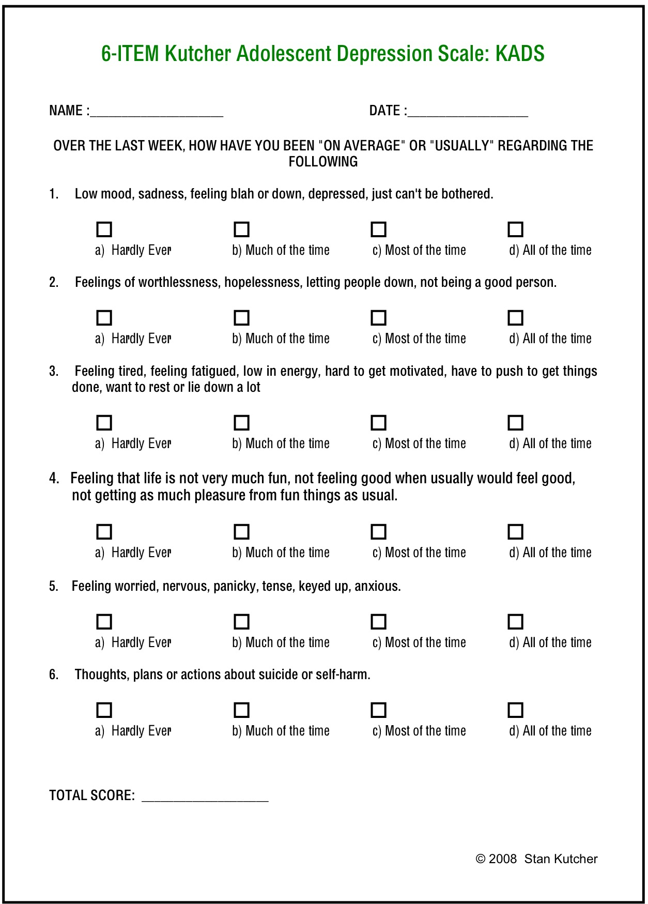
Kutcher Adolescent Depression Scale (for Health Providers)
Score of 6 or greater is correlated with depression
Normed for ages 12-18
http://teenmentalhealth.org/wp-content/uploads/2014/09/6-KADS.pdf
Notes:
This is a tool that family physicians have been trained to use in screening for youth suspected of having depression. This is a rating form to be completed by the youth and the school counselor can score them and write a letter (summarizing the results). The parents can take the letter and Depression Scale to their child’s doctor.

Slide 61
Depression: What to do
Depression is highly treatable (medications and evidence based psychological therapies): referral to health provider as soon as possible KNOWLEDGE ESSENTIAL
All treatments decrease risk for suicide and decrease suicide rates – essential to support youth in access to care and continuity of care.
Academic expectations may need to be modified due to Depression effects on motivation and cognition.
Mood enhancing activities (Taking charge of your health) should be prescribed
Be aware of the risk of suicide – discuss with health providers what the role of educators should be in each individuals case.
Develop a youth supporting educational/health collaboration with appropriate consents.
Clarify role of school with regards to potential crisis situations. FAMILY ENGAGEMENT
Notes:
When the brain is depressed it isn’t just the mood of the individual that is impacted.
Multiple domains are impacted –
social life – withdrawn and lack interest in previous activities that brought them joy,
Health – suffer from aches and pains, not sleeping well or sleeping too much
Cognition – inability to focus, unmotivated
Academic functions are impaired.
Click on the link to show the Taking Charge of Your Health
A child with depression may be designated as a student requiring Moderate Mental Health Support (R) or Intensive Mental Illness (H) and receive mental health support at school and academic adaptations. When identified with (H) then collaboration occurs with an outside agency, often Child and Youth Mental Health or a private psychologist or counselor, and the child’s school team.

Slide 62
Depression and Treatment
Often can be effectively treated in primary care
Psychological treatments (CBT ) and medications (SSRI) are helpful
KADS – 6 useful tool for assessment of Depression
Treatment of the acute episode usually takes 8 – 10 weeks before a substantial improvement takes place
Antidepressant medication use and psychological treatment both decrease suicide rates
Modification of school curriculum may be needed to accommodate for the cognitive problems that occur with depression (concentration; lack of motivation)
Depression is a substantive risk factor for suicide
Notes:
Treatment takes time. For teens, treatment of the acute episode usually takes between 8 and 10 weeks before a substantial improvement takes place.
Adults tend to respond quicker (4-6 weeks of treatment).
Even though a student feels better after 3 or 4 therapeutic sessions, they need to continue treatment to prevent relapse.
Early identification and effective treatment are critical in treating depression.

Slide 63
Depression Video - Ellie
https://www.youtube.com/watch?time_continue=1&v=i8EPzkxAiVw

Slide 64
Depression: Additional Concerns
Health providers should always ask about
suicidal thoughts and suicide plans and
substance abuse
CAUTION

Slide 65
Bipolar Disorder
History of at least one depressive episode and at least one manic episode. Hypomania is a concern.
Rapid mood changes including irritability and anger outbursts.
Self-destructive or self-harmful behaviors – including: spending sprees; violence towards others; sexual indiscretions; etc.
Drug or alcohol overuse, misuse or abuse.
Psychotic symptoms including: hallucinations and delusions when manic
Approximately 1% of population
Notes:
Bipolar Disorder is a type of mood disorder. However, unlike in Depression, the problem in Bipolar Disorder is in the brain’s regulation of the usual ups and downs of normal mood.
Bipolar Disorder causes unusual shifts in mood, energy, activity levels, and the ability to carry out day-to-day tasks.
These moods range from periods of extremely “up,” elated, and energized behavior (known as manic episodes) to very sad, “down,” or hopeless periods (known as depressive episodes). Less severe manic periods are known as hypomanic episodes.
Sometimes a mood episode includes symptoms of both manic and depressive symptoms. This is called an episode with mixed features
Because Bipolar Disorder has a large genetic component, immediate family members of someone with Bipolar Disorder are at a much higher risk of also developing the disorder than people without Bipolar Disorder in their family.
Less than 2 percent of people have Bipolar Disorder (any type) and it is almost equally as prevalent among women and men. It usually begins in the late teens to early twenties. The symptoms of Bipolar Disorder can be subtle or extreme. Mild Bipolar symptoms may sometimes be confused with “being a teenager”. Typical teenage strife does not cause Bipolar Disorder or any mental illness.
First episode is generally depression, happens in teens. Can be a clinical challenge to determine bipolar or depression.
Mania:
Decreased need for sleep
Inflated self-esteem or grandiosity
Flight of ideas, racing thoughts, rapid speech
Over activity
Distractible
engagement in pleasurable activities without regard to potential negative consequences. (unrestrained buying sprees, unprotected sex)
Irritable mood
Drugs and alcohol may be used to self cope and reduce mania
A note for schools: It can be difficult to re-integrate a student who has had previous manic episode behaviors (our master trainer told us a story about a youth who stripped down to underwear and ran around the school in a manic state. As treatment progressed the youth struggled with re-integrating into school because everyone (staff and students) associated him with that “one time you ran naked through the campus”).

Slide 66
Bipolar Disorder and Treatment
Usually will require psychiatric care and ongoing monitoring (hospitalizations often needed)
Medications are necessary (include: lithium; anti-psychotic medicines, anti-epileptic medicines)
Psychosocial treatments are also often needed –tailored to need
Adaptations and/or Modification of school curriculum may be needed to accommodate for the cognitive problems that occur with bipolar disorder –mathematics may become problematic
Bipolar Disorder substantially increases suicide risk
Notes:
Most effective therapies are CBT, Interpersonal and Social Rhythm Therapy (it emphasizes techniques to improve medication adherence, manage stressful life events, and reduce disruptions in social rhythms), and Family Focus Therapy (provides psychoeducation about the disorder and improves the communication and problem solving strategies in families).
Often comorbidities with other mental illnesses: 75% have anxiety disorder, 37% have substance abuse disorder, and 14% have binge eating disorders.
Common cognitive problems:
the polarities of mood elevation and depression have adverse impact upon memory, focus, thinking and planning.
Examples of the kinds of deficits reported are difficulties with linguistic working memory (word retrieval), difficulties with planning, prioritizing and organizing of behavior (executive functioning), problems with retention of what’s been read or listened to, as well as the experience of mildly dulled or slowed thought processes.

Slide 67
Danielle’s Story
https://youtu.be/o3jV4cbAN-Q

Slide 68
LUNCHTIME

Slide 69
Post Lunch Check In
What prompted you to volunteer for this training?
What are you hoping to take away/learn from this training?

Slide 70
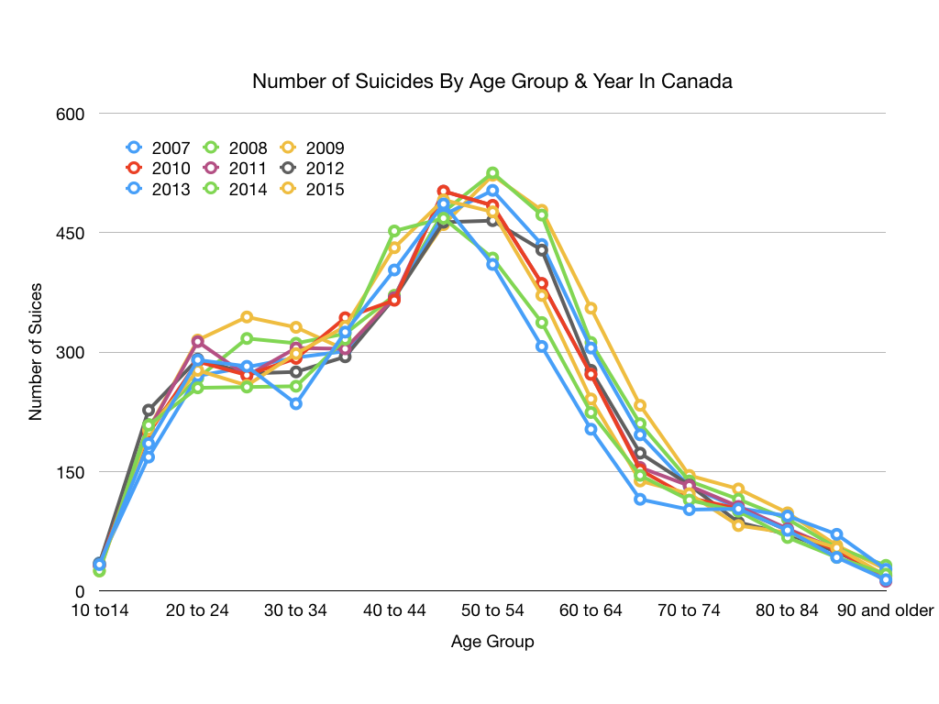
Number of Suicides By Age Group & Year- Canada
Source: Statistics Canada
Notes:
Notice that the first increase is highly correlated with the onset of mental illness in adolescence. Then it appears to level out.
Then there is another increase from 40-50….why? [allow for discussion of possibilities]
The recent suicides of fashion designer Kate Spade, who was 55, and celebrity chef Anthony Bourdain, who was 61, have shined a public spotlight on suicide in middle age.
“The group with the highest risk is around age 45 to 55 and then those over 85, but the question is, why at that age?”
We tend to start our lives happy, but that contentment begins to wane around 18 and then reaches a low in our 40s, he said. In our 50s, happiness levels often begin to rise again and keep going up, though they may drop in the final years of life.
Instability in the workplace, ageism, relationship fractures such as divorce or the death of a spouse, children leaving home and chronic illness and isolation are among the conditions that can make middle age a vulnerable period in a person’s life.
One of these difficult situations, combined with impulsivity and an untreated mental illness can lead to a suicide attempt.

Slide 71
Youth Suicide
Youth suicide is a rare but tragic event for any community
Most youth suicide is associated with the presence of a mental illness (Depression) that has not been diagnosed or is not being appropriately treated.
Youth suicide is not the result of the usual stresses of being a teenager AND not all high risk die AND not all who die show signs
Suicide attempts need to be differentiated from self-harm events– they require different approaches to deal with them.
The use of youth specific suicide assessment tools can assist professionals in the evaluation of youth suicide risk – DOES NOT PREDICT SUICIDE
Notes:
Suicide itself is not a mental disorder, but one of the most important causes of suicide is mental illness – most often Depression, Bipolar Disorder (Manic Depression), Schizophrenia, and Substance Use Disorders.
The great majority of people who experience a mental illness do not die by suicide. However, of those who die from suicide, more than 90 percent have a diagnosable mental disorder.
People who die by suicide are frequently experiencing undiagnosed, undertreated, or untreated depression.
An estimated 2-15 % of persons who have been diagnosed with major depression die by suicide. Suicide risk is highest in depressed individuals who feel hopeless about the future, those who have just been discharged from the hospital, those who have a family history of suicide and those who have made a suicide attempt in the past.
An estimated 3-20% of persons who have been diagnosed with bipolar disorder die by suicide.
An estimated 6-15% of persons diagnosed with schizophrenia die by suicide. Suicide is the leading cause of premature death in those diagnosed with schizophrenia. Between 75 and 95% of these individuals are male.
Also at high risk are individuals who suffer from depression at the same time as another mental illness. This is called “co-occurring” disorders or comorbidity.
Specifically, the presence of substance abuse, anxiety disorders, schizophrenia and bipolar disorder put those with depression at greater risk for suicide.
People with personality disorders are approximately three times as likely to die by suicide than those without.
Self Harming is different than suicide attempts, and require different approaches. Suicide attempts are designed to kill oneself, self harm is not designed to kill oneself. Self harming is contagious and driven by social environment.
Remember, we are not tasked with diagnosing youth. We can appropriately refer youth to school counselors or school-based therapists. These professionals may make referrals or provide screenings and next steps.

Slide 72
Established risk factors increase risk of death by suicide
Presence of a mental disorder
Previous suicide attempt
Family history of suicide (especially if completed)
Family history of mental disorder
Substance abuse
Juvenile justice involvement
History of abuse
Previous suicide attempt(s)
Presence of a current plan
Availability of lethal means (access to methods)
Notes:
Risk factors for suicide are not definite ways to identify youth who will attempt death by suicide. Risk factors increase the probability of suicide, but does not make it certain.
District Suicide Risk Assessment protocol
Example of one of the first SRAs I did.

Slide 73
Youth Suicide- Treatment Works
Suicide is an emotional issue – emotionally driven decisions are often not the best decisions. Essential to do the right thing, not just something.
Current evidence shows that the most effective approach to suicide prevention is identification, diagnosis and effective treatment of mental disorders
Gatekeeper programs in controlled settings or institutions have good promise for positive impacts.
Notes:
Teens are impulsive, early and effective treatment and response are essential. Not over-react, not under-react
Gatekeeper training for education professionals with respect to the recognition of Depression and other mental illnesses and procedures for referral to mental health services.
Journal article on SOS and YR: J of the Canadian Academy of Child and Adolescent Psychiatry 24:1, Winter 2015

Slide 74
Self Injury/Harm
(Crisis & Trauma Resource Institute)
Definition: deliberate, self-inflicted and self-effected bodily harm of a socially unacceptable nature, done without suicidal intent and carried out to reduce or communicate psychological or emotional distress.
Notes:
This is a complicated subject because its intent is usually positive (reduce distress) and it is almost always works temporarily. It can be invigorating and make a person feel as sense of power and control. So, in a crisis, cutting can be a better alternative than other impulsive risky behaviours. Therefore, how we respond to is critical. Not over-react, not under-react. Not call 911, not dismiss it as nothing.
I recently found this on a self harm chat forum. "I am currently branding myself as a new form of self harm. I am unhappy to say that I have sort of relapsed on self harm and it's returned with a vengeance. Burning and cutting have never made me feel so powerful. I am not suicidal, it's purely an unhealthy mechanism I've picked up again."

Slide 75
Functions of Self Injury/Harm
To feel better emotionally
To get a rush
To end Dissociation or Emotional Numbness
To punish oneself
To communicate to others
Notes:
Rapid relief from emotional distress
Endorphins secreted into the bloodstream
Some people just want to feel something, pain is better than feeling nothing
An expression of self-loathing and feelings of worthlessness
Some have difficulty expressing emotions. Important not to dismiss as attention-seeking or manipulative behaviour

Slide 76
Two Types of Self Injury/Harm
Direct Self Injury could include:
Scratching
Cutting (70%+)
Carving (cutting words or symbols)
Burning
Branding
Skin picking
Head banging
Indirect Self Injury could include:
Substance Misuse
Eating Disordered Behaviour
Risk-Taking Behaviour (phsyical, sexual, situational like parties or raves)

Slide 77
Persistent Self-harm
http://teenmentalhealth.org/understanding-self-injury-self-harm/
https://www.aacap.org/aacap/Families_and_Youth/Facts_for_Families/FFF-Guide/Self-Injury-In-Adolescents-073.aspx
Notes:
When someone self-injures, almost always they do not intend to die. Young people who self-injure may do so as a method to cope with stress– hurting themselves is often seen as a way to control their upsetting feelings. Others do so to dissociate from their problems (e.g. to distract themselves from emotional pain). Research suggests that self-injury can activate different chemicals in the brain which relieve emotional turmoil for a short period of time.
self-harming teens need assistance to learn more effective ways to solve life problems. Connecting them with professional assistance is recommended.
Additional info:
http://teenmentalhealth.org/understanding-self-injury-self-harm/
http://www.aacap.org/aacap/Families_and_Youth/Facts_for_Families/FFF-Guide/Self-Injury-In-Adolescents-073.aspx

Slide 78
Distinguishing Suicide Attempt from Self Injury
Suicide Attempt
Intent is to end all feeling; escape life
Serious physical damage, lethal means used
Rarely chronic, one method used
Sense of hopelessness and helplessness; suicide is seen as the only way out
No decrease in discomfort following the act
Central issue: depression/rage/grief regarding inescapable pain
Self Injury
Intent is to feel better by obtaining relief from intense emotions or from numbness
Modest physical damage, non lethal means used
Frequently chronic, several methods may be used over time
Some sense of control or ability to manage emotions
Rapid decrease in discomfort followed by return to usual affect
Central issue: body alienation/numbness or emotional vulnerability, inadequate self soothing skills or peer influences that endorse self injury

Slide 79

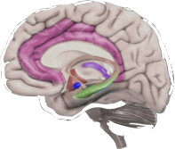


What is signaling?
Brain Registers Danger!
Prepared to FIGHT
or FLEE!
DANGER!!!!
Initiation of physiologic cascade
increased: heart rate, alertness, perception, tension
Sensory Perception + Internal Signals
Notes:
Signaling is part of the brain system.
What we have on this slide is a visual representation of the Parasympathetic Nervous System Cascade…it is a quick neural process to warn us about risk or danger when there is one.
Danger happens!
We sense the danger
Our brain registers DANGER
Our body initiates the cascade of signals and circuits to make us respond instantly for survival: Fight Flight or Freeze
When you’re in danger, your body’s natural reaction is to rapidly initiate the fight-or-flight response. This brain response occurs immediately when someone senses danger and it activates many brain areas that are designed to protect you from that danger by preparing you to “fight” the danger or to escape from it (i.e., “flight”).
As part of this response, the brain triggers the release of adrenaline and other hormones throughout your body, so you can respond to the threat. This protective mechanism is called the fight-or-flight response and it helps us to survive. Your emotional and physical responses during fight-or-flight can be described as panic to fight or flight
We are rigged to freak out first then regulate it
We elicit a response from our limbic system then use our prefrontal cortex to act
We either seek out solutions or strategies to help us solve the problem/challenge/danger by seeking help or applying interventions OR we retreat, avoid and place focus on interventions which elevate the stress response. ie. Negative self-talk

Slide 80

Are you aware of how you respond to danger or threat?
Notes:
Think about a situation in which you have experienced danger or a threat.....was your response to fight, flee or freeze?
When you think back on that experience, can you pinpoint your reaction and thinking process once the threat registered?
Did you experience any physical symptoms (shaking, stomach upset, sweating)?

Slide 81

Notes:
This reaction would be when adaptation happens and the problem is solved OR how we feel when we realize a situation is not a real threat!!

Slide 82
What is Anxiety?
!
!
!
Brain Registers Danger!
No Danger
https://youtu.be/RPyzPH8sB2A
ANXIETY
Initiation of physiologic cascade
increased: heart rate, alertness, perception, tension
Sensory Perception + Internal Signals
Notes:
With anxiety the "signaling" function of the brain is used to alert us to any potential problem in our environment. This is the mechanism we call the stress-response. It is the signal that adaptation is needed and that when adaptation happens (that means the problem is solved) the signal goes away and the person has a skill that they can use in other circumstances. The brain system involved with "signaling" also is the same as that which alerts us to immediate and severe danger – and causes the fight, flight or freeze response. This has evolved over centuries to keep us out of harms way.
We often use these words interchangeably which is not helpful and can cause confusion. Often we just lump them under the category of "stress", without noting whether the condition is acute or chronic (the impact is different) or whether the condition is "positive", "tolerable", or "toxic".
It is important to distinguish among three kinds of stress:
Positive stress, caused by dealing with frustration, getting an immunization, and other normative experiences, is an important aspect of healthy development that is experienced in the context of stable and supportive relationships that facilitate adaptive responses.
Tolerable stress, from experiences such as the loss of a loved one, serious illness, or a natural disaster, occurs within a time-limited period, during which protective relationships help to bring the body’s stress-response systems back to baseline.
Toxic stress refers to strong, frequent, and/or prolonged activation of the body’s stress-response systems in the absence of the buffering protection of adult support. Major risk factors include extreme poverty, recurrent physical and/or emotional abuse, chronic neglect, severe maternal depression, parental substance abuse, and family violence. Toxic stress disrupts brain architecture, affects other organ systems, and leads to lower thresholds for responsiveness in stress-management systems, thereby increasing the risk for stress-related disease and cognitive impairment, well into the adult years.
We also often use the word "anxiety" to mean a stress-response created by something in the environment that is not likely to be harmful. We can differentiate this concept of anxiety as healthy and resilience building or as negative and resilience impeding. This depends on how we think about and act in response to the anxiety (or stress-response) signal.
Positive Coping:
An example of positive coping would be:
There is a challenge I need to face
I can get through this
I problem solve and draw from strategies
I learn new skills and adaptation happens
The result is resilience building; "I can do it, it worked"
Negative Coping:
An example of negative coping would be:
I can't do this
I'm overwhelmed
I'm stressed out
(negative self-talk)
I Avoid or focusing on decreasing the stress-response rather than on problem solving
I do not learn new skills and I do not adapt
The result is "I can't do it" (self-sabotage)
Although some anxiety can be motivating, anxious students generally find it more difficult to operate at optimum levels.
Individuals need to have an optimal level of anxiety in order to improve their performance on a task. Too much anxiety and we are paralyzed. Too little, and we are unmotivated, but just the right amount keeps us alert and focused so we perform to the best of our abilities.
When working with students, we coach them to practice their coping strategies when they are in a calm state so they are more likely to draw on those strategies when they are feeling anxious.

Slide 83
Fight, Flight or Freeze
https://www.youtube.com/watch?v=RPyzPH8sB2A
Notes:
This is a short video on the Fight, Flight or Freeze Response

Slide 84
What is a normal stress response?
  Situation or Trigger
  first date
  preparing for exam
  performing at a concert
  giving a speech
  moving from home
  climbing a tall ladder
Stress Response
Apprehension
Nervousness
Tension
Edginess
Nausea
Sweating
Trembling
Outcome
adaptation to the stressor and when successful results in learning of new skills – the person becomes more resilient
Notes:
What is a normal stress response?
The better term here is "healthy stress or anxiety" as opposed to "normal stress or anxiety"
This is a term which describes a normal feeling people experience when faced with a threat or danger, or when stressed (eg. First date, giving a public speech, performing at a concert, or exams). It is transient, a normal stress response and doesn't interfere with a person's well-being, and does not prevent a person from achieving their goals.
Feelings of anxiety are related to experiences of life, such as a new relationship, a new job or school, illness, or accident. Feeling anxious is is appropriate in these situations and usually we feel anxious for only a limited time. These feelings are not regarded as clinical anxiety, but are part of everyday life.
When people become anxious, they typically feel upset, uncomfortable, and tense and may experience many physical symptoms such as stomach upset, shaking, or headaches.

Slide 85
Anxiety is constant hyperarousal
  No situation or trigger – environmental stressors can exacerbate baseline anxiety BUT NOT NEEDED – HYPERAROUSAL ALWAYS THERE
Stress Response
Apprehension
Nervousness
Tension
Edginess
Nausea
Sweating
Trembling
Outcome
Persistent, excessive& Inappropriate
Causes impairment
High Intensity
Leads to dysfunctional coping
-withdrawal
-avoidance
Notes:
When anxiety is constant, the third category is different
Anxiety grows each time the individual avoids a stimuli and the period of habituation (ie. Avoiding the activity in order to diminish the physiological responses and/or feelings/emotions that arise) becomes longer. If an individual can complete a task that makes the feelings/physiological symptoms emerge, then the anxiety and habituation diminish. They can see that they can work through the anxiety with successful results.

Slide 86

Mental Disorder of Signaling:
The anxiety disorders
Notes:
What are Anxiety Disorders?
The anxiety disorders are a group of illnesses characterized by persistent feelings of intense anxiety. There are feelings of continual or extreme discomfort and tension, and may include panic attacks.
People are likely to be diagnosed with an anxiety disorder when their level of anxiety and feelings of panic are so extreme that they significantly interfere with daily life and stop them from doing what they want to do. This is what characterizes an anxiety disorder as more than norma or healthyl feelings of anxiety.
Anxiety disorders affect the way the person thinks, feels and behaves and, if not treated, cause considerable suffering and distress. They often begin in adolescence or early adulthood and may sometimes be triggered by significant stress.
Anxiety disorders are common and may affect one in twenty people at any given time.
All anxiety disorders are characterized by heightened anxiety or panic as well as significant problems in everyday life.
Physical Symptoms may include: Insomnia, palpitations, increased heart rate, suffocation, dizziness, shaking or tremors, shortness of breath, stomach upset, restlessness, diarrhea, change in appetite, flushing, blushing, sweating, faintness, or chest pain
Thinking or Cognitive Symptoms include: worry or apprehension, difficulty making decisions, poor concentration, repeatedly thinking the same distressing thoughts, obsessions and ruminations, catastrophic thinking, increased or decreased awareness of one's surroundings, and confusion.
Behavioral Symptoms include: aggression, avoidance, agitation, restlessness, substance use, sleep medicines, social withdrawal, and repeated behaviors.

Slide 87
What Anxiety Feels Like
https://www.youtube.com/watch?v=nCgm1xQa06c
Resource: http://www.adam.mb.ca/anxiety-disorders
Notes:
http://www.adam.mb.ca/anxiety-disorders
This video provides an example of what anxiety feels like (***warning, one F-bomb)
The other resource at the bottom of this page contains videos of the various anxiety disorders and mental disorders of behavior

Slide 88
Generalized Anxiety Disorder
Having many persistent physical symptoms that cause distress but for which there is no good medical explanation – such as: headaches; stomachaches; pain; etc.
Worrying about many things, much more than other people seem to worry and needing constant reassurance?
Having trouble “letting go” of the worry
Usually seeming tense or “on edge”
Worrying of such intensity that it interferes with enjoying life or doing things that he or she would like to do
Approximately 1% of young people
Notes:
Generalized Anxiety Disorder (GAD) is a disruption in how your brain controls the signals it uses to identify danger and initiate action to help you avoid it. This signaling mechanism does not work as it should and you experience the danger signal when there is no danger.
GAD is excessive anxiety and worry about everyday events that occurs over a prolonged period of time.
Someone with GAD worries excessively about many different things and is not able to control his or her worry. They are Masterful Worriers
The worrying and anxiety causes serious emotional distress, and causes problems at school, at work, and in relationships.
These feelings of anxiety usually also have physical components, including headaches, aches and pains, nausea, shaking and sweating.
Feeling anxious in response to danger or in new situations is a perfectly normal response. It’s called the fight, flight or freeze response and helps us survive in dangerous situations. But these typical feelings are different from GAD. A person with GAD constantly feels tense and on edge, even when there is no danger present.
Fear is not based on rationality – things we are afraid of are not high on death rate as we think….ie fear of snakes vs death by coconut (falling coconuts)

Slide 89
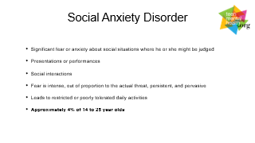
Social Anxiety Disorder
Significant fear or anxiety about social situations where he or she might be judged
Presentations or performances
Social interactions
Fear is intense, out of proportion to the actual threat, persistent, and pervasive
Leads to restricted or poorly tolerated daily activities
Approximately 4% of 14 to 25 year olds
Notes:
Social Anxiety Disorder is when certain social or performance situations (e.g., meeting new people or giving a speech) are avoided due to substantial fear of being judged or embarrassed in front of other people.
When exposed to a social situation, someone with Social Anxiety Disorder is so afraid of being negatively evaluated or judged that it significantly interferes with his or her ability to live a normal life. They believe they may be considered flawed or worthless if any sign (SAD) of poor performance is detected.
This can cause him or her to avoid everyday social situations, like going shopping, speaking up in class, using a public bathroom, or attending school.
It is perfectly acceptable to be anxious occasionally during social situations. This type of anxiety often helps us prepare for that situation.
For example: walking into a situation where you don't know anyone, practicing a speech before giving it in class; making sure you have enough money before going out on a date; etc.
However, usual, expected, and normal social situations almost always provoke fear or anxiety in individuals with Social Anxiety Disorder. This fear or anxiety is way out of proportion to the situation. Someone with Social Anxiety Disorder often knows that his or her fears are unreasonable and that other people don’t feel the same way. This can make him or her feel really alone and think that no one else can understand how he or she feels, which can lead to feelings of loneliness or sadness.
For 75% of people with Social Anxiety Disorder, it began when they were between 8 and 15 years old. Social Anxiety Disorder is thought to be caused by a combination of genetics, the environment, and learning.
They cope by either trying to do everything perfectly, limiting what they are doing in front of others, especially eating, drinking, speaking or writing or they withdraw from contact with others. They will often experience panic symptoms in social situations and will avoid many situations where they feel observed by others.
In a school setting students may retreat to avoid situations (go to online learning or homeschooling). Students may avoid crowded places such as hallways, cafeteria, etc. Encourage them to find a safe place within the building that they can go when they are experiencing significant fear or anxiety.
Social Anxiety Disorder does not occur as the result of a negative social event.
Case Study:
A student convinced his parents to let him do online learning. He achieved straight A grades. His parents realized he had withdrawn from all social activity. He was not riding the bus anymore, not going out with friends. He began staying in the basement all day long playing Nintendo. For the intervention, a gradual integration to transition into school was initiated. They started by driving by school, then sitting outside school, walk In building, then observation, then join in…
He would not go to cafeteria or library b/c he would have a panic attack. He would wait until bell had gone to go to class to avoid people in hallways. If 2 people were talking in class, it must be about him…..….. Parents refused medication so CBT used, as well as Emotional interviewing. If medication could have been tried, might have cut timeframe in half. Preparatory period was slow. Eventually he joined the Drama Club, could ride the bus, he works and he could function.
Add substance use into mix. Have one drink at party, feel good, next time have a few more drinks and it gets easier….etc Then have a drink before school
This is a slippery slope and how easy it can be to start and rely on substance use/misuse
In counselling when we are working with students with social anxiety we see sporadic attendance, avoidance cycle and so we work on the slow exposure to coming to school, working in a safe, quiet location such as the counselling center and slowly having them attend one or two classes and eventual full integration. When setbacks occur, we go back to working in the counselling center or other safe location and begin the process again. Flexibility of program delivery is important as well as communication with parents, student and staff.
Students with SAD often want social contact, but are too anxious to initiate contact
Prolonged social isolation may result in depression
Alcohol misuse may occur as it helps reduce the feelings of anxiety in the short term, so students with SAD are at risk for substance misuse.

Slide 90
A typical panic attack
Symptoms:
Heart pounding
Sweating
Trembling
Air hunger
Smothering Chest pain Stomach pain
Nausea
Dizziness
Tingling
Numbness of feet & hands Feeling flushed
Feeling chilled
Am I going crazy?!
Am I going to DIE?!
Feelings of Panic
0
5
10
Time in Minutes
Notes:
Sometimes panic can occur “out of the blue”, when you’re not in any danger.
These panic episodes are called panic attacks. Because you’re not in any danger, these panic attacks aren’t useful; and in fact, they can cause significant problems.
If someone experiences many panic attacks, he or she often begins to worry about having another attack and the anticipation causes him or her to feel even more anxiety.
Sometimes this worry becomes so strong that he or she will avoid going to places where a panic attack might happen. For some people, this may severely limit where they feel comfortable going (such as: school or anywhere in public), resulting in another mental disorder called Agoraphobia.
Panic attacks can be NORMAL – they happen. It doesn’t always indicate a mental illness, but chronic panic attacks are not normal.

Slide 91
Panic Disorder
Recurrent panic attacks with no obvious cause
Fear of future panic attacks (anticipatory anxiety)
Avoidance of difficult-to-escape-from situations (Agoraphobia)
Approximately 2% of 15 to 24 year- olds
Notes:
Panic Disorder occurs when people suffer from sudden, unexpected and uncontrollable panic attacks.
These panic attacks aren’t caused by any obvious fear (e.g., having a panic attack because you’re afraid of heights and on top of a ladder or if you’re afraid of flying and about to board a plane).
People with Panic Disorder experience anticipatory anxiety (worrying about having another attack or the consequences of having another attack) and avoid going to places where an attack might happen.
Not all people who have panic attacks have Panic Disorder. Panic attacks can occur in many different Anxiety Disorders and also in people who don’t have an Anxiety Disorder at all. In Panic Disorder, the panic attacks occur without any obvious reason. In other Anxiety Disorders (e.g., Social Anxiety Disorder), the panic attacks are triggered only by feared situations or thoughts (e.g., being in certain social situations).
In any one-year period, about 2-3 percent of people will have Panic Disorder. Although anyone can develop Panic Disorder, rates are higher among family members of people with Panic Disorder or other anxiety disorders.
Panic attacks may begin in childhood or the early teen years, although Panic Disorder usually begins in late adolescence or early adulthood.
Most people have 3-4 in their lifetime

Slide 92
Outcomes of Untreated
Anxiety Disorder
Substance use disorders or substance misuse (alcohol, nicotine)
Functional impairment: social; vocational
Depression
Notes:
The amount of distress, the level of disruption to your life, duration and the developmental age of the child are what turns typical anxiety into a disorder.
4% of students aged 4-17 in BC experience clinical levels of anxiety (Waddel et al, 2014)
Anxiety is the most common mental health concern worldwide

Slide 93
Examination Anxiety
(wrong name)
Normal response to the expected and usual stress of an examination – it’s a NORMAL STRESS RESPONSE
Most people experience some degree of examination stress response – adaptive
A few people may experience excessive stress response – maladaptive (unable to adapt to the situation or environment)
Those with maladaptive stress response may often have pre-existing mental health problems, such as an Anxiety Disorder
Notes:
Exam Worry would be the proper name
The key here is not to accommodate around the worry of exam and allow them to avoid or withdraw from the test (stimulus or event) they are anxious about
Have them practice and work through the worry

Slide 94
Dealing with Exam Stress Response
Do not pathologize normal as abnormal
Prepare students from the beginning of the year – praise hard work not being “smart”
Usual stress response interventions (exercise, healthy eating, box breathing, mindfulness, muscle relaxation)
Effective study: sufficient; avoid binge and all-nighters; review; make notes; voice learning; key review points
Get a good nights sleep – review keys in AM
Preparation: location; details
Psychological: realistic perceptions
Failure can be adaptive – some people need to have this experience to work harder
Notes:
Failure can be a distress response. Students learn they have to alter their approach.
Failure can be adaptive, some people need to have this experience to work harder.
As educators, we have learned to allow time for stress response interventions (box breathing, focusing attention strategies, muscle relaxations). Practicing exam situations and the coping strategies can help to alleviate the anxiety.

Slide 95
Discussion
1. What is your own experience with anxiety? Can you think back to a time when you first experienced anxiety due to a worry or fear?
2. What does anxiety look like in the classroom?
3. How do you currently manage anxiety in the classroom?
4. Do you notice more anxiety among your students now than five years ago?
Notes:
We are going to do a quick brainstorm in groups of 3.
1 member to get the chart paper and pen
1 member to record
1 member to share out
Groups share out responses

Slide 96
Movement Break
Stand Up
Pinch your nose with your left hand
Pinch your left earlobe with your right hand
Quickly switch hands 5 X
Rub the fingertips of both hands together
Notice how that feels
Now focus on just your index finger
Can you feel just that finger rubbing and how it feels?
Notes:
15 minute break

Slide 97
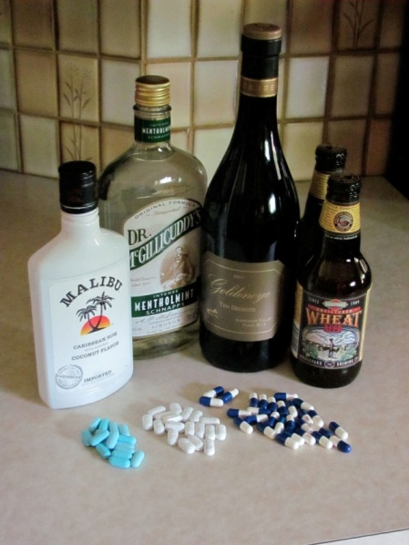


Mental Disorders of Behaviour & Somatic: PTSD, ED, OCD, ADHD
and Substance Use

Slide 98
Post Traumatic Stress Disorder (PTSD)
Severe and persistent emotional response to a situation in which the safety or body integrity of the person is threatened (rape, war, earthquake, train wreck)
Symptoms noted 6 weeks or longer after the trauma may include: re-experiencing; autonomic hyperarousal; avoidance; functional impairment
Can be made worse by psycho-social debriefing interventions
Approximately 5% of American adolescents. Canadian stats are unknown.
Notes:
With Post-traumatic stress disorder some people who have experienced major traumas such as war, torture, hurricanes, earthquakes, accidents or personal violence continue to feel terror long after the event is over.
They may experience nightmares or flashbacks for years. The flashbacks are often brought about by triggers related to the experience.
The individual will attempt to avoid any thoughts or situations that might trigger memories of the event. He or she may also have difficulty remembering parts of the event, may have a distorted understanding of the causes or consequences of the event, a persistent negative emotional state, significant loss of interest in important events. Feelings of detachment or estrangement from others, inability to produce positive emotions, and persistent exaggerated negative beliefs about him or herself and the world (ie. "No one can be trusted").
PTSD is different than an acute response – anyone who experiences such events will be stressed out or have a severe stress response. However, for most people the symptoms will abate or go away over time.
In trauma, the cognitive and emotional memories remain connected. When a person is triggered OR spontaneously without any triggers, they re-experience all symptoms they had at the time of the event, sometimes even experiencing additional symptoms.
Children may have trauma that teachers are not aware of. Some behaviors may be a result of trauma. Triggers for trauma vary from individual to individual. There are no set triggers for PTSD. The popular use of the word "trigger" is often confusing as it usually refers to a memory of a negative event (and not PTSD). This is normal, does not need to be policed and over time is associated with less and less memory of the event. Trying to extinguish triggers for normal event memories may have the impact of perpetuating them, not resolving them.

Slide 99
The Acute Stress Response
Affects 100% of Population
Common symptoms are: worry; sleep problems; hyper-arousal; irritable
May impair functioning
Resolves without medical treatment
What to do?- Resume usual activities & mobilize emotional supports
Intensity of Impairing symptoms
Trauma
Days
Weeks
Months
Notes:
Everyone has an acute stress response.
Generally ends in 6-10 weeks, and gets better over time
The good news is that our brains are designed to handle acute stress events. This involves a process where cognitive memory and
Emotional memory are paired. Over time, the emotional memory becomes less attached to the cognitive memory of the experience.
Eventually, most individuals will be able to cognitively recall the stressful event without fully having to re-experience it and the strong emotions or physiological symptoms.

Slide 100
Post Traumatic Stress Disorder
Re-experiencing
Avoidance/Numbing Hyper-arousal
Functional Impairment
Caution
Intensity of Impairing symptoms
Failure of Stress Response to resolve
Trauma
Days
Weeks
Months
Notes:
In PTSD, the curve does not decline, or go away – it continues.
Encouraging debriefing of a traumatic event can increase PTSD – we don’t want to re-traumatize and increase likelihood of PTSD.
Our brains are doing their best job! For survival and thriving, we want to remember cognitively about threats, but not Emotionally.
Emotion drives memory into long-term memory storage. Our brain needs to de-couple cognitive remembering from emotional remembering.
PTSD has both components, and is when our brain fails to de-couple the cogitative memory form the emotional memory.
Failure for acute stress response to alleviate. Experience it (event/memory) again if not worse.

Slide 101
Traumatic Events and the School Setting: What To Do
The Critical Incident Response Team will be dispatched and will follow protocol and plans for support as needed. Team Leaders meet with the school principal and formulate a plan, debriefing with staff and set up supports for staff and students.
Stress symptoms immediately following a traumatic event are NORMAL and may/may not require outside interventions such as grief/crisis counselors. Information about what is expected and normal as well as community resources should be provided to students, parents and staff. Provide clear leadership and information about the event and what will be done next. – HAVE A PLAN
Check in with and Identify symptomatic individuals(staff and students) after the event.
Notes:
For traumatic events in the school setting we have our Critical Incident Response Team that goes into the schools to support staff, students and families.
If you have a traumatic event the key is to provide age appropriate information to youth (stick to the facts).
Provide containment around trauma to avoid incorrect info getting out
The team formulates a plan of action with Upper Administration (Superintendent and Head of Student Services, Team Leaders and Principal(s) of school(s) affected).
Make events optional and always be careful of how it impacts students, staff and family (don’t make memorials permanent)
Avoid whole-school assemblies
Targeted counselling supports (gathering room) for individuals who may be impacted or who come forward may be provided (using embedded resource). Getting back to routine as soon as possible are also recommended.
Part of preparing for traumatic events includes Lock Down procedures where we train and prepare what to do. We don’t want to create more trauma emotionally by scaring them during practice. Have conversations around it, but keep them low key and not so intense.

Slide 102
Amy’s Story
https://www.youtube.com/watch?time_continue=18&v=Ymqo4u-Sh_k
Notes:
We are moving on to Eating Disorders and we will start with Amy's story

Slide 103
Eating Disorders
Bulimia
Much more common and often hidden
cycles of excessive, rapid eating (binge) often followed by purging (self-induced vomiting); often associated with multiple “weight control” activities
Approximately 1-1.5% of women
Anorexia
Rare but powerful emotional impact and may have very serious consequences -death
Severe weight loss; associated physical symptoms; severely distorted body image; “phobic” about food
Approximately 0.4% of women
Differentiate from population variance in eating behaviors, including “teen” dietary chaos, fad diet and all the other things.
10x as common in women as in men; Typically starts in adolescence
Notes:
Anorexia Nervosa involves severe weight loss and starvation.
It is the one mental health disorder that can lead directly to death: death through starvation.
(others may lead to suicide)
When you don't include the risk for suicide, this is the mental illness that has the worst outcomes for morbidity. If left untreated, eating disorders significantly increase the risk of mortality. Eating disorders are hard to spot, secretive and treatment resistant.
Bulimia Nervosa involves binge and purge food behaviors
Do not bring people who are first-hand speakers on BN or self harming, not an effective intervention.
Anorexia easier to spot. It is a shock to body and can take 3-5 years off life expectancy and individuals can’t regain that by eating back to normal weight
Bulimia is more common. A person can show avg wt, and everything with grades, friends is so often hidden and appears normal.
Eating Disorders pair with cutting in many instances but kids that are cutting, don’t usually pair with an eating disorder

Slide 104
Eating Disorders and Treatment
Usually require specialty mental health services
Psychological treatments considered to be first line treatments
Medications can be helpful for some young people who have BN but not usually helpful in AN
Treatment usually takes 12 weeks or more before a substantial improvement takes place. Hospitalization may be needed if disorder is severe.
Secrecy and avoidance of treatment recommendations are common.
If you notice self-harm behaviors communicate your observations to
the treatment team.
Notes:
It is recommended that youth suspected of having an eating disorder are directly linked to specialist(Clinic at Children’s Hospital) or counselor
Behavioral treatment is common
Get caloric intake returned to brain so may require hospitalization first where they weigh in and weigh out
Family intervention most robust treatment component
SSRI’s (Selective Seratonin Reuptake Inhibitors)are used for Bulimia in some cases (Can treat both bulimia and depression)
Meds don’t work for Anorexia
It is very challenging and needs treatment and counselling and sometimes hospitalization where forced re-feeding may be necessary if a young person's weight falls below a critical level.
Various psychological interventions that include family participation may be helpful in both disorders.
For prevention – good social connection, healthy social rel’ships, healthy diet, sleep, and education about good mental health are recommended.
In School – we take the lead from the clinician and hospital. Exposure and eating specific amounts (meal plan)
Power struggles over food or “Preaching” about healthy eating are NOT effective for treatment.

Slide 105

Obsessive Compulsive Disorder
Obsessions - recurrent, intrusive, unwanted thoughts or images or impulses that cause significant distress and functional impairment
Compulsions – recurrent, repetitive behaviours that are time consuming and cause significant distress or functional impairment
Person realizes that the obsessions and compulsions are excessive and unrealistic but can not control them
Notes:
Obsessive Compulsive Disorder is one example of a Mental Disorder of Behavior
Behavior defined is our ability to interact with others and our environment through "doing" and actions in response to internal or external stimuli. We all use brain functions to drive our behaviors every second of every day and are largely unaware that we are doing so. Our brains integrate all of these functions to enable us to do even the simplest task.
Obsessive compulsive disorder
This disorder involves intrusive unwanted thoughts (obsessions)and the performance of elaborate rituals called (compulsions) in an attempt to control or banish the persistent thoughts or to avoid feelings of unease.
The rituals are usually time consuming and seriously interfere with everyday life. For example, people may be constantly driven to wash their hands or continually return home to check that the door is locked or that the oven is turned off.
People with this disorder may be embarrassed and keep it a secret, even from their families.
Obsession drives compulsion
A person can have some signs and symptoms and not the full disorder…symmetry is a common symptom or sign
Proportion is the main factor in this disorder
Medication does help. SSRI (med), start slow and go low but start for young ages.
talk therapy
It could look like Perfectionism in school work

Slide 106
Obsessive Compulsive Disorder:
What to do
Staff can discuss their own or a student’s concerns with the school counsellor. Concerns can be brought to SBT.
OCD is best treated with a combination of cognitive behavior therapy and an SSRI (Selective Seratonin Reuptake Inhibitor)type medication.
Usually requires specialty mental health care: 12 WEEKS FOR SYMPTOM REDUCTION
Notes:
With effective treatment of this disorder we see a 70% reduction in symptoms can occur but usually the obsession and compulsions remain
To some degree (the symptoms never completely go away).
Thought –stopping (rubber band on wrist) is not an effective treatment.
Hair plucking is different (trichotillomania) but some commonalities
Often tics and tic disorder are found with an OCD diagnosis – clinicians are still unsure as to why

Slide 107
Obsessive Compulsive Disorder
https://www.youtube.com/watch?time_continue=8&v=_GT-qKTp9L0
Notes:
This next video provides one person's experiences with OCD

Slide 108

Attention Deficit Hyperactivity Disorder
Onsets before age twelve
Three Major Domains:
    Attention
    Hyperactivity
    Impulsivity
    Functional Impairment in MULTIPLE domains
    .- disorder of executive functioning
Approximately 3-7% of school-aged children and adolescents
Notes:
What is Attention Deficit Hyperactivity Disorder?
Attention Deficit Hyperactivity Disorder is the most commonly diagnosed behavioural disorder of childhood. In any six-month period, ADHD affects an estimated 4 -6 % of young people between the ages of 9 and 17. Boys are two to three times more likely then girls to develop ADHD. Although ADHD is usually associated with children, the disorder can persist into adulthood. Children and adults with ADHD are easily distracted by sights and sounds and other features of their environment, cannot concentrate for long periods of time, are restless and impulsive, or have a tendency to daydream and be slow to complete tasks
Symptoms
The three predominant symptoms of ADHD are 1) inability to regulate activity level (hyperactivity); 2) inability to attend to tasks (inattention); and 3) impulsivity, or inability to inhibit behavior.
Common symptoms include varying degrees of the following:
Poor concentration and brief attention span
Increased activity - always on the go
Impulsive - doesn't stop to think
Social and relationship problems
Fearless and takes undue risks
Poor coordination
Sleep problems
Normal or high intelligence but under perform at school
ADHD is a neurodevelopmental disorder, which means that it’s a disorder caused by problems in the growth or development of the brain. This is why some children may “grow out” of ADHD. Their brain growth and development improves. What causes these problems? From what we understand today, ADHD has an important genetic component. It tends to run in families, which means that the immediate family members of someone with ADHD are much more likely to also have ADHD than the general population. Environmental factors may also play a role. Of particular concern are those that impact brain growth and development in the womb, during birth or in early childhood. A person’s environment can also influence the extent to which ADHD causes problems in his or her life.
ADHD is diagnosed more often in boys than girls. Girls with ADHD are more likely to have difficulty paying attention, but they often don’t demonstrate as much hyperactivity as boys. Girls who have trouble paying attention often daydream, whereas inattentive boys are more likely to move around constantly or fiddle aimlessly.
For useful information about ADHD refer to the following website:
http://www.psychiatry24x7.com/homes/adhd.jhtml

Slide 109
ADHD and Treatment
Often can be effectively treated in primary care
School participation in assessment of treatment outcomes very helpful
Medications are usually necessary: psychostimulants and others
Treatment response usually evident within one week (psychostimulants) may take 2 -4 weeks with other medications
Effective treatments improve outcomes, when they are maintained – some students will improve with age and as their brains mature –decrease risk for substance abuse
Notes:
Medication has a bad rap, but is most effective for ADHD.
Process: Let counsellor know your concerns so they can bring the student forward to SBT to gather more information, talk with the parents, and screen using the Snap-4 which can be provided for the Dr.
We all have the ability to orient our attention and an ability to sustain our attention to one thing. However, children with ADHD are statistically different in their ability to sustain attention. Students with ADHD are two standard deviations away from the average when measured with psychometric tests. About 30% of youth with ADHD will also have a learning disorder. Therefore, schools should evaluate all students with ADHD for the presence of an LD through school based testing.
Adults working with children with ADHD should utilize a strength-based approach. Focus on positive strategies and student's successes.

Slide 110
Teens & Drugs
Substance Use
Substance Over-use
Substance Mis-use
Substance Abuse
Substance Dependence
SUBSTANCE USE DISORDER (DSM 5)
And what is “Addiction”?
Notes:
Language matters.
When we talk about medicine, use the words medicine. Don’t call Tylenol “drugs” or reinforce the conflation of medicine and drugs.
When talking about drugs, use the word drugs.
We see a lot of misuse and abuse, but not a lot of addiction

Slide 111
What is Addiction?
Essential Criteria For Drug Addiction: The ABC’s of Addiction
A=
Abuse of Intended Use: Use for non therapeutic purposes
B=
Dysfunctional Behaviour: Presence of typical drug seeking behaviours / neglect of responsibilities / Use despite negative personal, vocational, legal consequences
C=
Craving induced by the substance
Notes:
People are most likely to begin abusing drugs*—including tobacco, alcohol, and illegal and prescription drugs—during adolescence and young adulthood
By the time they are seniors, almost 70 percent of high school students will have tried alcohol, half will have taken an illegal drug, nearly 40 percent will have smoked a cigarette, and more than 20 percent will have used a prescription drug for a nonmedical purpose.¹ There are many reasons adolescents use these substances, including the desire for new experiences, an attempt to deal with problems or perform better in school, and simple peer pressure. Adolescents are “biologically wired” to seek new experiences and take risks, as well as to carve out their own identity.
Trying drugs may fulfill all of these normal developmental drives, but in an unhealthy way that can have very serious long-term consequences. Most teens do not escalate from trying drugs to developing an addiction or other substance use disorders.
https://www.drugabuse.gov/publications/principles-adolescent-substance-use-disorder-treatment-research-based-guide/introduction
The A is for Abuse for intended use ie. Prescription drugs
The B is for Behavior – ie stealing to support habit of using drugs
and C is for Craving - the high, feelings of confidence, let guard down and its fun

Slide 112




Understanding Withdrawal
symptoms
treatment
relapse
rebound
withdrawal
Notes:
Withdrawal is the physical, cognitive, and emotional sensations caused by the substance leaving the brain
Often, the onset of withdrawal symptoms will trigger someone to start using again. Re-introducing the drug or alcohol in the early stages of withdrawal will satisfy the body’s need for the substance and relieve symptoms. However, this is not actually treating the withdrawal—just postponing it.
Common symptoms of withdrawal include:
Severe headaches, including tension headaches and migraines
Restlessness
Muscle tremors
Insomnia
Gastrointestinal problems, including nausea, vomiting and diarrhea
Irritability, sudden mood changes and depression
Paranoia
Chills and cold flashes
Fatigue
While withdrawal symptoms may make it challenging to avoid further use of a substance, the symptoms of withdrawal will dissipate with time.

Slide 113
Substance Use:
What It Looks Like In Schools
Participant in “drug sub-culture”
Signs of intoxication in the classroom or in the school building
Frequent “lates”-after lunch or breaks
Declining grades and “dropping out” of previously involved social or other school activities
Excessive pre-occupation with substances of abuse
Approximately 10.3% young people
Notes:
The “high” produced by drugs represents a flooding of the brain’s reward circuits with much more dopamine than natural rewards generate. This creates an especially strong drive to repeat the experience.
Despite popular belief, willpower alone is often insufficient to overcome an addiction. Drug use has compromised the very parts of the brain that make it possible to “say no.”
Not all young people are equally at risk for developing an addiction. Various factors including inherited genetic predispositions and adverse experiences in early life make trying drugs and developing a substance use disorder more likely.
Approximately 10.3% of young people have a substance use addiction.
Harm Reduction such as Dare, Scared Straight – not not overly effective
The potential risks of use and the impact would be
friends who are using, academic decline, preoccupation with drugs use and attendance, etc. Any others?

Slide 114
Adolescent Alcohol &
Substance Use Screen (CRAFFT)
C- Have you ever ridden in a CAR driven by someone (including yourself) who was "high" or had been using alcohol or drugs?
R- Do you ever use alcohol or drugs to RELAX, feel better about yourself, or fit in?
A- Do you ever use alcohol/drugs while you are by yourself, ALONE?
F- Do you ever FORGET things you did while using alcohol or drugs?
F- Do your family or FRIENDS ever tell you that you should cut down on your drinking or drug use
T- Have you gotten into TROUBLE while you were using alcohol or drugs?
Notes:
CRAFFT – tool used for the screening of alcohol misuse or abuse
C = you don’t have to be using but can be at risk
This one tested well with teens
Is a good conversation starter
2 of these are of concern, would then make a referral to Fraser House (drug and alcohol support program and clinicians).
CAGE cut down, annoyed, guilty, eye opener in morning to get going

Slide 115
Treatment Purpose: Recovery
Control symptoms
Stop symptoms from coming back
Promote recovery (social skills training, vocational/educational enhancements, etc.) – to be able to function as well as possible!
Exercise
Good sleep
Consistent daily routine
Positive social life/relationships
Healthy nutrition
Music/dance/art
Notes:
Treatments are established as standard by legitimate organizations at national and international levels.
Specific treatments can:
Control Symptoms
Stop symptoms from coming back
Promote recovery – to function as well as possible
Complimentary treatments (such as exercise, good sleep, etc) do not meet threshold for specific treatment. They may help, but are not the sole solution. Use complimentary treatments to supplement specific treatments. What is good for the body is good for the brain!

Slide 116

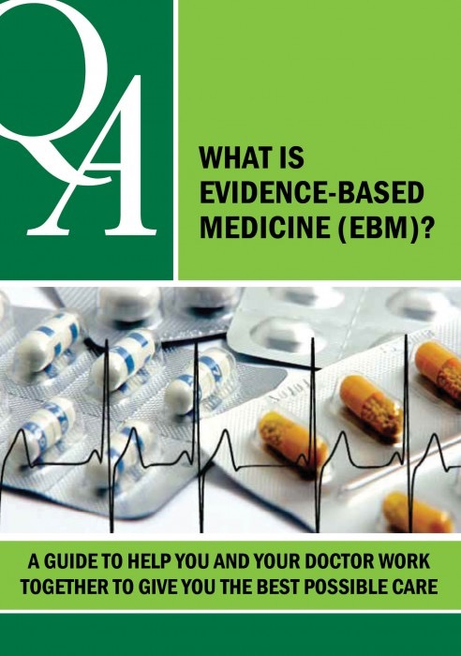
Helping –Get Well, Stay Well, Keep Well
All helping interventions act on the brain – and assist in one or more of the functions of the brain
Psychological (counseling; specific psychotherapies) – common effects
Somatic (medications; others)
Social (groups; communities; etc.)
Learn how to ask about your treatment: evidence based medicine – www.teenmentalhealth.org
Notes:
User manual guide for students and adults
It covers the risks and side effects,and if it doesn’t work, what next?
It contains some good questions and empowers youth to be a collaborator in their treatment

Slide 117

Discussion
What is the educator’s role in student mental health?
Notes:
Work in groups of 3, choose different group members from last time
5 minutes, share out in groups

Slide 118
The Educator’s Role in Student Mental Health
Modelling
Validation
Listening
Non-judgmental
Help with regulation
Provide strategies
Help identify triggers
Identify serious cases – Counsellor, SBT
Look at the purpose their anxiety serves

Slide 119
Supportive Helping Principles
This is not solely your responsibility. Shared with other go-to educators, school counsellors and administration.
Open minded but clear limits – not friend
Supportive challenging of negative perspectives and opinions
Interpersonal issues – support and advise (do not understand too quickly – if at all)
Clear messages about drug use; self-harm or dangerous behaviour
Confidential but with clear limits; never agree to keep harmful activities secret
Know the school’s policies and procedures
Notes:
This slide contains some supporting principles when talking with students. Have them explain everything. I know what it means for me, but you have to break that down for me as to what it means for you
Be respectfully curious
“Don’t do people a disservice by understanding them too quickly” Let them talk or explain
Some kids I know that……are also….is that the same for you?
Set confidentiality rules at start of conversation. Can’t go back and state why you have to report after they disclose because they feel they have been betrayed. Some students may decide not to disclose or share when they hear that you must report safety concerns.
Can ruin a relationship
A good reminder at beginning of a conversation or lesson – stating, " I will continue to be there and support you, but I may have to involve a counsellor".
Rely on your counsellors and other Go-to-instructors – share your experiences, check and balance with each other and debrief as needed.

Slide 120
Confidentiality: Common Issues
Essential to address issues of confidentiality from the beginning when first meeting with a student , not after there is a problem. Teens may want confidentiality from: parents; school; peers. Parents may want confidentiality from: children; partner; school
Cultural norms and expectations may impact
Know the regulatory frameworks of your professional and licensing bodies. Self-harm and harm to others, or others’ harming the individual are deal-breakers and must be reported. Review the process of reporting and communication.(clarify and write down if needed)
Electronic Interactions: email; texting (public)
Documentation (facts, no opinions)
Notes:
We get further with help and involvement from parents
Cultural norms have a huge impact – takes time, respect, engagement, sometimes translators – it can be challenging but work together (it is important!)
No friendships on facebook!!
If an individual is suicidal, homicidal, or showing signs of psychosis you must report (concern for student safety)
Symptoms of psychosis include:
difficulty concentrating.
depressed mood.
sleeping too much or not enough.
anxiety.
suspiciousness.
withdrawal from family and friends.
delusions.
Hallucinations
Document facts and exact statements NOT our opinions

Slide 121
Teacher Strategies Talking with Parents
  Three important “Don’ts”:
#1: Don’t wait for a problem to start a relationship.
If the first time you introduce yourself to a student’s parents is when you meet to discuss a mental health concern, your challenge, and the resistance you may meet, are that much greater. Instead, make an attempt to call or meet the parents of each student in your class early in the semester. Let them know that you are looking forward to partnering with them to help their child succeed. If possible, try to call parents occasionally to share positive feedback about their children as well. If and when a concern arises, you’ll be glad you did.
#2: Don’t go it alone.
As soon as you notice a potential mental health concern with one of your students, your first call should be to your school’s guidance counselor. He or she is trained to help everyone involved – you, the student and the parents. In partnership, you can determine the best strategy for sharing your concerns with the parents, identifying resources and next steps.
#3: Don't assume the worst.
Discussing a concern with a student's parents doesn't always set up an adversarial relationship. Most parents will be grateful for the candid fact-based information you can share, and many will be relieved to have their own concerns validated.
Source: Center for the Advancement of Mental Health Practices in Schools. Effective Communication with Parents
Notes:
Check G4 file
I’ve noticed________________and I am wondering if you have noticed anything similar?
Establish communication early with parents, especially if you have been made aware of existing issues or designations.
Involve your school counsellor if concerns arise to determine the course of action (ie. SBT or care team meeting).

Slide 122
Teacher Strategies For Working With Parent
Use a strength-based approach. Make a list of positive things about the child, along with no more than 3-4 areas of concern that you would like to address together. Be focused and clear: PRIORIZE.
Invite the parent to share their concerns.
Ask permission to share your concerns, allow time for them to respond to your concerns, and to offer solutions.
Use active listening by repeating back in your own words what you think the parent is saying and then ask for confirmation that you heard it correctly.
Express empathy. Ask permission to share what you have observed about their student in the classroom that concerns you, and then ask what they have observed at home, and what strategies they might have tried in the past to address their concerns. Use open-ended questions and reflective listening
Notes:
Remember optics
You might have parents dealing with stigma; they may have had negative experiences with school
Or they may have same issue as their child,e sensitive

Slide 123
Teacher Strategies Talking with Parents
Help parents see the difference between where the student is now and where he/she wants to be. You may need to help them compare the consequences of change versus maintaining the status quo.
Avoid arguing. You’re not seeking to prove a point or to be right. Instead, you are trying help the parent/guardian understand your concern and see the pros and cons of change.
Roll with resistance rather than meeting it head on. It’s common and understandable for parents to resist acknowledging a mental health problem, or to feel that somehow they are being “blamed” for the situation. They do not necessarily have to agree with you.
Acknowledge the positive attempts they and the student have made so far. Your optimism can reduce the discomfort that parents may feel.
Communicate respect. Act as a compassionate and knowledgeable consultant, while respecting the family’s freedom of choice and self-direction.
Notes:
Be prepared that you may be the one to plant seeds that you may not see grow. Your concerns may be ignored, or not engaged with because the family is not ready.
Share as much information as possible including strengths and positives. (successes).
Psych Eds – may need to go over again or leave time to allow them to process then ask questions

Slide 124
Preparing for Parental Resistance or Denial
Shake hands to welcome them.
Sit face-to-face.
Ask permission to share your concerns with the family.
Establish the issues to be covered .
Speak gently, calmly and confidently.
Stress the positive, and be gentle with the negative.
Use open-ended questions and reflective listening.
Listen with empathy and respect, which also requires reflective listening.
Welcome constructive criticism and ideas.
Remember that you and the parent are allies.
Focus on problems, not personalities.
Share feedback – if you have objective data about the concern (grades, attendance, etc.), share it.
Affirm, reinforce and compliment – frequently acknowledge the positives in both the student and the parents.
Discuss a plan – transition from discussing the concern to providing options and negotiating a plan for addressing it.
Provide information and resources
Notes:
It’s not uncommon for family members to deny the existence of a mental health or behavioral problem. If during your conversation a parent/guardian grows defensive or rejects your concern, continue to rely on these conversational tools.* And remember: the way you behave and respond plays a big role in diffusing or aggravating that resistance. We can't force families to take action.
Meds are about restoring the brains function before the disorder happened (stigma)
The Force – Institute of families

Slide 125

Notes:
Hand out list of Mission Community Resources that support topics covered.

