Slide 1
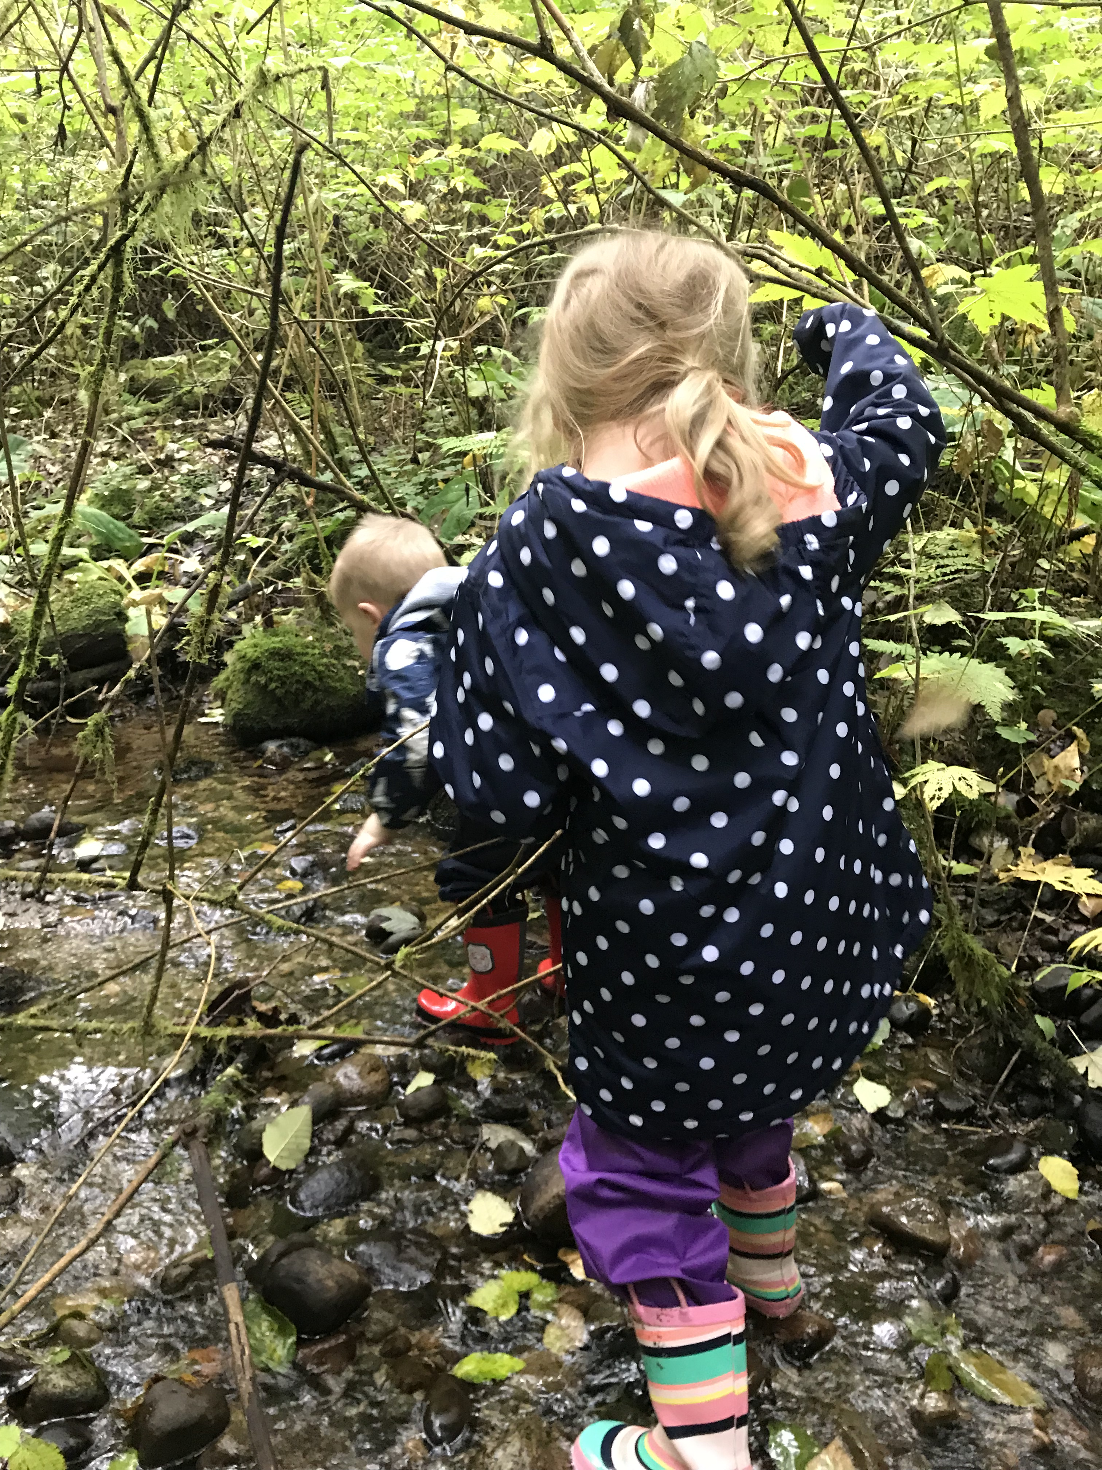
Session #6
May 2023
Changing Possibilities for
Young Children
2022-2023
Barb McBride
bbmcbride@shaw.ca

Slide 2

Notes:
Our intention in CR4YC is to bring joy to the children you work with and yourselves. We want to create a “House of Joy”.

Slide 3
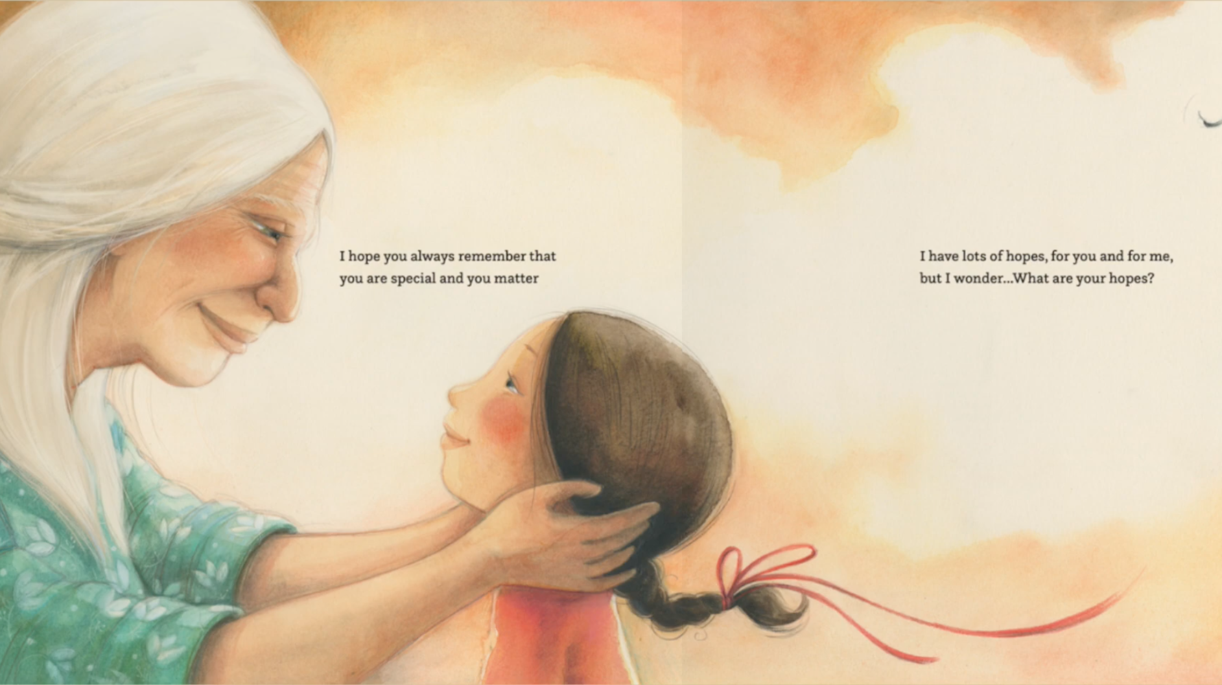
Children’s Responses
In your triads, share your children’s responses to “I Hope”. Each member write down one ‘Hope’ that was read aloud.
Each participant will then read the ‘Hope’ they recorded.
Monique Gray Smith

Slide 4
Let’s Celebrate Together~
(Possible format for Sharing)
You will be given one hour to create ”Your Story That Matters”.
After the hour we will divide the group in two.
  !/2 the group will sit with their panel. The second half of the group will each choose to sit with a colleague while they talk about their panel for 5 minutes.
  After 5 minutes move to another colleague’s panel and repeat process.
  Move again after 5 minutes.
When all have shared their creations we will have a gallery walk to appreciate all panels.
Leads will take photographs of the panels and organize them in a format that can be shared with the group myself.

Slide 5

Let’s Celebrate Together
Creating your story that matters…Some of the things you may wish to use when creating your panel include:
  Traces of moments with your Wonder Child
  Printed pictures and observations you have made throughout the year
  Loose parts and artifacts you have brought
  Excerpts from your Initial and Final Case Studies and Personal Reflections sheets
  Writings you have done around quotes during our session
  Reflections on how your practice has evolved
  Children’s literature you have read and child’s responses
  Your Wonder Child and their Family’s voices
  Your advice to future educators
  Questions or wonderings you still have

