Slide 1

Ministry of Education and Childcare -
Assessment Framework
April 28, 2023

Slide 2

Land Acknowledgement
Good Mind, Good Heart, Good Feeling
Notes:
Importance of grounding in place. What does it mean to be here, in Mission, at this time?
Sto:lo teaching of a good mind and a good heart.

Slide 3

Who is here?
This Photo by Unknown author is licensed under CC BY.
Notes:
Enrolling and non-enrolling teachers, EA’s, ILWs, Indigenous success advocates, YCW’s, counsellors, administrators – everyone in this room is here to support the well-being and development of other human beings. Networks of support – no one role does this work in isolation. It can only be done in community with one another.

Slide 4
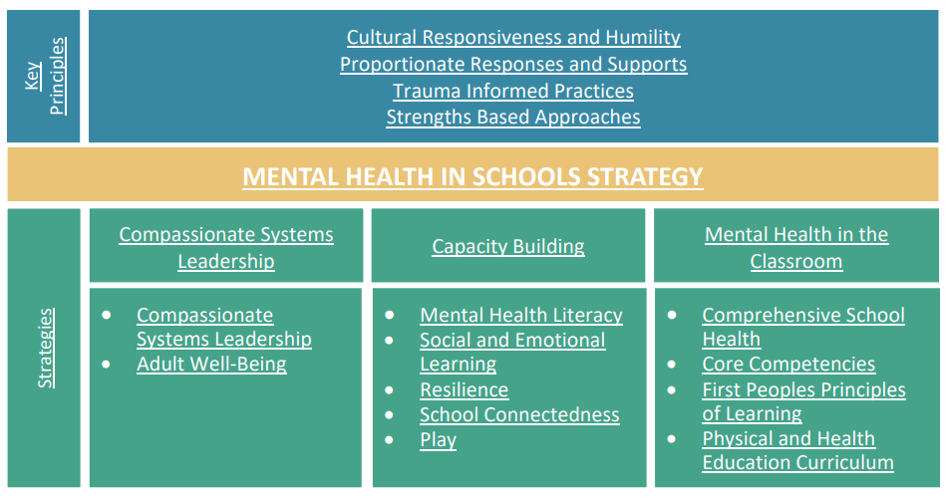
Mental Health in Schools Strategy
Notes:
Ministry’s K-12 Mental Health in Schools Strategy centered around 3 pillars: Compassionate Systems Leadership, Capacity Building, Mental Health in the Classroom. Compassionate Systems Leadership is notably the first and central to that work, and highlighted in this graphic, is adult well-being. We know some of our kids are struggling from 3 years of living in a pandemic, increased use of social media, etc. That is no different for many of us.

Slide 5
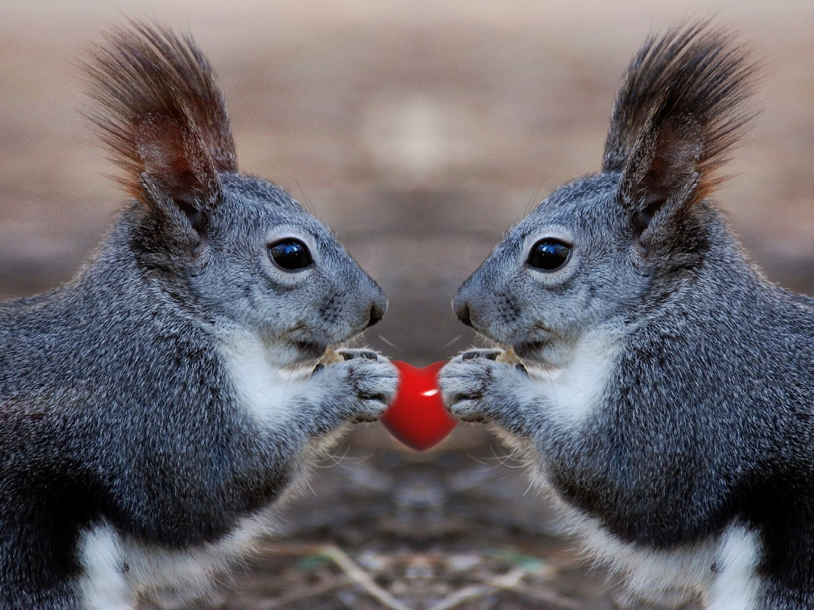


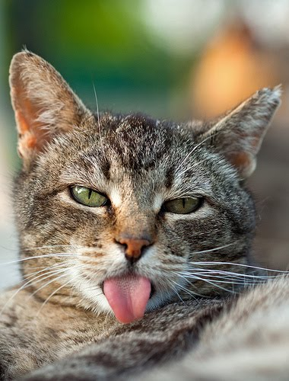



Checking In – How are you?
Notes:
We often talk about educating the whole child, but what about the whole adult educating them? We don't walk in the door as thinking heads, with no heart (emotions) or body.
How does this relate to assessment? How we are showing up matters. Asking students to get used to becoming self-aware – assessment is not just about our judgment; it is about building students’ self-awareness

Slide 6

Practices of Being Together
Check in with yourself
Ask questions
Don't assume
Experience discomfort
Listen for understanding
Take risks
Be present
“When we engage in our learning with courage, curiosity, humility, respect, and commitment, we grow in our capacities to create and support more responsive and powerful learning environments”. Brene Brown
Notes:
QR code to post your questions (don't assume you are the only one with that question);
it's ok to feel a little uncomfortable (change is always hard especially when we're feeling uncertainty);
Listen to each other to gain understanding; dialogue can be messy (assessment leads)
Be present; try to limit cell phone use (texting or phone calls) to break times

Slide 7
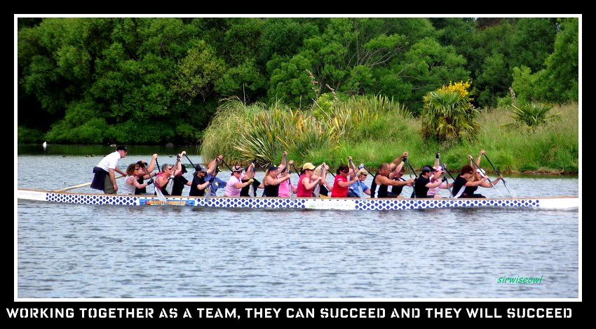
Recognizing that…
We each have different gifts, knowledge, and challenges
Our work is both individual and collective
Learning is recursive and takes patience and time
Our learning (and plans) will never be perfect
Interrupting systems is challenging
We are responsible for our own learning – engage or not
This Photo by Unknown Author is licensed under CC BY-NC-ND
Notes:
Together with assessment leads and mentor teachers and JEAC we have been working to make sense of the new reporting order within our own context. We don’t have every answer and we have not anticipated every problem or nuance. We want to hear from you and we need to be aware this process will unfold and refine over time. Change is messy but we are here to support you and do what we can to make it as effective as possible. Thank you to the assessment leads and mentor teachers who have stepped forward to assist with this work. Please be kind to them – they did not write the reporting order!!
We also recognize everyone is at a different place, some have been piloting assessment changes for a couple of years, some are hearing for the first time. Even if some of the information you hear today is something you’ve heard before, it is an opportunity to engage more deeply with it, to see it through a different lens, and to gain new perspectives.

Slide 8


Learning is holistic, reflexive, reflective, experiential, and relational (focused on connectedness, on reciprocal relationships, and a sense of place).
Learning takes patience and time.
(FPPL)

Slide 9
Shape of the Day
Overview of Assessment Policy: Where We Are Going
Break
Breakout Groups: How We Will Get There
Lunch
Logistics and Planning for Next Steps
Notes:
Breakout groups will be by department – cross school collaboration
Making Learning Visible
Providing Feedback
Working in school or department groups to plan next steps
Back together for district logistics and next steps (tools, timing)

Slide 10
Intentions
Identify
I can identify the major shifts in assessment and reporting and why they are happening
Make
I can make teaching and learning visible through learning intentions, criteria, and feedback
Understand
I can understand the Proficiency Scale and can use it with students.
I understand students’ experience with the Scale
Communicate
I can communicate student learning through descriptive feedback
Remember
I can remember that I am a learner too, with strengths to build on and areas to grow. Every learner takes one step at a time.

Slide 11
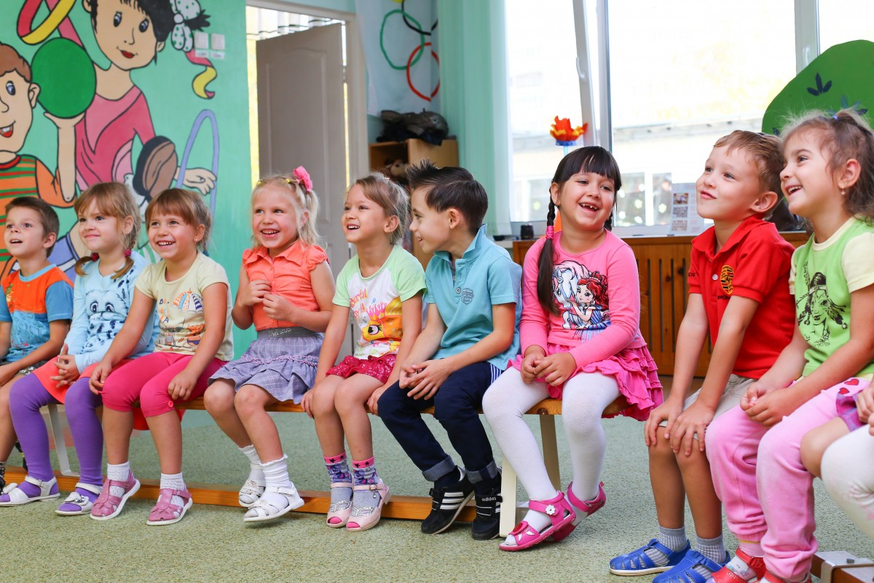

Why Now?
Curriculum and assessment aligned
Context – global and local, economic, social, cultural
When students walk across the stage at graduation, what do we want them to have?
Notes:
Think about the dreams people have for their children as they enter kindergarten, and the dreams we hold for youth as they leave us. What will their journey be about? What do we want for them as they graduate and cross the stage?

Slide 12
Curriculum and Assessment Alignment
Curriculum
Assessment
Depth of learning
Active participation of learners
Literacy and numeracy foundations
Core Competencies
Indigenous worldviews and perspectives
Demonstrate depth of learning
Active participation of learners
Literacy and numeracy foundations
Self-assessment and goal setting
Indigenous worldviews and perspectives (learning takes patience and time, learning involves exploration of one's identity, learning is holistic...)

Slide 13
Goal of the Curriculum
The goal of the curriculum is to support the development of educated citizens who are critical and creative thinkers and communicators, and who are personally and socially responsible in all areas of their lives. The curriculum supports the ways in which students think, learn, and grow, and prepares them for a lifetime of successful learning in a world where change is constant.
Notes:
The pace of change has increased exponentially. We are still training for futures that don’t exist for students. You may notice this goal as laid out by the Ministry is centered on the development of the Core Competencies.

Slide 14

Goals of Assessment and Communicating Student Learning
Student voice and ownership
"Students take part in meaningful conversations that help them develop responsibility for engaging deeply with their learning."
Parents/Caregivers informed and involved
"Parents and caregivers are well informed, are involved in decisions and dialogue about their child's learning, and understand ways to support and further their child's learning."
Notes:
The goal is not to simply add more sentences to comment boxes. The goal is to increase student voice and ownership so they have a better understanding of who they are as learners, they recognize their learning and their growth and can set direction for learning.

Slide 15
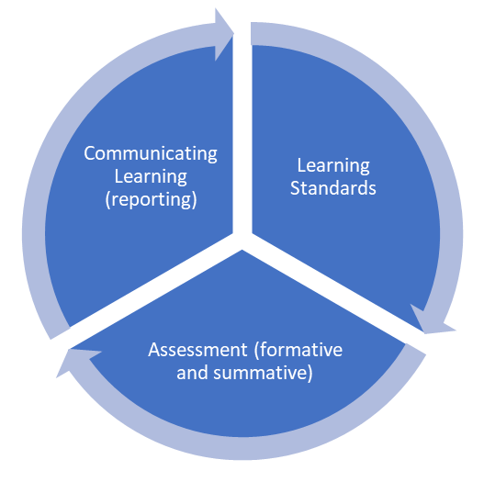
Learning Cycle
Notes:
Interconnected aspects of learning that are not separable from each other. Each depends on the other two and changes as a result of the other two. We choose, adapt, or change the learning standards we choose based on what we know about our students. What we know is based on what we observe, what we discuss with them, and what they produce. We communicate based on what they have learned, which is based on the learning standards.

Slide 16
Setting the Stage for Assessment and Learning
Being transparent about learning intentions and why they matter
Co-constructing criteria with the student
Setting goals and expectations and clearly communicating them
Building community and relationships
Considering student context and needs

Slide 17
What's Staying the Same?
Communicating learning in relation to the curriculum
Using formative and summative assessments in a variety of ways
Including universal adaptations for all students
Meeting IEP requirements
Teachers noticing and naming Core Competencies and giving students a chance to reflect on Core Competencies
Communicating learning throughout the semester/year
Letter grades and percentages grades 10-12

Slide 18
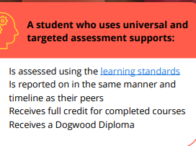
Same – Universal Supports
All students are eligible to receive universal assessment supports to support their learning – not just students with disabilities and diverse abilities, or those with an Individual Education Plan (IEP).
Notes:
Setting the stage for learning includes the supports we provide for students, based on their needs and contexts. We tend to still hold onto an ethic of fairness that is based on equality instead of equity. This leads us to think of we give supports to one student and not another, the student with supports isn’t learning as much as the one without supports so we can’t give them the same proficiency level or letter grade. Did they learn what you intended them to learn? That’s all you need to ask. Full stop. We are there to support and scaffold learning. If learning happened, we successfully taught.

Slide 19
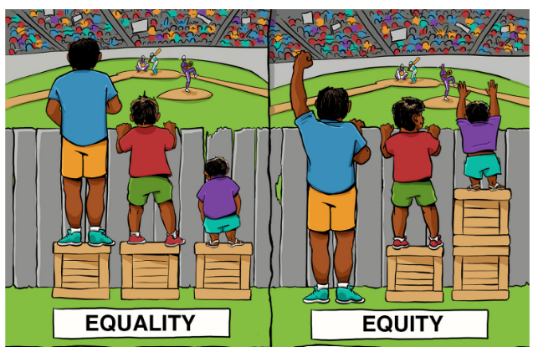

Slide 20
Universal Supports – Gathering Information
These examples can be used for ALL students, and MUST be used for those who have IEPs that indicate the strategies.
Using digital and/or audio texts or peer or adult helpers to assist with reading
Presenting information in various formats (e.g., pictures, videos, print, audio)
Providing templates and graphic organizers
Using assistive tools and technology

Slide 21
Universal Supports Continued...
Providing alternative ways of demonstrating knowledge
Extending time to complete assignments or tests
Taking breaks
Providing options for self and/or peer assessment
Offering feedback to inform revisions and improvements for reassessment
Adapting assessments (reduced questions, alternative formats, simplifying language, providing visual prompts, etc.)

Slide 22
Universal Supports Continued...
Varying question structure and response types
Offering multiple exposures to materials and multiple attempts to demonstrate knowledge
Chunking assignments, projects, essays, and tests into small, manageable tasks that are more easily accomplished
Phasing completion of tests, projects, and assignments (e.g., taking a test over multiple days)

Slide 23
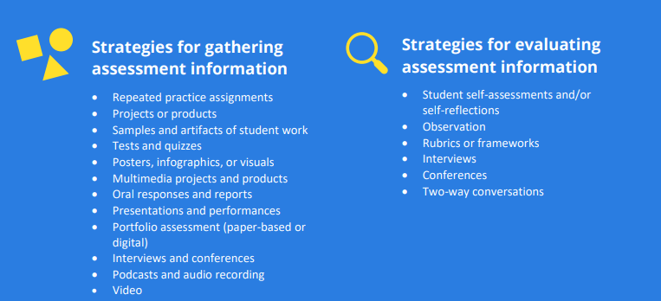

Slide 24
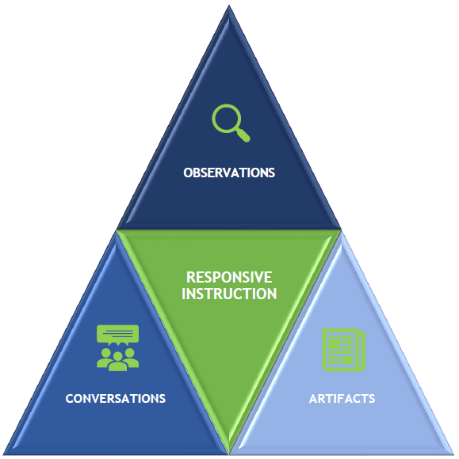
Notes:
Real world experiences and conversations/observations are valid. For example, volunteer work, shopping fieldtrips, etc.

Slide 25

Collecting Data
"Averaging marks over a term, semester, or year does not provide an accurate picture of student learning. Learning is continuous. Therefore, learning demonstrated close to the communication of student learning will be the most reflective of student proficiency and should be used as the strongest evidence of learning when deciding on a letter grade and percentage."
Ministry of Education and Childcare, p. 35.
Notes:
Britney story of averaging; common sense!

Slide 26
Some changes you will notice...
Proficiency Scale K-9
Descriptive feedback (strength-based)
Student self-assessment of Core Competencies K-12, at least 3 times
Increased student voice and involvement
(reflection, self-assessment, goal-setting)
Learning Updates and
Summary of Learning

Slide 27
Proficiency - Ministry
Supports lifelong learning by shifting the focus from marks to learning
Values most recent evidence of learning when providing student marks, rather than averaging over a term
Views learning as ongoing, rather than signaling that learning is done
Is inclusive of all students
Maintains high provincial standards (new performance standards being developed)

Slide 28

Proficiency Scales
Are not equivalent to letter grades!
Are based on the learning standards
Work habits/behaviour/engagement are not a factor in determining proficiency
Each category represents a range
Learners may move back and forth on the scale at different times and areas of learning
All learners have a place on the Proficiency Scale
This Photo by Unknown author is licensed under CC BY.

Slide 29
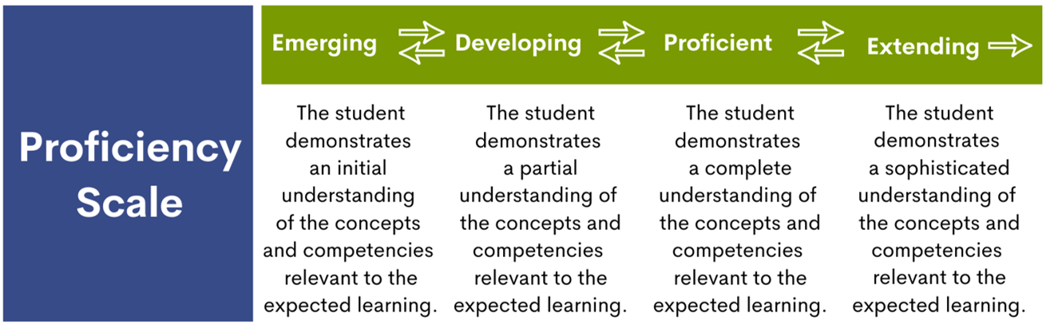
Proficiency

Slide 30
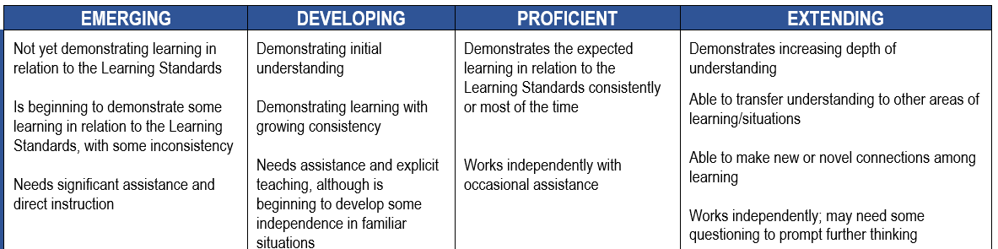
Notes:
There is a range within each level. Proficient is the goal we aim for – that all students will become proficient in relation to the learning standards. Extending is not about doing more work for bonus points. It’s also not about working above grade level (although they may be). It’s about going deeper with their learning and that means we have to make space for that to happen. Going deeper on a multiple choice test is not possible. What learning opportunities do we create, and is there an opportunity to extend beyond proficient? What could that look like?

Slide 31

Engagement/Learning Habits/Behaviour
Proficiency and letter grades based on the learning standards only.
Learning habits, engagement, and behaviour are reported separately through descriptive feedback or student self-reflection.
Learning habits, engagement, and behaviour do not contribute to a student's overall mark.
Learning Updates should not be the first time a parent or student receives feedback on engagement, learning habits, or behaviour.
Assessment and reporting are not disciplinary tools.
This Photo by Unknown author is licensed under CC BY-NC-ND.

Slide 32
Written Learning Updates
Communication of learning in relation to the learning standards or IEP goals using Proficiency Scale indicators, letters grades/percentages
Feedback
  Student strengths (what they can do)
  Areas for further growth
  Ways to support growth
  Engagement: attitudes, learning habits, social responsibility
Attendance
Student-generated content (self-reflection of the Core Competencies and goal-setting
IEP statement for some students (language to come)

Slide 33
Summary of Learning
Summary of learning in relation to the learning standards or IEP goals using Proficiency Scale indicators, letters grades/percentages
Feedback
  Student strengths (what they can do)
  Growth over time
  Areas for further growth
  Ways to support growth
  Engagement: attitudes, learning habits, social responsibility
Attendance
Student-generated content (self-reflection of the Core Competencies and goal-setting
At the end of the year, graduation status update indicating student progress in relation to graduation program requirements.
IEP statement for some students (language to come)
Notes:
“Final report card” and “summary of learning” are slightly different. Instead of tallying all the marks for a final report card (last chance), it is about summarizing the growth of the student’s learning over time. In order to do that you need to know where they started.

Slide 34
Summary of Learning – Making Growth Visible
We need to know their starting place
  Pre-Assessments that can include discussions, observations, group activities, pre-tests, brainstorming, etc.
Student reflections
Before and after work samples
Portfolio posts
Incorporating feedback given

Slide 35
Feedback - Ministry
"Descriptive feedback includes concise, strengths-based, written comments or documented conversations that are aligned with the learning standards and describe student learning, as well as identifying specific areas for future growth. … Feedback is focused on what a student can do and what they are working toward." (p. 39)

Slide 36
Praise
Great job!
Good for you!
You're so talented!
This is awesome!
You worked so hard!

Slide 37
Formative (in the moment)
Feedback for Students
I appreciated the way you created interesting visuals and gave detailed information about your topic for your Capstone project. An idea for next time could be to speak more slowly so the audience can catch all your ideas.
I notice you are able to monitor your exertion levels. You are slowing down and speeding up based on what you are able to do instead of what others are doing. How do you think you might start increasing the distance you can run?

Slide 38
Learning Updates – Descriptive Feedback
Student’s learning in relation to the learning standards (what they can do)
What they can work on next
How to support learning
Engagement: attitudes, learning habits, social responsibility

Slide 39
Learning Updates – Descriptive Feedback
Student’s learning in relation to the learning standards (what they can do)
What they can work on next
How to support learning
Engagement: behaviour, learning habits, social responsibility

Slide 40
Learning Updates – Descriptive Feedback
Student’s learning in relation to the learning standards (what they can do)
  Albert is starting to show understanding of the major plot points in a difficult text.
What they can work on next
  Albert is continuing to work on the ability to write longer pieces using complex sentences.
How to support learning
  He will have the opportunity to practice this skill by editing his written text and incorporating feedback from others.
Engagement: behaviour, learning habits, social responsibility
  Albert demonstrates a strong work ethic, responds well to feedback, and works well with others.

Slide 41
Summary of Learning – Descriptive Feedback
Student’s learning in relation to the learning standards (what they can do)
Summary of student learning: reference to growth over time
  Albert has grown considerably in his ability to…
What they can work on next
How to support learning
Engagement: attitude, learning habits, social responsibility

Slide 42
Feedback and Student Voice
"When directing attention to areas for future growth, a student's self-reflection on Core Competencies and goal setting becomes important. Involving students in the process of setting goals in areas where they need further development, and working toward those goals, is an important part of the learning process and development of the whole child." (p. 40)

Slide 43
Increasing Student Voice and Involvement
"Self-reflection and goal setting actively involve students in the learning process."
"A growing body of research shows that student self-reflection leads to an increase in student confidence in their abilities and greater student satisfaction." (p. 6)

Slide 44
To what extent are students involved in the learning and assessment process?
What am I learning and why is it important?
How am I doing with my learning?
What goals do I have for my learning?

Slide 45
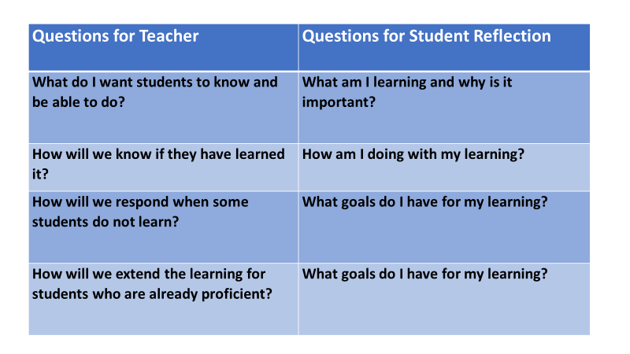

Slide 46
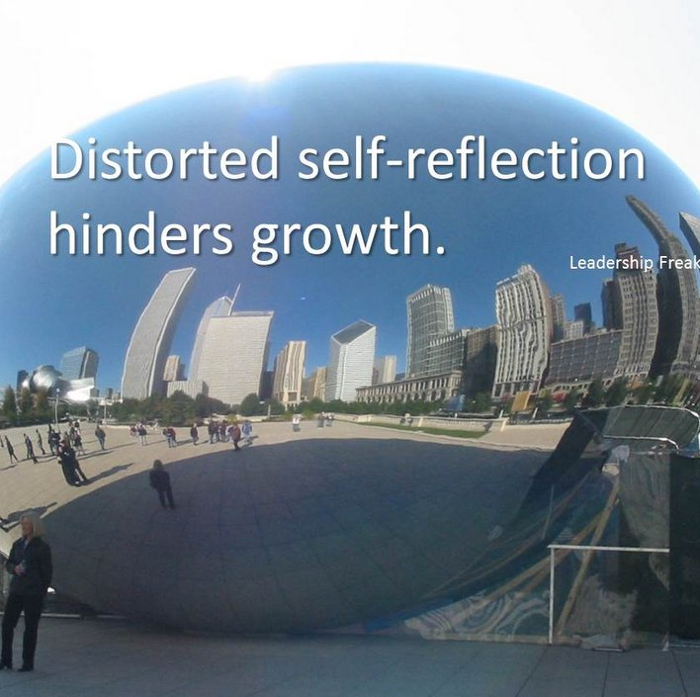
How do we scaffold students' abilities to reflect on their learning and set goals for future growth?
This Photo by Unknown Author is licensed under CC BY

Slide 47
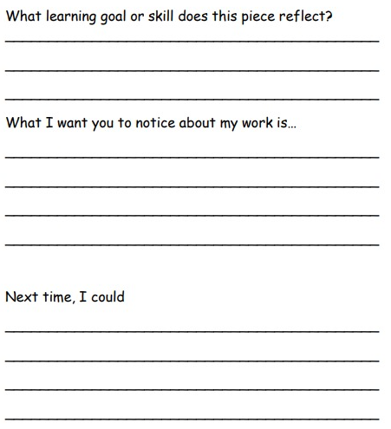
Reflection example
With thanks to Jennine Chapman, ESR
Notes:
It doesn’t need to be complicated….

Slide 48

Curriculum and Assessment Connection

Slide 49
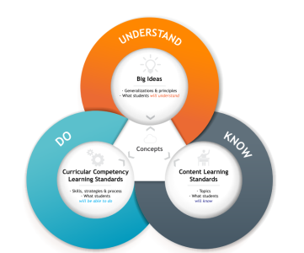
Know, Do, Understand Model (KDU)
Know – Content – What information will students need to know?
Do – Curricular Competencies – What skills, strategies, and processes do students need? What will they be able to do with the information?
Understand – Why does this matter? How does it connect?

Slide 50

The importance of bringing content and competencies together
If our focus is on what students know without also focusing on the skills and processes needed to do something with the knowledge, what happens?
  Behaviours – They can tell us what the rules are and what they were supposed to do, but they may not have developed the skills and strategies to be able to put that learning into practice.
  Math – They may know math facts or are able to follow algorithms, but can’t apply that information to problem solving.
  Reading – They know what a reading strategy is but are not able to use that strategy to help them understand new text.

Slide 51

Know, Do, Understand (KDU) Model
For Educators -
  Know the content – what information do you need to know to do your work?
  Do your work – what skills, strategies, and processes do you need to develop?
  Understand the purpose – why is this decision being made for this learner?
  What is the best way of revealing your proficiency?

Slide 52

KDU Model of Learning
Know – Content
  What information is needed to engage with this topic?
  Example: What are reading strategies?
Do – Curricular Competencies
  What can I do with that information?
  Example: How can I use specific reading strategies to help me understand different forms of media?
Understand – Big Ideas
  What is the purpose of learning this? Why does it matter?

Slide 53
Learning Standards
"Learning standards are explicit statements of what students are expected to be able to do (Curricular Competencies) and define what students should know (Content) in each area of learning at a particular grade level." (p. 8)

Slide 54
Identifying Learning Standards
Navigating the curriculum:
https://curriculum.gov.bc.ca/
Importance of elaborations – multiple ways to access them

Slide 55
Learning Standards – Math Gr. 8
Curricular Competencies
  Estimate reasonably
  Demonstrate and apply mental math strategies
Content
  Financial literacy – best buys

Slide 56
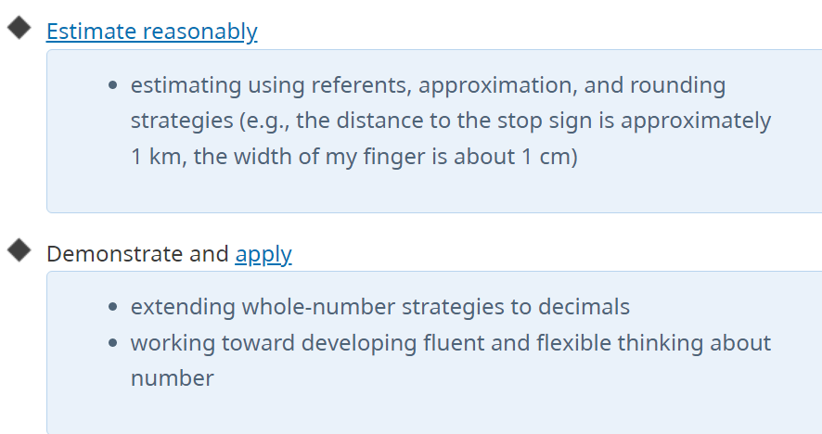
Learning Standards – Math Gr. 8
Notes:
I can

Slide 57
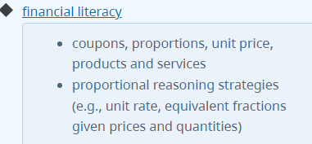
Learning Standards – Math Gr. 8

Slide 58

Learning Standard
I can use mental math strategies to estimate reasonably what the best buy is

Slide 59


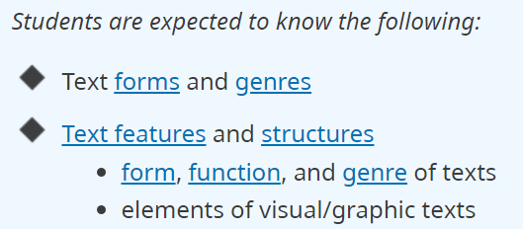
Curricular Competencies
Content
CREATIVE WRITING 11
Notes:
I was thinking about a writing assignment where students choose a social issue that matters to them and persuade different audiences of their point of view. I want students to know that what matters to them, matters. I decided to make the different audiences be younger children and older adults. When I looked at the curriculum these competencies and content stood out to me.

Slide 60
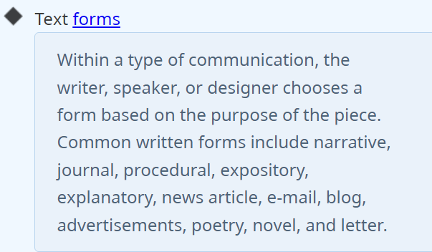

Slide 61
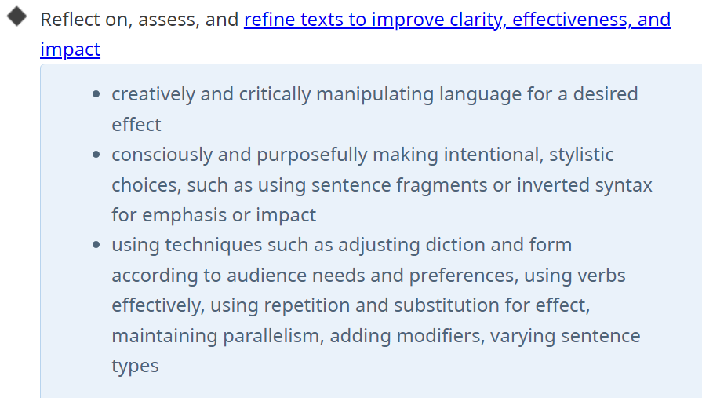

Slide 62
Learning Standard
Choose appropriate text form and features to persuade an audience of your point of view, and reflect on, assess, and refine your text to improve clarity, effectiveness, and impact.
Refine further – what does it look like for students?
I can choose an appropriate text form and use effective text features to persuade audiences of different ages about a solution to a complex social issue that matters to me.

Slide 63

Choosing Learning Objectives
Anchor your learning plans in the curriculum. What is the Learning Standard(s) you will focus on?
Develop specific learning objectives based on what you know your students will need to be able to do to reach that Learning Standard.
If it's a simple and accessible Learning Standard you may not need to simplify with smaller objectives.
The more complex the Learning Standard(s), the more you may need to have smaller objectives.

Slide 64

Learning Focus Based on Learning Standards
I can choose an appropriate text form and use effective text features to persuade audiences of different ages about a solution to a complex social issue that matters to me.
In order to reach that goal, we will set these objectives:
I can identify text forms and choose the best one to persuade someone younger than me and to persuade someone older than me
I can utilize various text features to increase the impact of my message
I can revise and edit text to clarify my message
I can use verbs effectively and use different sentence types to create impact

Slide 65
What would proficiency look like?
If you clearly define the learning intentions and criteria at the start, the information for written feedback is already there. If not, report cards will be very difficult to write because you simply won’t have the information you need.

Slide 66
Criteria
Emerging | Developing | Proficient | Extending
With assistance, can write a solution to a problem in one text form Uses a text frame to insert an argument for a solution to a problem | Can write a solution to a problem in more than one text form Language is simple and has some clarity Edits to correct errors | Uses effective text forms to persuade different audiences about a solution to a complex social issue Edits text to refine message for clarity and impact | Uses highly persuasive and creative text forms and features to offer solutions to a complex social issue. Strategically and creatively adapts text forms based on the age and knowledge of audiences. Edits and refines messages and features to increase clarity and impact. Each message is uniquely tailored to the audience and is highly creative and impactful

Slide 67
What happens when we change the Curricular Competency?
Competency:
Content

Slide 68

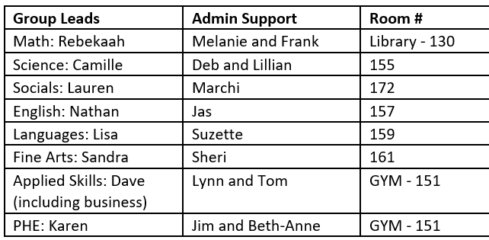
Department Collaboration
Non-enrolling teachers, counsellors, EAs, YCWs, ILWs choose one of the groups
Notes:
Assessment leads and mentor teachers did not write the reporting order – please be kind to them. They have been working hard to make sense of the order in order to support colleagues – all of you – in making the transition.

