Slide 1
Reporting on Language arts
Mission school district #75

Slide 2
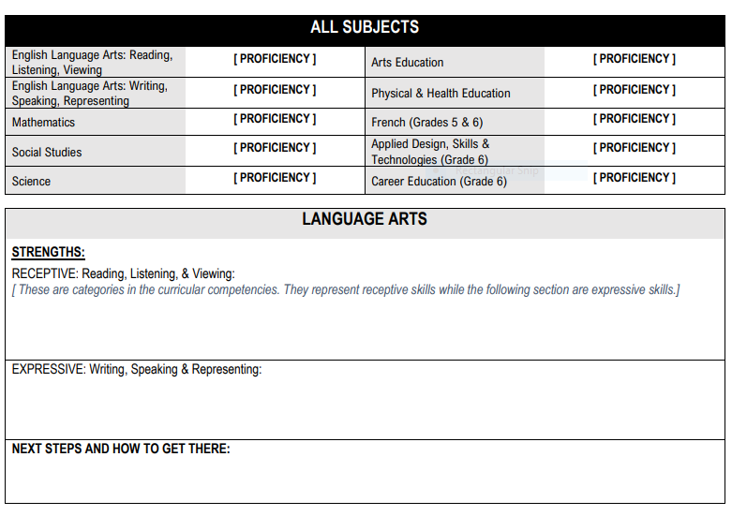
Communicating student learning
Teachers will be communicating using the four-point Provincial Proficiency scale (emerging, developing, proficient, extending) and providing descriptive feedback.
Every term, need to comment about Mathematics and Language Arts. Other subjects you can alternate on reporting (e.g., Social Studies and Science) in the Further Area of Study at different times but need to comment on every subject in one of the Learning Updates and again in the Summary of Learning.
Descriptive feedback provided on the strengths and next steps for improvement in two main curricular competency categories for Language Arts: Comprehend and Connect (reading, listening, viewing) and Create and Communicate (writing, speaking, representing), plus connecting to the content.
Notes:
Delete this slide when you finish preparing the other slides.

Slide 3
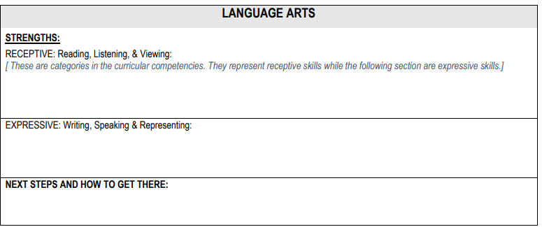
Receptive skills: can comment on their strengths in reading, listening or viewing skills. Their ability to understand information received.
Expressive skills: can comment on their strengths in writing, speaking or representing skills. Their ability to communicate ideas.
Both set of skills are often intertwined in your Language Arts lessons but also cross-curricular lessons. For example, in a unit on Habitats in Science, students might display listening or viewing skills while watching videos or taking part in classroom discussions (receptive). They might also gain information from reading articles (receptive). They may also represent their ideas when contributing to classroom discussion, making posters, writing and researching about a topic (expressive). Lots of opportunities to observe and assess in a term.
Consider your Language Arts and cross-curricular lessons for the term. Where do students have an opportunity to display and progress their receptive skills and their expressive skills?

Slide 4
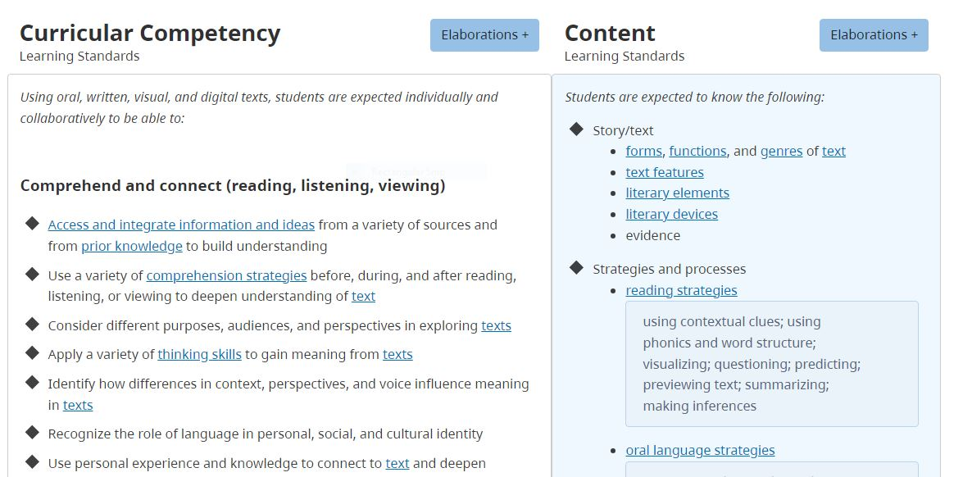
Connecting curricular competency to content
Learning Standards can be used as a starting point for descriptive feedback: need to take a Curricular Competency (left side) and pairing with Content (right side). Use to help frame your comments.
Make sure to click on the elaborations for examples of the content.

Slide 5
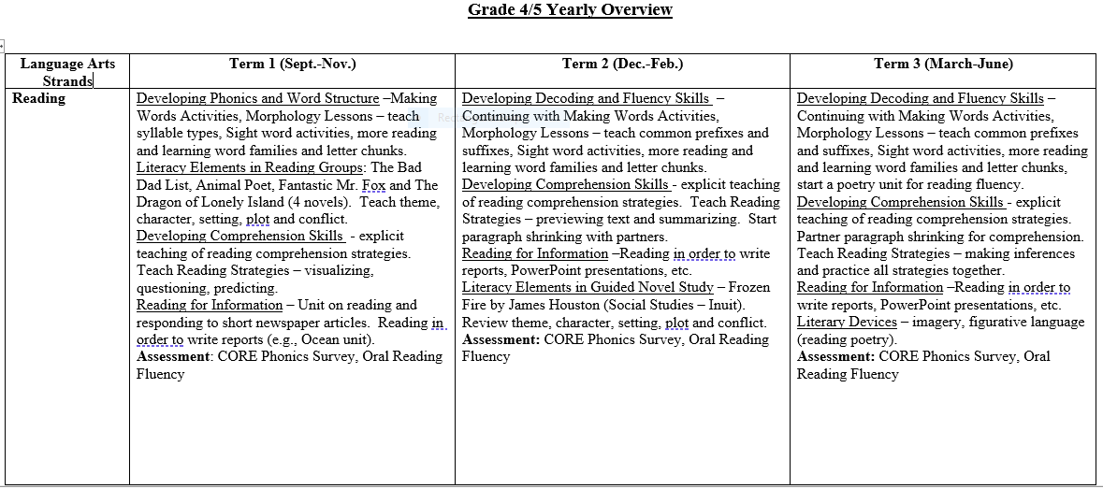
Classroom Example for Receptive skills:
Grade 4/5 yearly Overview plan

Slide 6
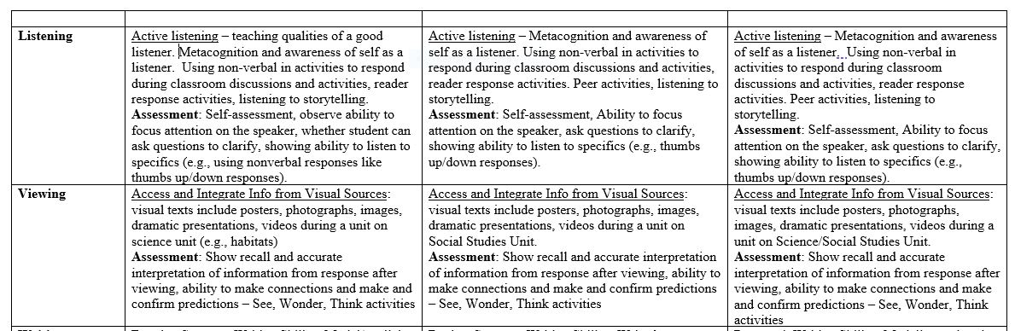
Classroom Example for receptive skills:
Grade 4/5 yearly plan

Slide 7
Examples of Receptive comments based on the Yearly plan
Reading
Viewing
Listening
Learning Standard: “Use a variety of comprehension strategies before, during and after reading” + “reading strategies”
Example Comment: Sarah is able respond to non-fiction texts by summarizing the main idea, drawing connections using her prior knowledge and making thoughtful inferences while researching about ocean animals.
Learning Standard: “Use a variety of comprehension strategies before, during and after viewing” + “text features”
Example Comment: Sarah is able to show recall and accurately interpret information from pictures in newspaper articles about ocean animals.
Learning Standard: “Apply a variety of thinking skills to gain meaning from texts” + “metacognitive strategies”
Example Comment: Sarah is able to self-reflect on her own active listening strategies (e.g., focusing on the speaker) during classroom discussions.

Slide 8
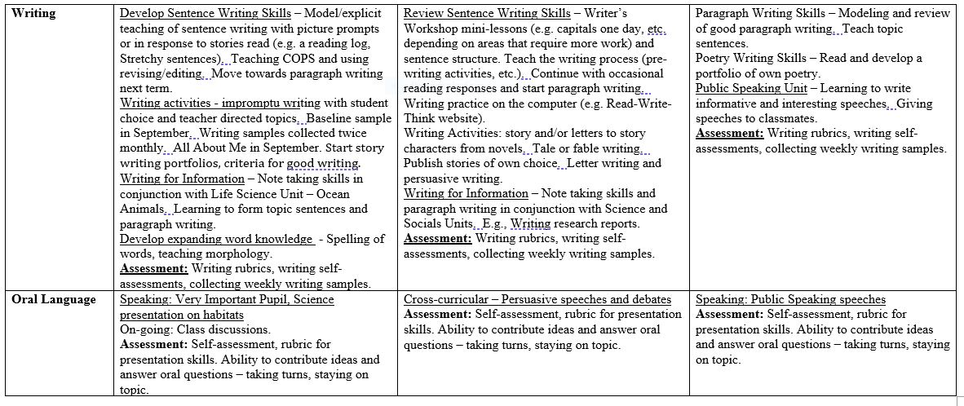
classroom Example for expressive skills:
Grade 4/5 yearly Overview plan

Slide 9
Examples of Expressive comments based on the yearly plan
Writing
Speaking
Representing
Learning Standard: “Communicate in sentences and paragraphs, applying conventions of Canadian spelling, grammar and punctuation” + “writing process”
Example Comment: Sarah can edit and revise her own writing using the COPS strategy during sentence writing activities.
Learning Standard: “Use storytelling processes” + “features of oral language”
Example Comment: Sarah can speak at a good pace and with expression when sharing stories about her weekend with the class.
Learning Standard: “Exchange ideas and perspectives to build shared understanding” + “forms, functions, genres of text”
Example Comment: Sarah is skillful at using PowerPoint presentations to share information with her peers (e.g., presentation on the Arctic).

Slide 10
Ideas for Assessment: receptive
Reading – oral reading fluency measures (e.g., DIBELS, PM Benchmark, MASI-R Oral Reading Fluency Measure from CORE), Grapheme-Phoneme Correspondences (e.g., CORE Phonics Survey), word identification (e.g., San Diego Quick Assessment), comprehension (e.g., CORE Reading Maze Comprehension Test), phonological awareness (e.g., ELPATS, Kilpatrick’s PAST assessment).
Listening – self-assessment and criteria for active listening (eyes on speaker, etc.), other than student behavior and oral responses, how can we tell that students who do not answer classroom discussion questions understand? Non-verbal responses (e.g., thumbs up/down) to get more participation.
Viewing – Oral or written recall, See Wonder Think activities- students are encouraged to see, think and wonder about an image as they read.

Slide 11
Ideas for Assessment: expressive
Writing – collecting writing samples, using rubrics or writing performance standards to assess writing, student self-assessments, writing workshop.
Speaking – oral presentations, sharing of ideas during show and tell and classroom discussions, opportunities for peer-to-peer talk.
Representing – other communication of thoughts and feelings including cartoons, brochures, poems, use of multimedia.

Slide 12
More Reporting Examples
Primary and intermediate

Slide 13

Examples for Primary (receptive)
Learning Standard: Curricular Competency + Content
Descriptive Feedback
Next Steps and How To Get There
Nora is working towards focusing on the speaker for longer periods of time.
Nora is working towards gaining more sight words so that she can read more fluently.
Nora continues to work on identifying more letters and sounds through a phonics program.
Nora listens attentively to stories. She is able to connect parts of the story to events that are happening in her family.
Nora is able to watch videos and ask thoughtful questions to grow her understanding.
Nora is starting to identify some of the upper and lowercase letters.
Nora can recognize her own name in print and the name of other students in the class.
Nora can identify some letter/sound associations to help her decode words that are new to her.
“Use developmentally appropriate reading, listening, and viewing strategies to make meaning (K-3).” + “Oral language strategies (K).”
“Use developmentally appropriate reading, listening, and viewing strategies to make meaning (K-3).” + “Letter knowledge (K).”

Slide 14
Examples for Primary (expressive)
Descriptive Feedback
Next Steps and How To Get There
Learning Standard: Curricular Competency + Content
Nora uses expressions of courtesy and is able to take turns when sharing ideas in a conversation.
Nora is able to speak more clearly and confidently with increased volume.
Nora is able to share stories about her family and enjoys answering questions during show and tell time.
Nora is able to print some initial letters to represent words in her writing.
Nora is able to write simple sentences with capitals at the beginning of sentences.
Nora is encouraged to share her ideas with her peers during classroom discussions.
Nora is working towards printing more words to accompany her pictures during writing centre time.
Nora is learning to write sentences ending with correct punctuation.
“Exchange ideas and perspectives to build shared understanding (K-5).” + “Oral strategies.”
“Exchange ideas and perspectives to build shared understanding (K-5). + “Letter formation (K).”
“Exchange ideas and perspectives to build shared understanding (K-5). + “Conventions (Gr. 1).”

Slide 15
Examples for Intermediates (receptive)
Descriptive Feedback
Next Steps and How To Get There
Learning Standard: Curricular Competency + Content
Nora is able to read and respond to fiction and non-fiction texts. She is often able to find specific details of the story or text when asked.
Nora is able to research a topic of interest using a variety of sources including newspaper articles, internet articles and texts. She enjoyed researching about Indigenous cultures this term.
Nora is able to recall and orally retell information from videos that she watches in Social Studies.
Nora is continuing to work on reading at a reasonable pace for listeners to follow and with increased expression.
Nora is working on deepening her comprehension of texts by drawing evidence from text to form stronger responses.
Nora will be learning to use a variety of sources to build her understanding including learning from class discussions and oral storytelling.
“Synthesize ideas from a variety of sources to build understanding (Grades 5-9).” + “Reading strategies.”
“Synthesize ideas from a variety of sources to build understanding (Grades 5-9).” + “Oral language strategies.”

Slide 16
Examples for intermediates (expressive)
Learning Standard: Curricular Competency + Content
Descriptive Feedback
Next Steps and How To Get There
Nora is able to use speaking strategies to show understanding when listening to a story.
Nora is able to share her ideas orally in various class activities.
Nora can capture her thoughts in basic sentences and has been producing writing samples more independently.
Nora is able to write a short paragraph with a topic sentence.
Nora is working on building her confidence in speaking in front of the class and will have opportunities to present next term.
Nora will practice creating basic sentences with punctuation, stronger verbs and the proper use of capitals.
Nora is encouraged to use a variety of sentence structures and vocabulary in her written work.
Nora is working towards writing simple paragraphs with more supporting details and the use of transition words.
“Exchange ideas and perspectives to build shared understanding (K-5).” + “Oral language strategies.”
“Exchange ideas and perspectives to build shared understanding (K-5).” + “Sentence structure and grammar.”
“Exchange ideas and perspectives to build shared understanding (K-5).” + “Paragraphing.”

Slide 17

Tips for report card comments
Describe student strengths and achievements in relation to learning standards (curricular competences and content). Only need to comment on groupings/clusters of learning standards. Do not need to comment on every learning standard that you teach.
Focus on what the student knows, can do and understands.
Personalize for each student.
Share evidence/examples of what the student has done to demonstrate their strengths.
Connect next step (s) to what the student is still working towards and ways to support continued learning (keep in mind what are the challenges for the student). Can include what you as the teacher plans to do to support in the classroom, what the student can do to improve or how the parent can support at home.

Slide 18
Language suggestions for Descriptive Feedback
Strengths
Next Steps and How To Get There
Is able to, is capable of, is developing, is skillful at, is developing, is proficient at…
Demonstrates a clear understanding, displays strong…
Has achieved, has developed, has learned, has very good insight…
Improved tremendously…
Can...accurately, consistently, effectively, explain, identify, solve, successfully…
Areas for further development: is beginning to demonstrate, is encouraged to, is learning that, is receiving additional help with, is working at, needs more opportunities to, needs ongoing help with, attempts to…
Ways to Support Learning: can practice/apply at home, is encouraged to, needs to ask, needs to review, needs reinforcement in, please continue to, needs to develop, needs improvement in…

Slide 19

Things to consider
IMPORTANT: The different examples of report card comments on the slides were to give a few more examples of what comments can look like but it is not necessary to comment on every learning standard that you teach.
There is not much room for many comments (room for about three bullets or comments per section) – need to keep the feedback meaningful, clear and concise. Use language that parents/guardians can understand.

